Slide 1
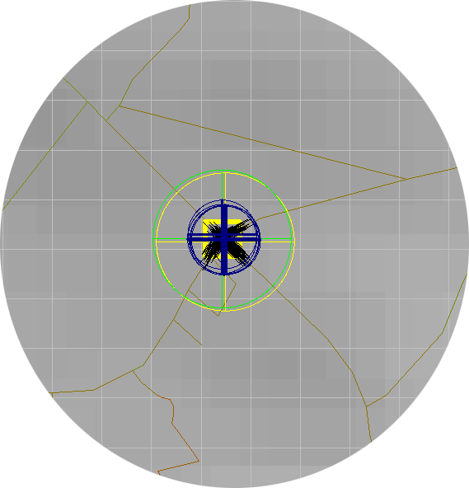
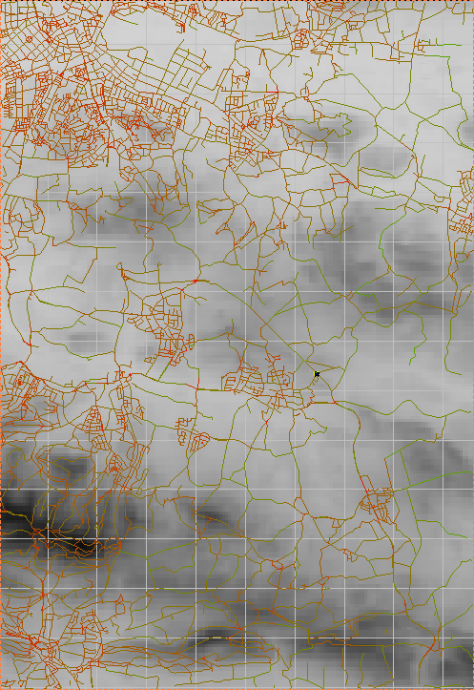

Slide 2
Introduction | World Model | Particle Filter | Evaluation
Introduction
Focal problem: global position estimation
de-facto standard: Global Navigation Satellite Systems (GNSS) such as GPS, GLONASS, Galileo
problems with GNSS: intentionally disturbed signals and reflected signals within street canyons or natural landscape features
Reduced problem tackled in this work:
assume to be located on a street network represented as a 3d map
exploit odometry, barometer, and compass measurements within particle filter framework to answer the question: where am I?

Slide 3
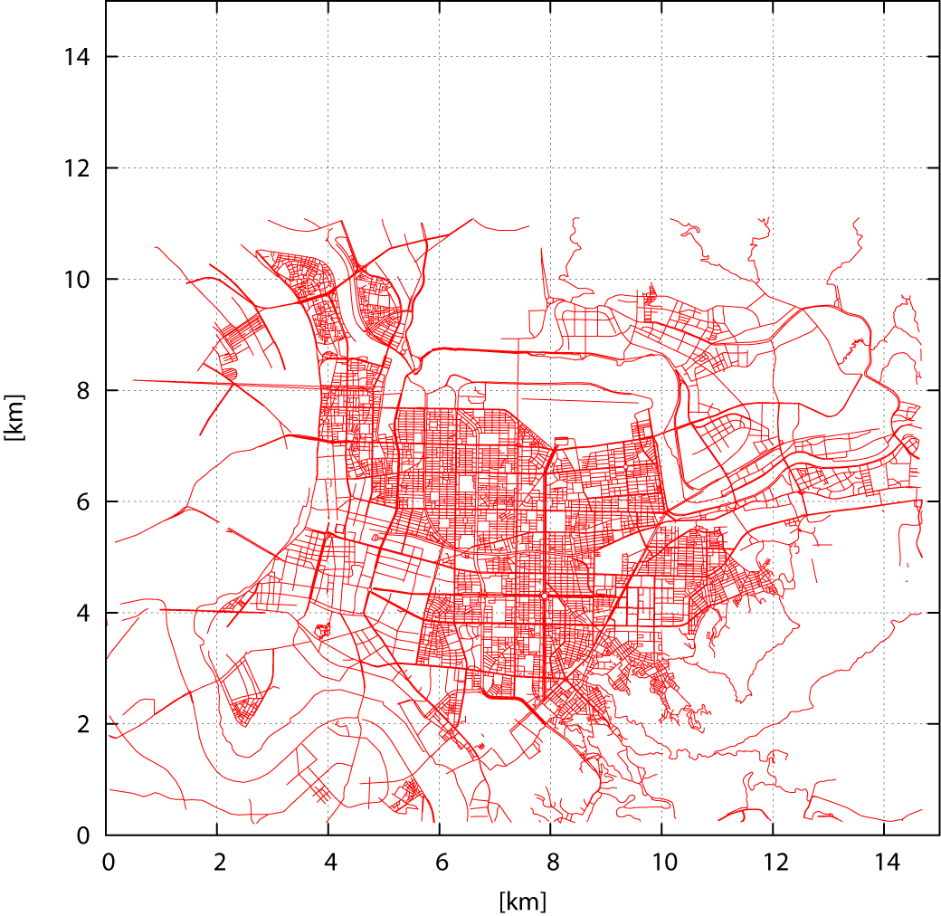
Introduction | World Model I | Particle Filter | Evaluation
World Model I
Road Network: OpenStreetMap (OSM) data
based on user-recorded GPS track logs
XML vector representation with classification of road types
OSM data stored in PMR-Quadtrees
space partitioning data structure sorting its entries into buckets
bucket is split into four child buckets when |entries| exceeds threshold c
let N := |position hypotheses| and M := |road segments| ↓ Ο(c*N) instead of Ο(M*N) distance(road segment, position) queries for finding closest road segment to given position hypothesis when using PMR-Quadtree

Slide 4
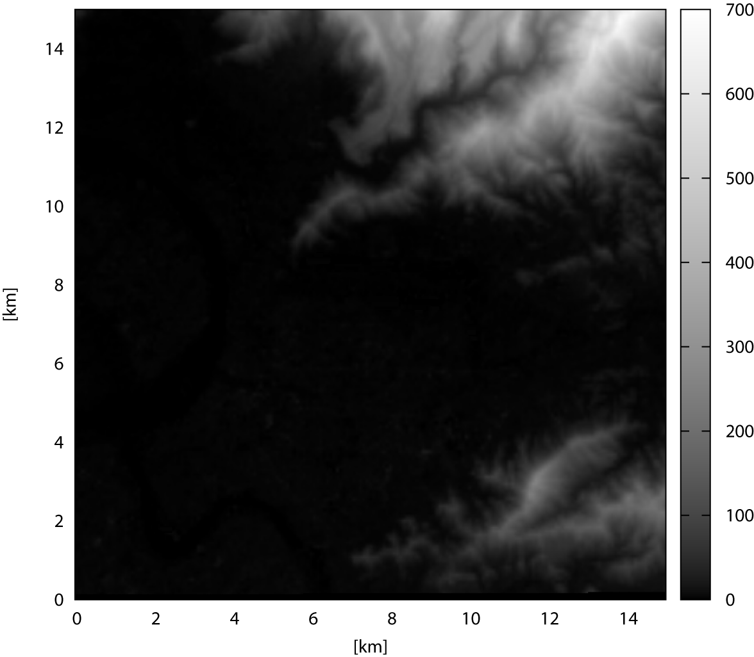
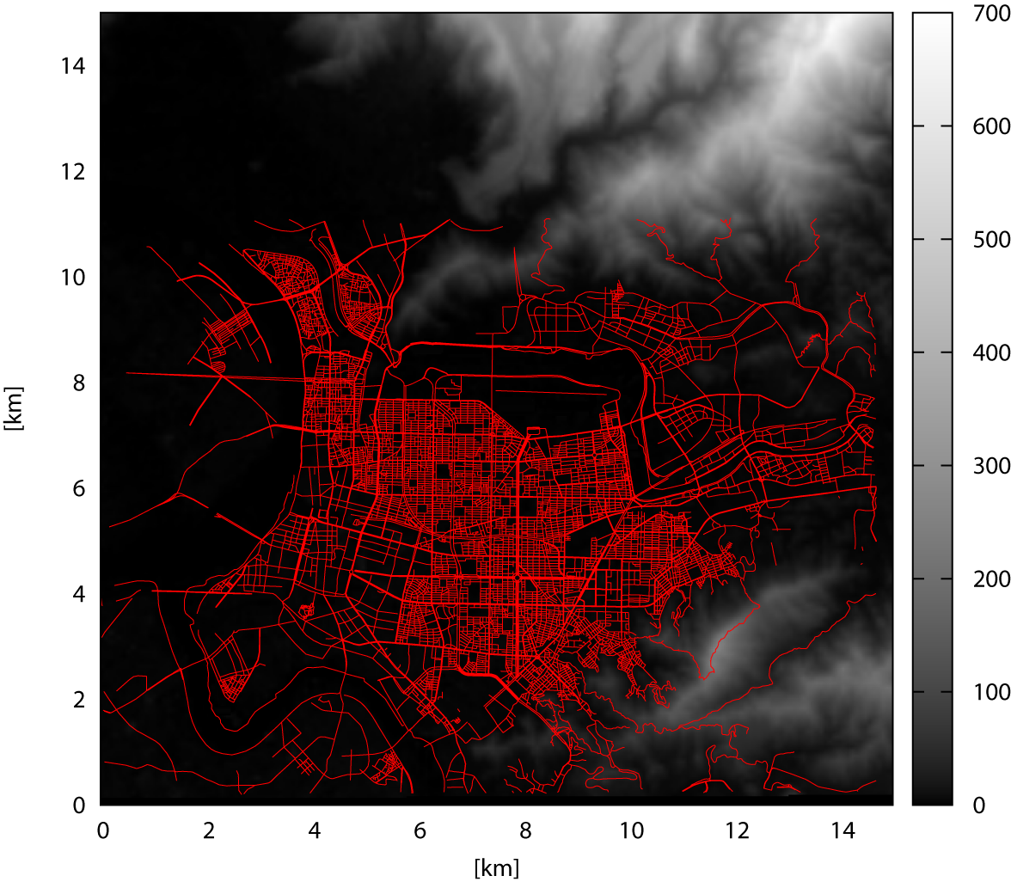
Introduction | World Model II | Particle Filter | Evaluation
World Model II
Digital Elevation Model: Shuttle Radar Topography Mission (SRTM) Data
covers earth’s surface between 60°N and 57°S
square resolution: 3 arcsec (~90m) standard 1 arcsec (~30m) USA
max relative vertical error: ±6m within 200 km
max absolute vertical error: ±16m for all measurements
void data points can be found over water bodies and mountainous regions
90m-tiles covering 1° lon * 1° lat are freely available to the public and shipped as 1201*1201 data points of 2 bytes each
TICC

Slide 5
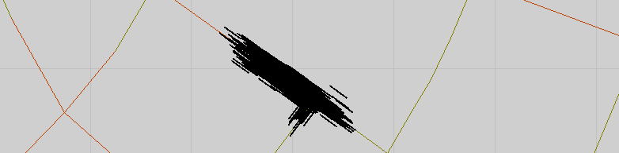
Introduction | World Model | Particle Filter I | Evaluation
Particle Filter I
Estimated state is a pose in 2-D
Particle implementation:
Motion model
State transition based on traveled distance
Move along roads only
Update of sample position

Slide 6
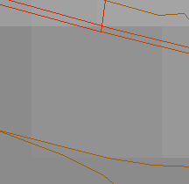
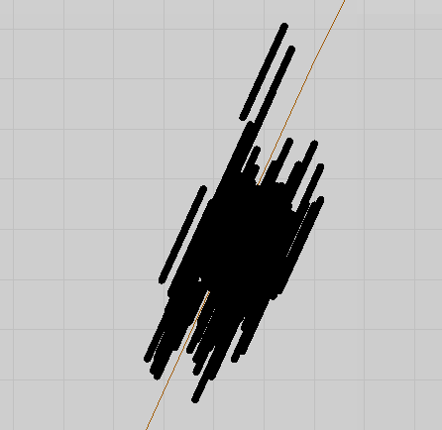
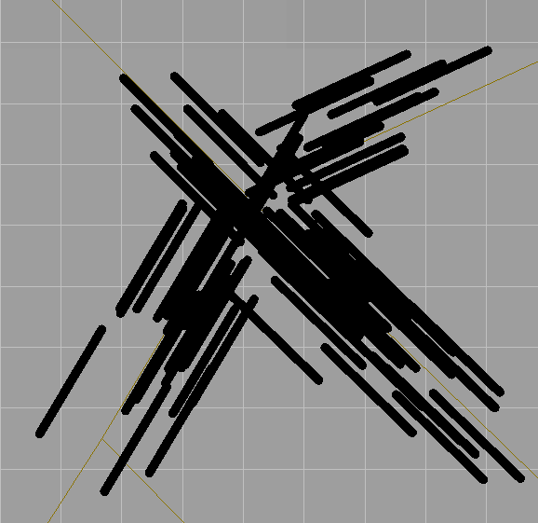
Introduction | World Model | Particle Filter II | Evaluation
Particle Filter II
Sensor model:
elevation measured by a barometer
virtual road distance measurement (always zero)
global orientation from compass
Computation of weighting:

Slide 7
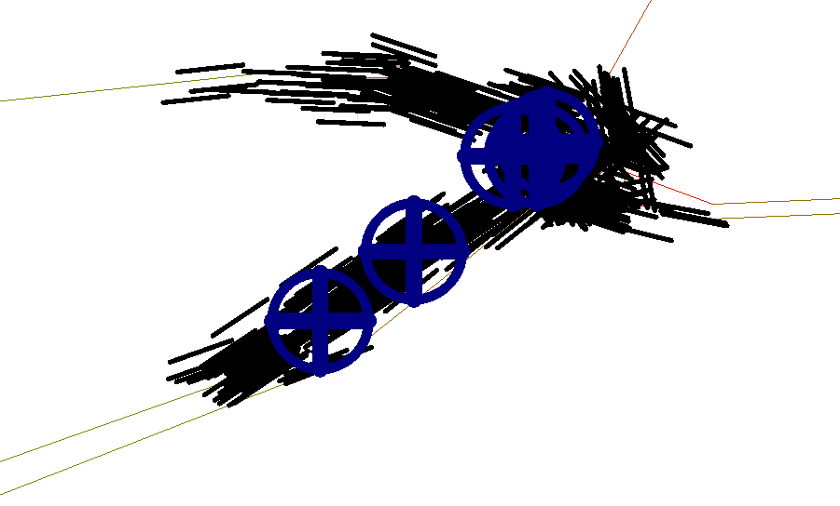
Introduction | World Model | Particle Filter II | Evaluation
Particle Filter III
Sensor Resetting
During tracking: Insertion of samples within dynamic frame
Compensates tracking errors
Allows localization without known start position
(work in progress)
Clustering
Tracking of multiple hypotheses
Algorithm based on resampling history

Slide 8
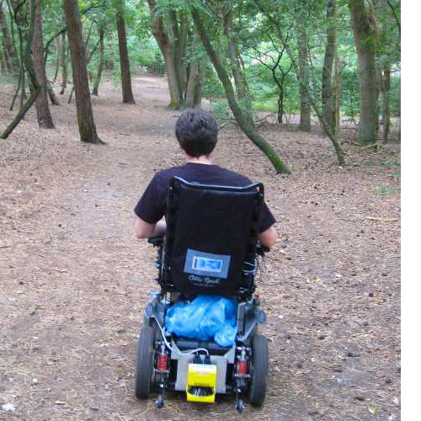
Introduction | World Model | Particle Filter | Evaluation I
Evaluation I
Test run 1: tracking of a wheelchair
length of test runs ~ 2.3km
odometer readings with 2mm driving distance/tick
magnetometer readings from Xsens MTx orientation tracker
altimeter readings from barometer with resolution of 30.48 cm and accuracy of ±3.048m
reference GNSS position from Garmin GPSMap 60CSx, WAAS/EGNOS enabled: positional accuracy of 3-5m in 95% of all measurements

Slide 9
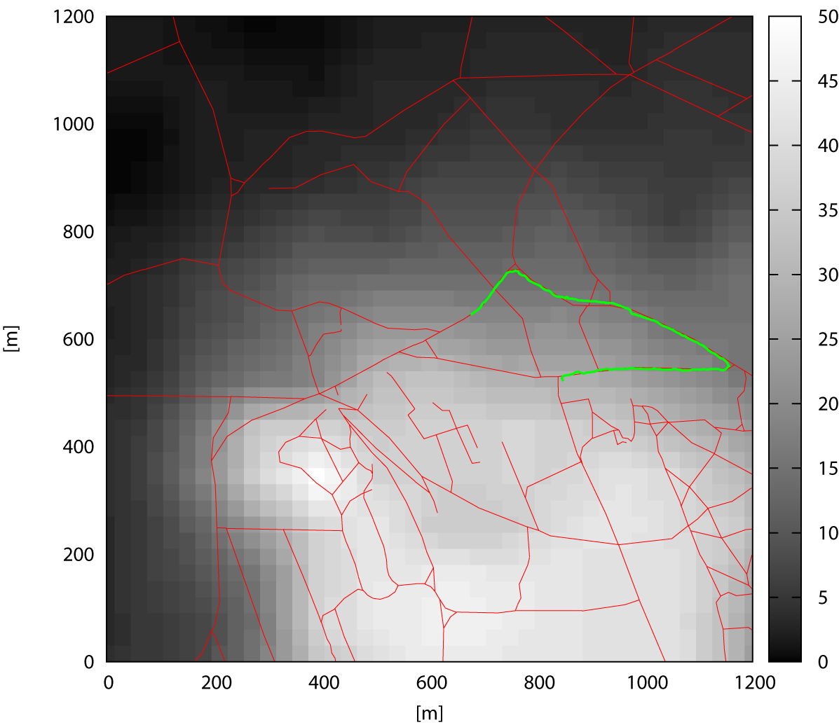
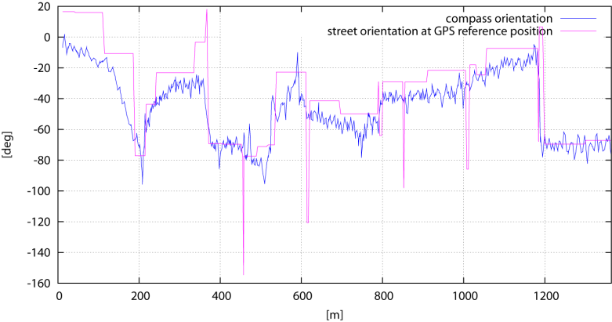
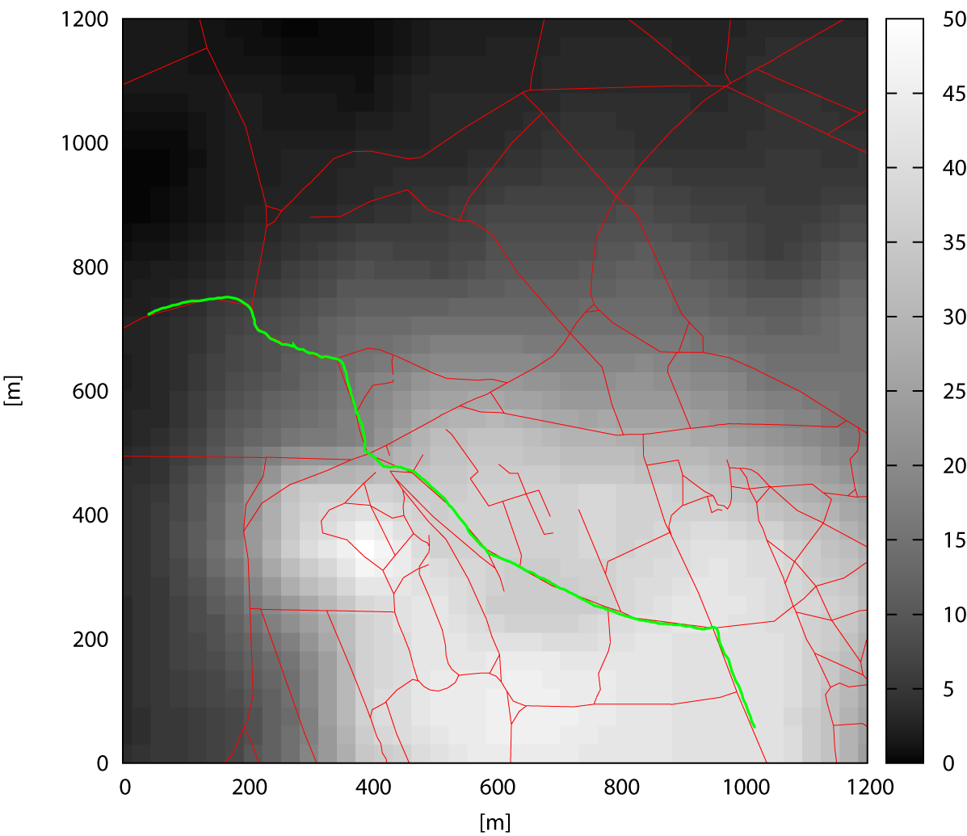
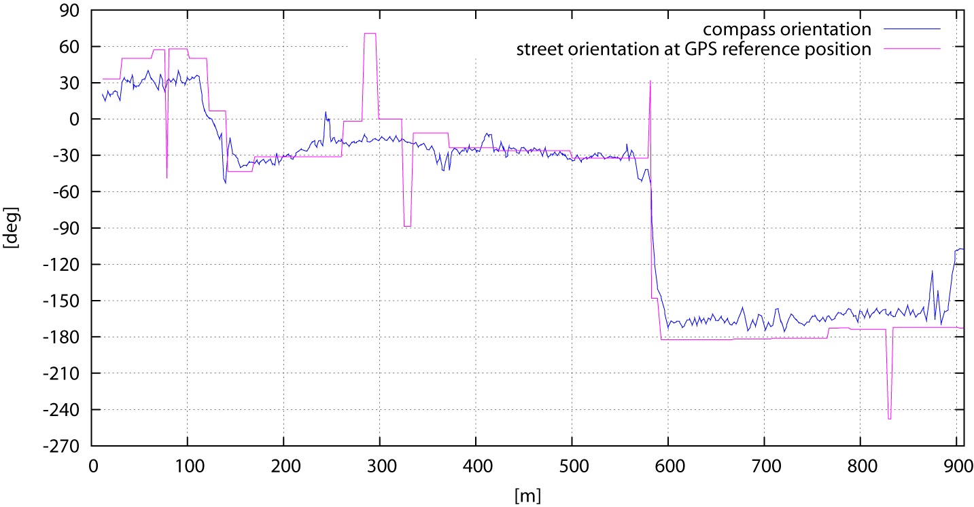
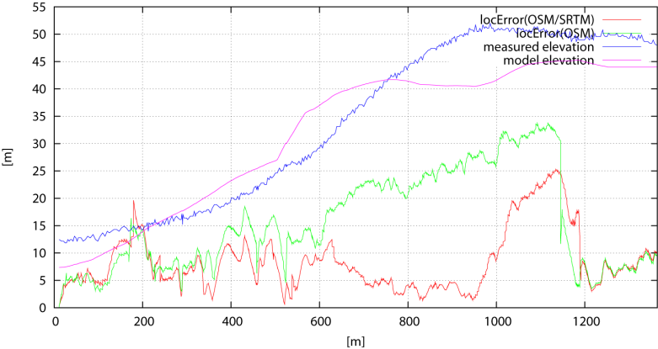
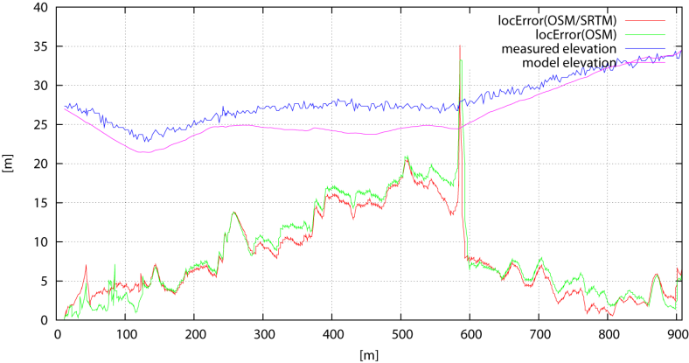
Introduction | World Model | Particle Filter | Evaluation II
Evaluation II
section 1 location: Worpswede, Germany
length: 908m
mode: tracking
section 2
location: Worpswede, Germany length: 1364m
mode: tracking

Slide 10
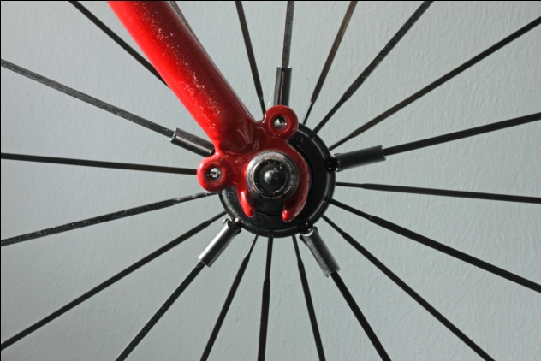
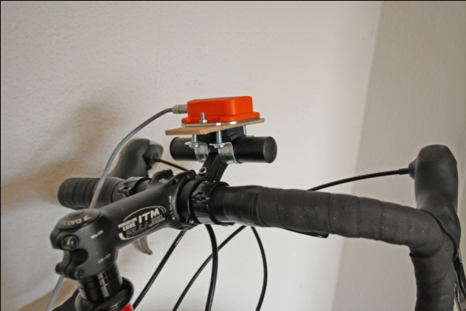
Introduction | World Model | Particle Filter | Evaluation III
Evaluation III
Test run 2: tracking/global localization of a bicycle
length of test runs ~ 40.8km
odometer readings with 42.5cm driving distance/tick
yaw-estimates from Xsens MTx orientation tracker, i.e. gyroscope-stabilized magnetometer
altimeter readings from barometer with resolution of 30.48cm and accuracy of ±3.048m
reference GNSS position from Garmin GPSMap 60CSx

Slide 11
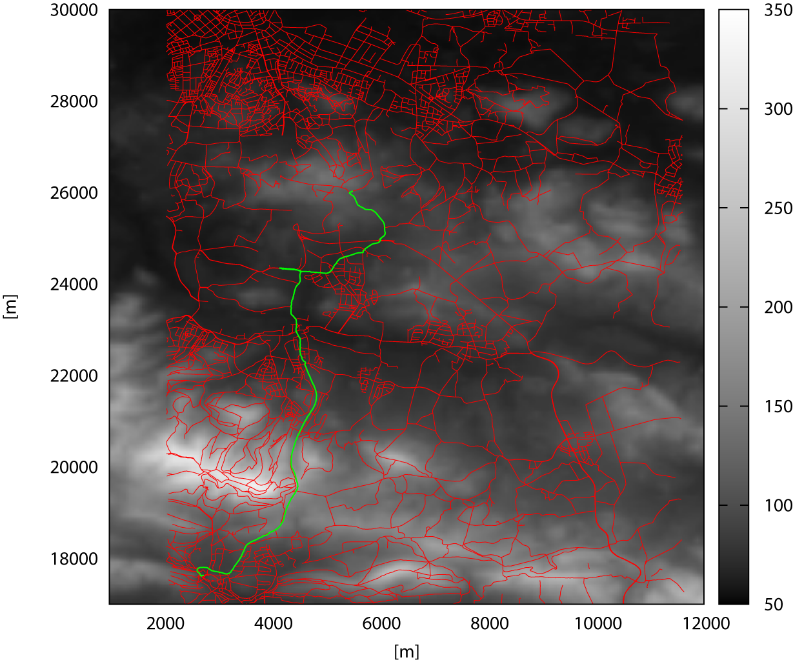

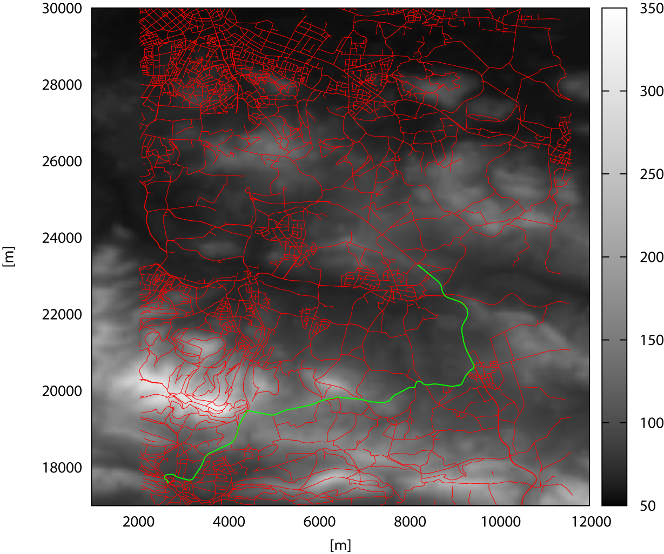
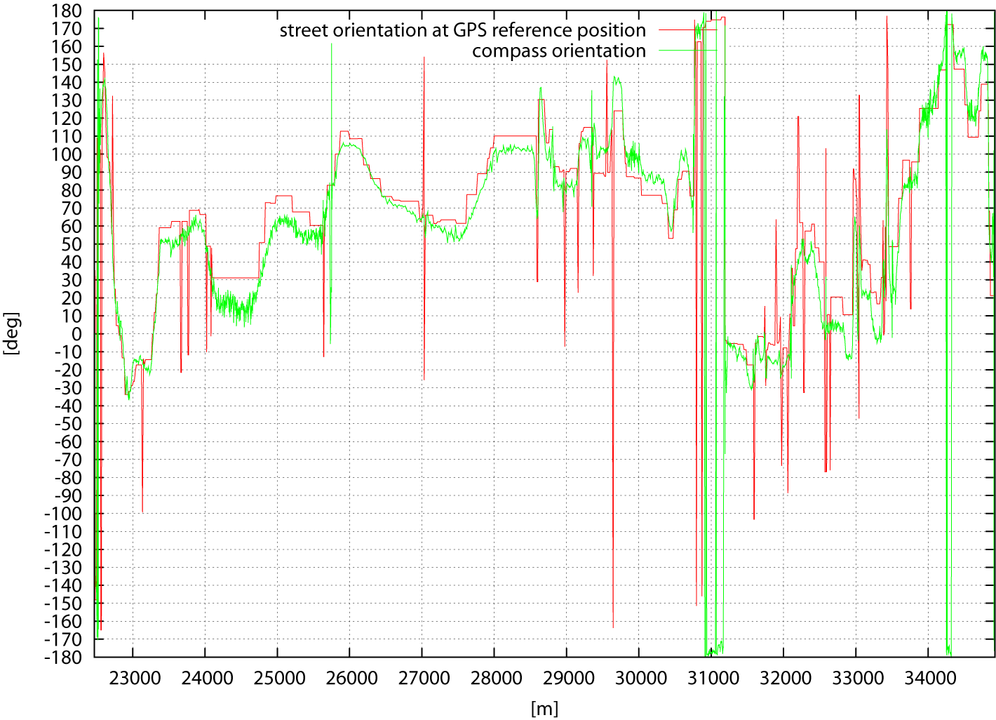
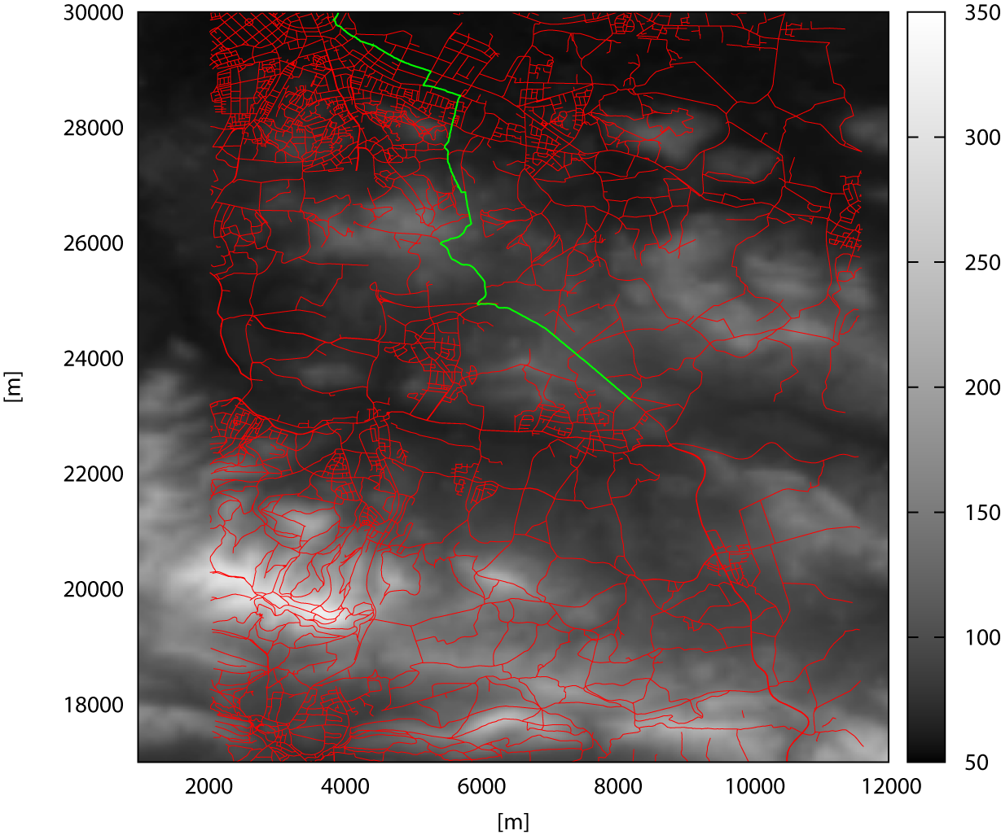
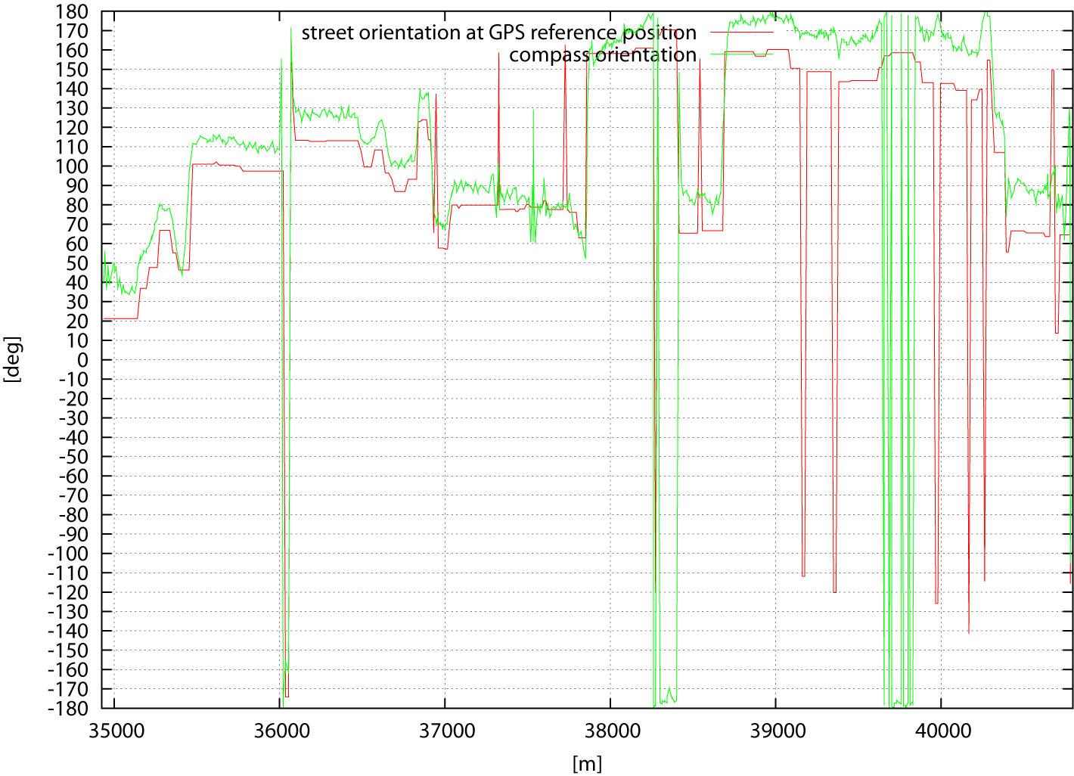
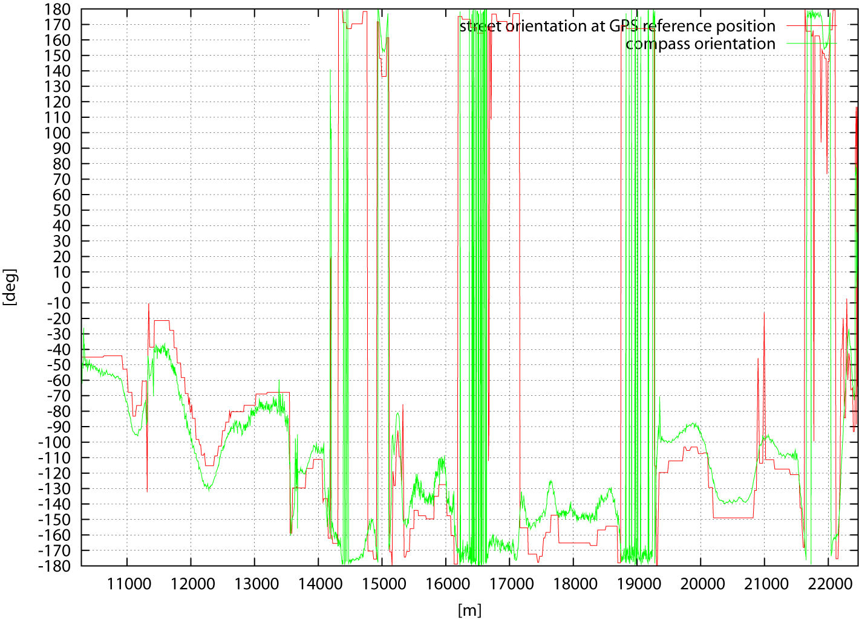
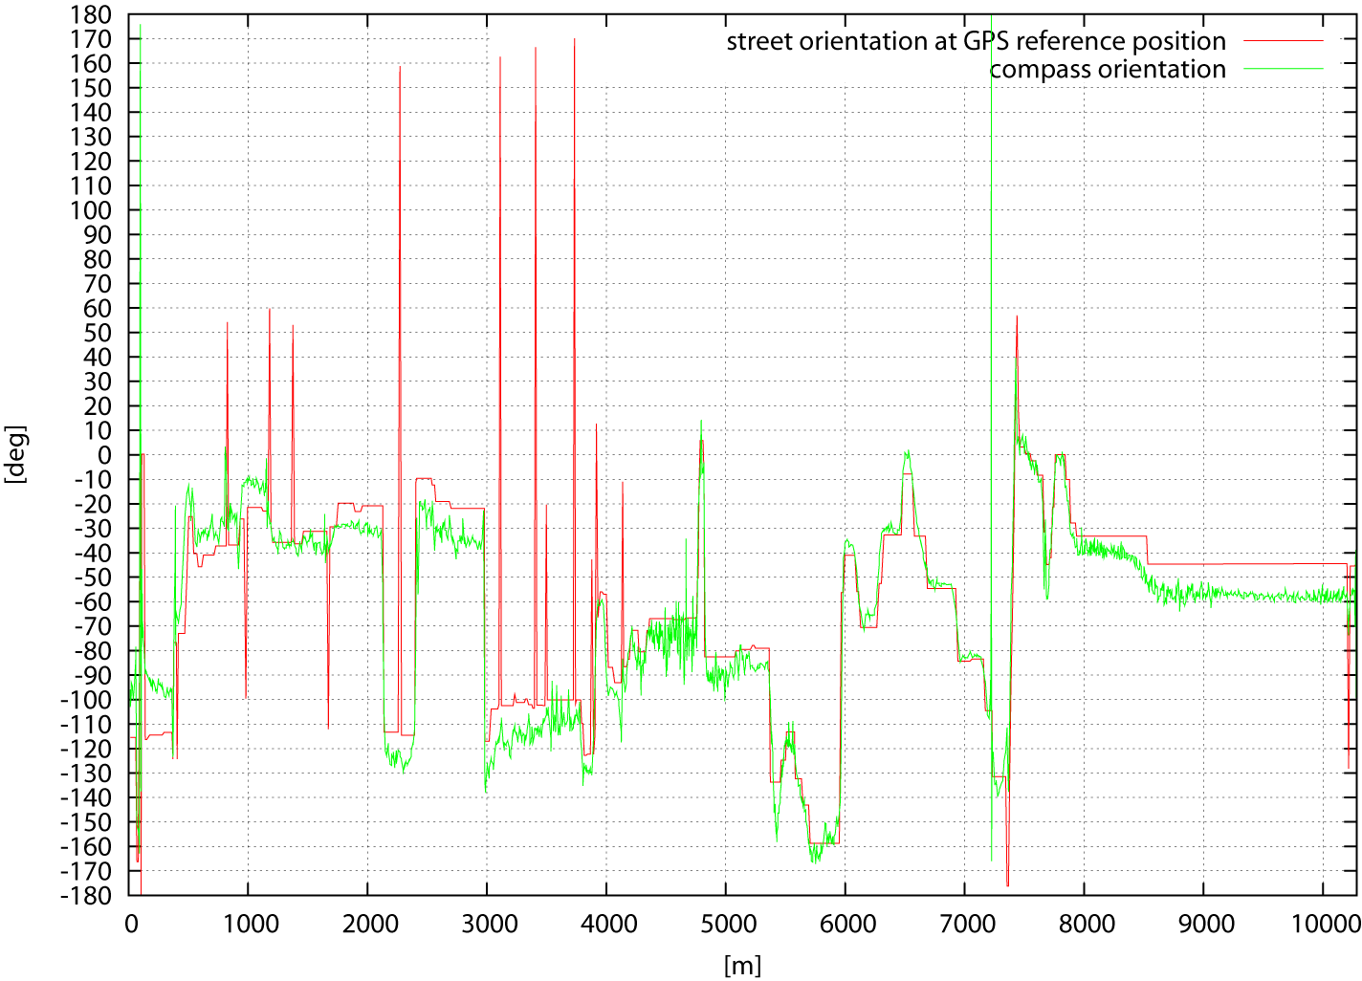
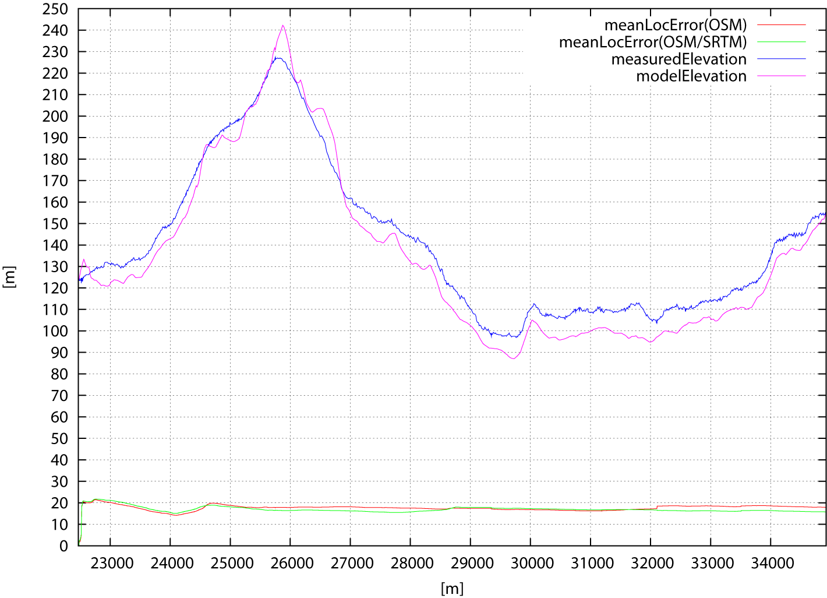
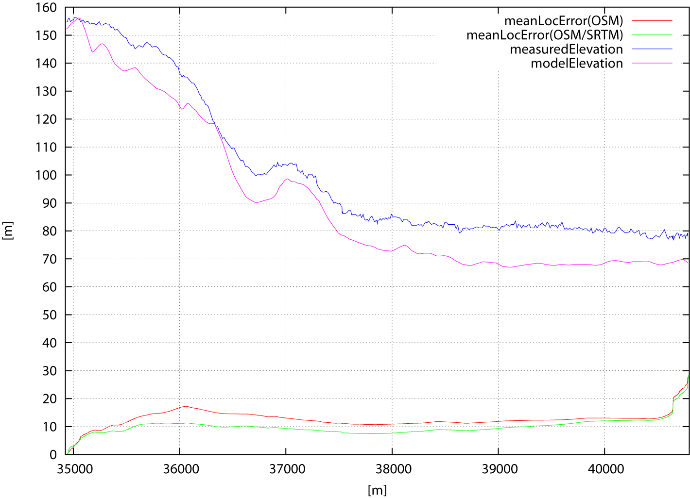
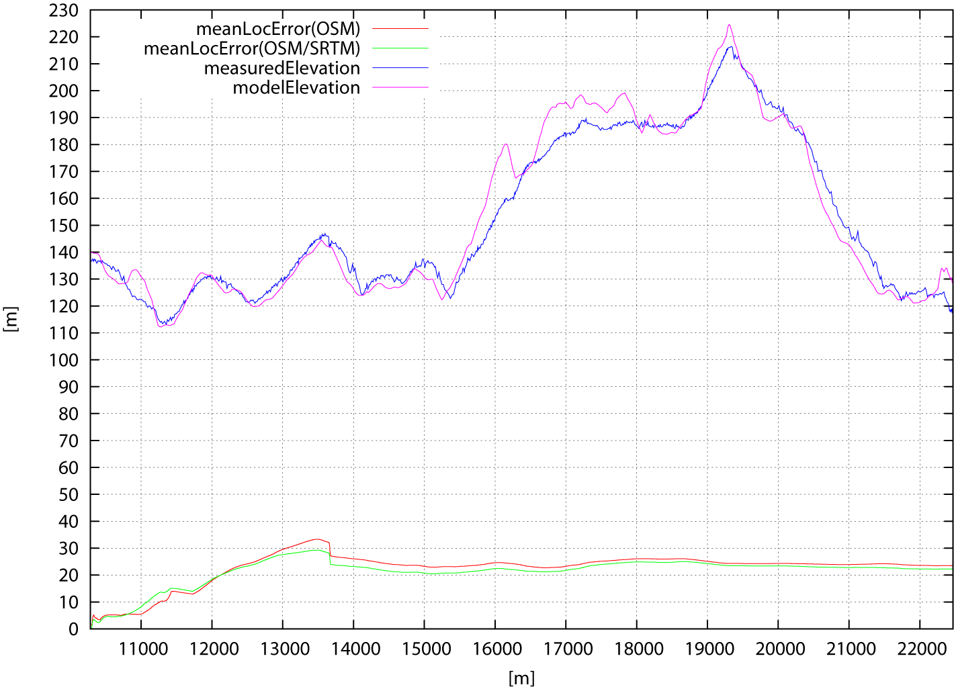
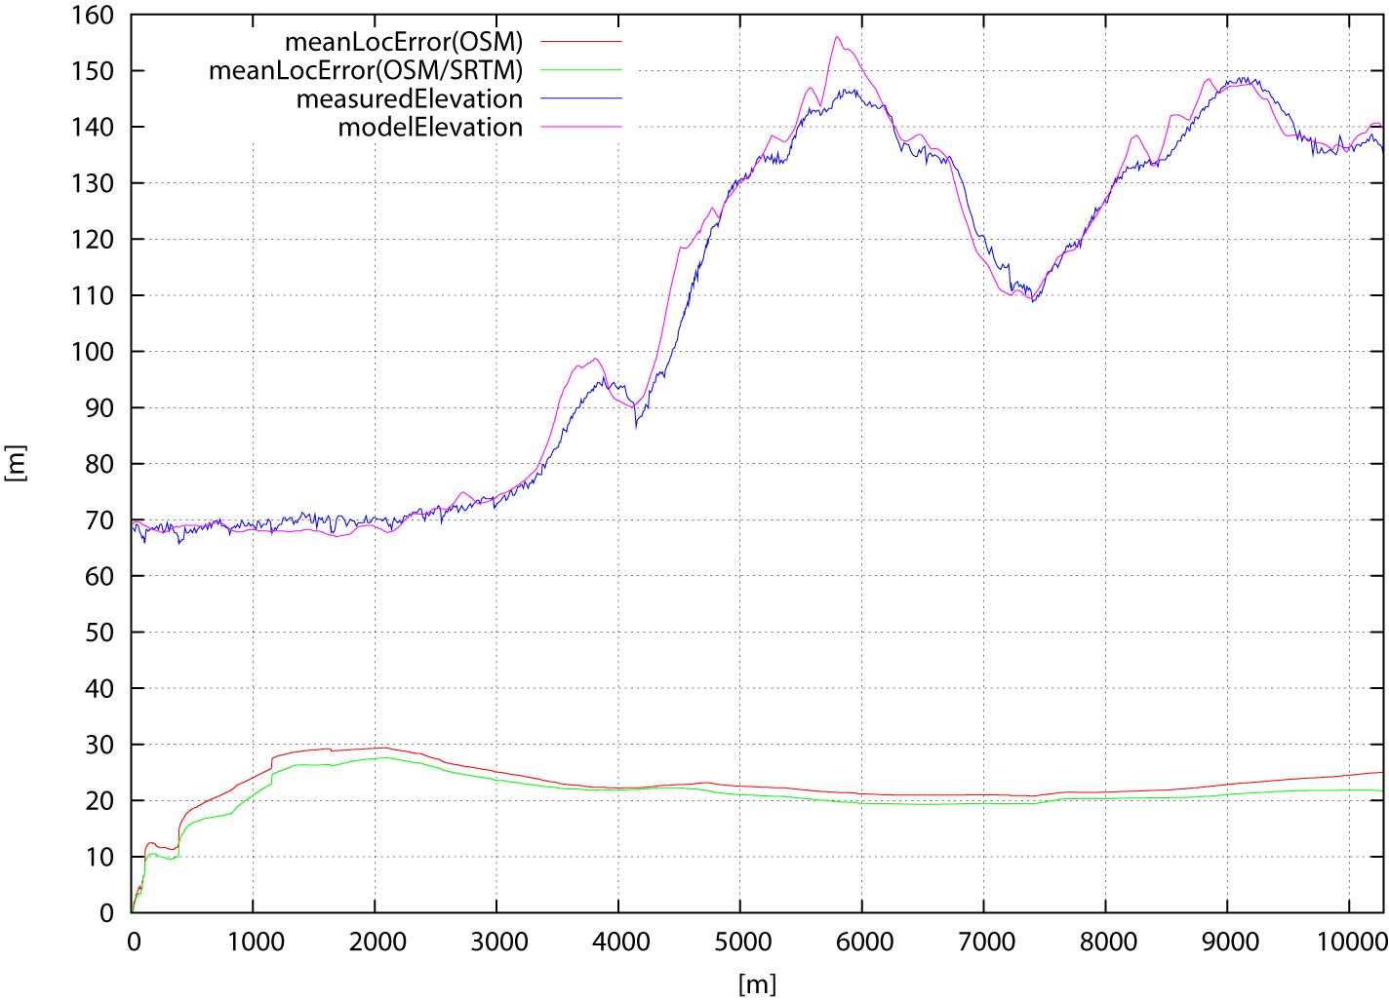
Introduction | World Model | Particle Filter | Evaluation IV
Evaluation IV
section 4
location: Osnabrück, Germany length: 5875 m
mode: tracking
section 2
location: Osnabrück, Germany length: 12186 m
mode: tracking
section 1
location: Osnabrück, Germany length: 10282 m
mode: tracking
section 3
location: Osnabrück, Germany length: 12454 m
mode: tracking

Slide 12
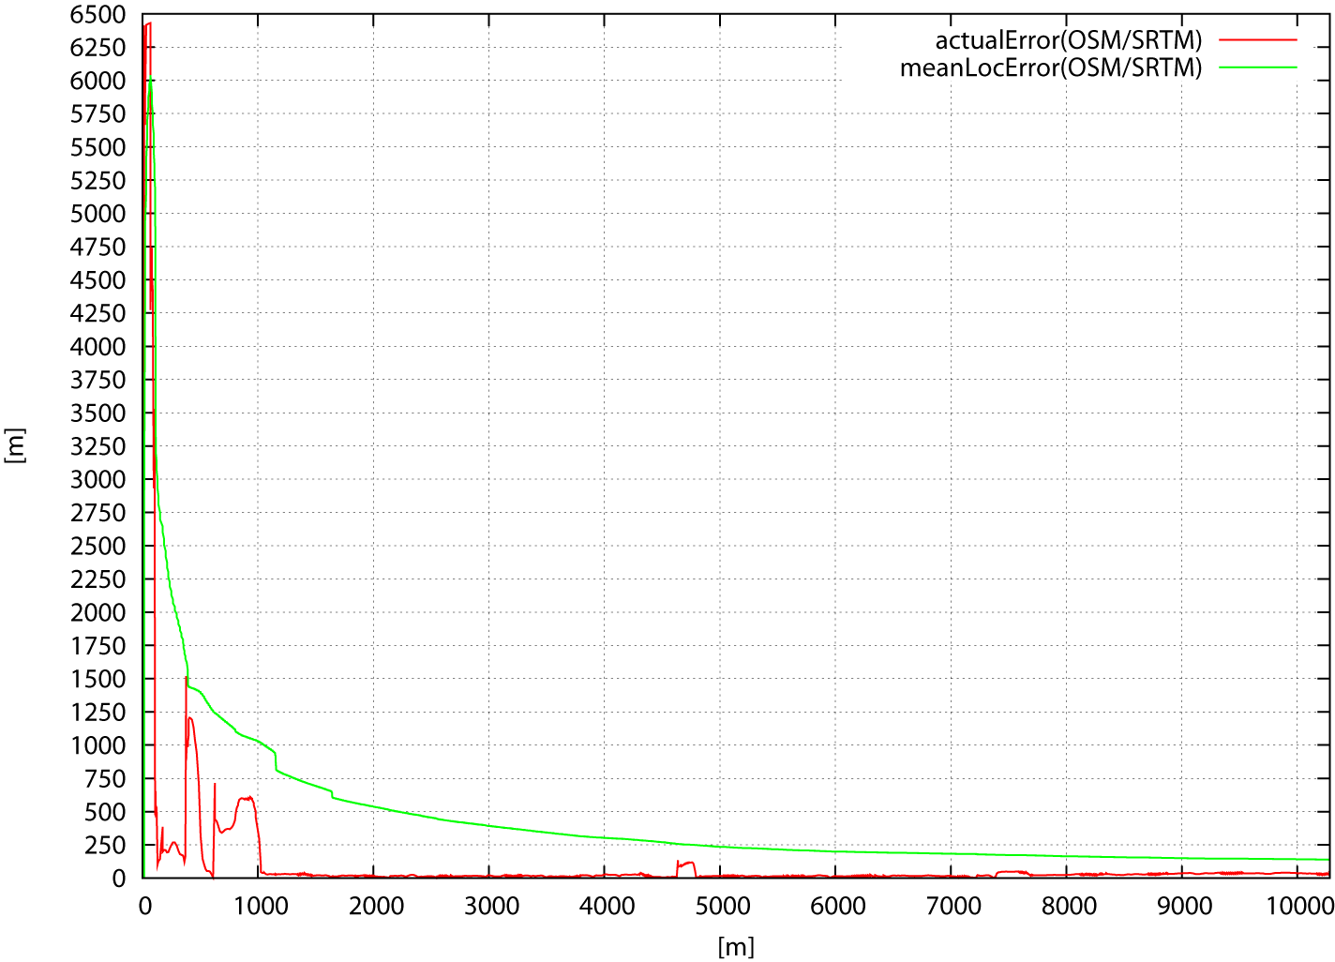
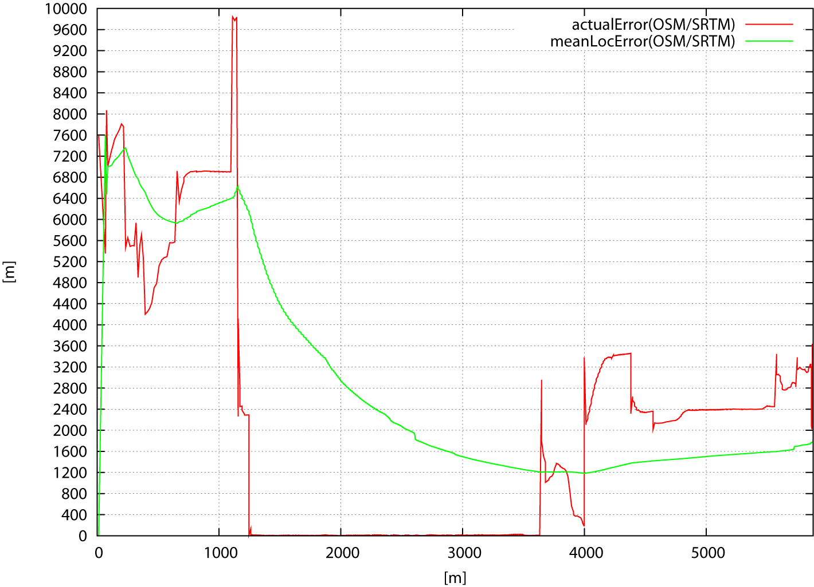
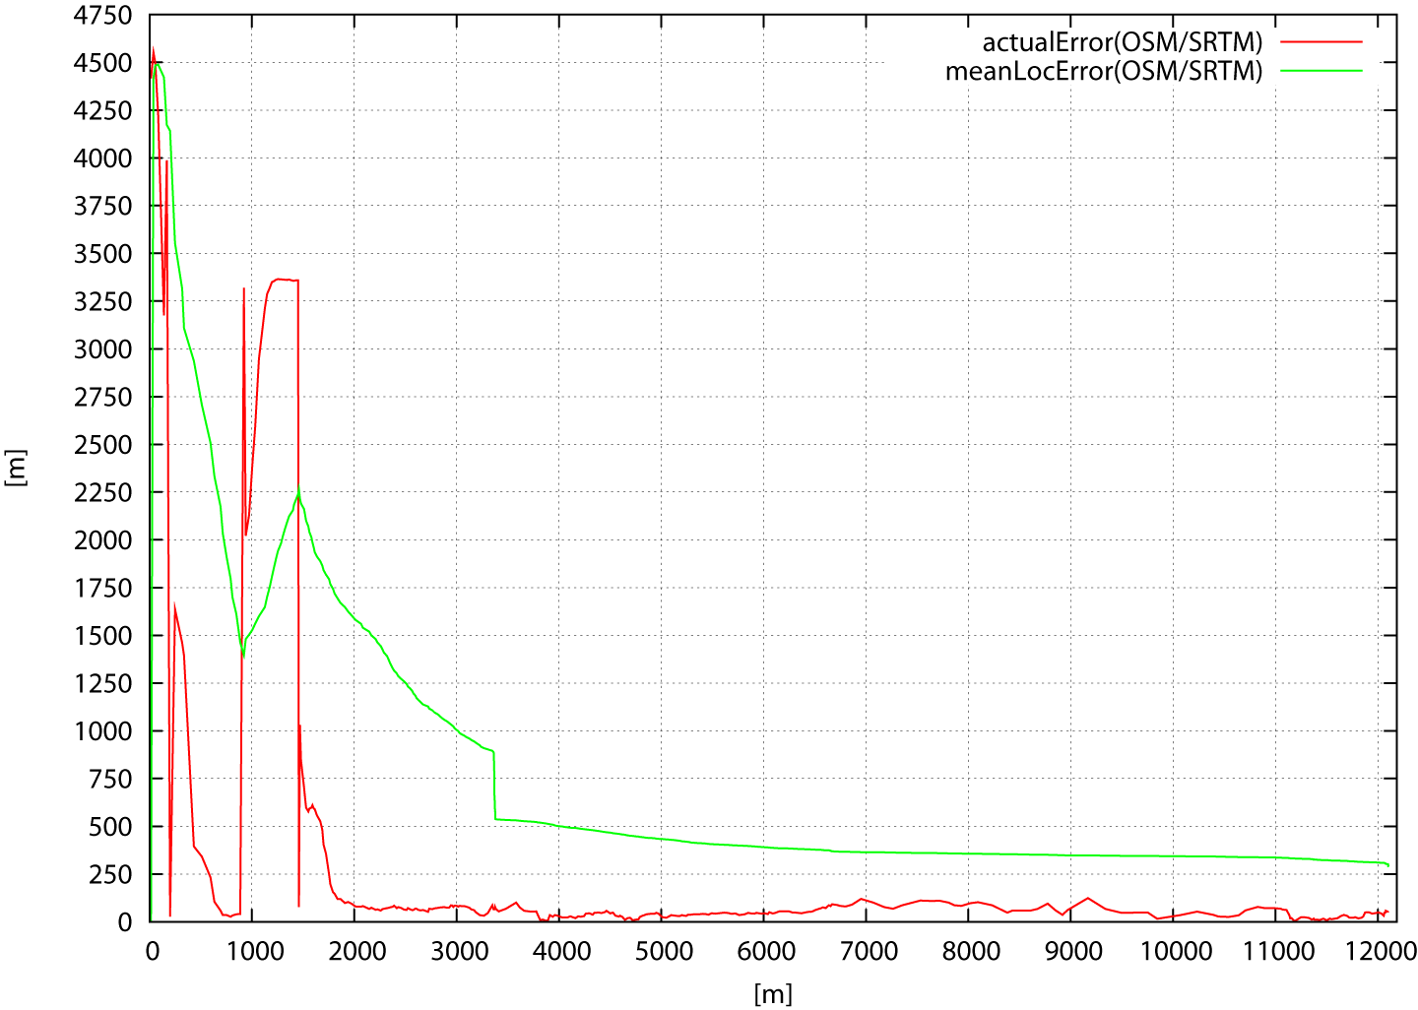
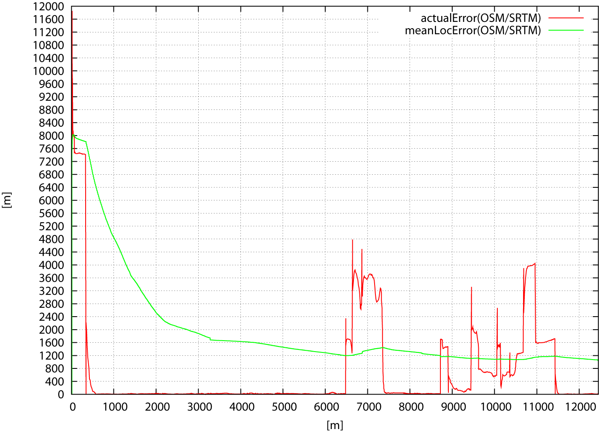
Introduction | World Model | Particle Filter | Evaluation V
Evaluation V
Outlook: global localization with unknown start-position
section 3
location: Osnabrück, Germany length: 12455 m
mode: global localization / 2% sensor resetting (elevation, orientation)
section 4
location: Osnabrück, Germany length: 5875 m
mode: global localization / 10% sensor resetting (elevation)
section 2
location: Osnabrück, Germany length: 12186 m
mode: global localization / 2% sensor resetting (elevation, orientation)
section 1
location: Osnabrück, Germany length: 10282 m
mode: global localization / 10% sensor resetting (elevation)

Slide 13
Thank you for your attention!
Questions?

