Slide 1
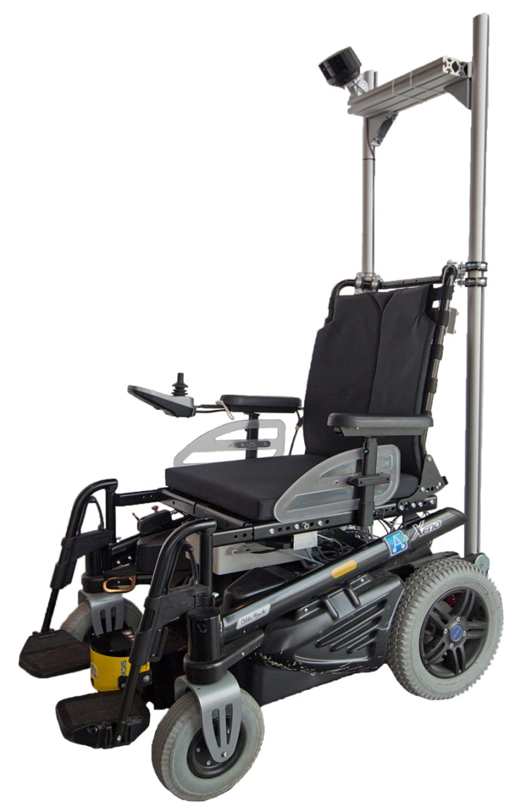
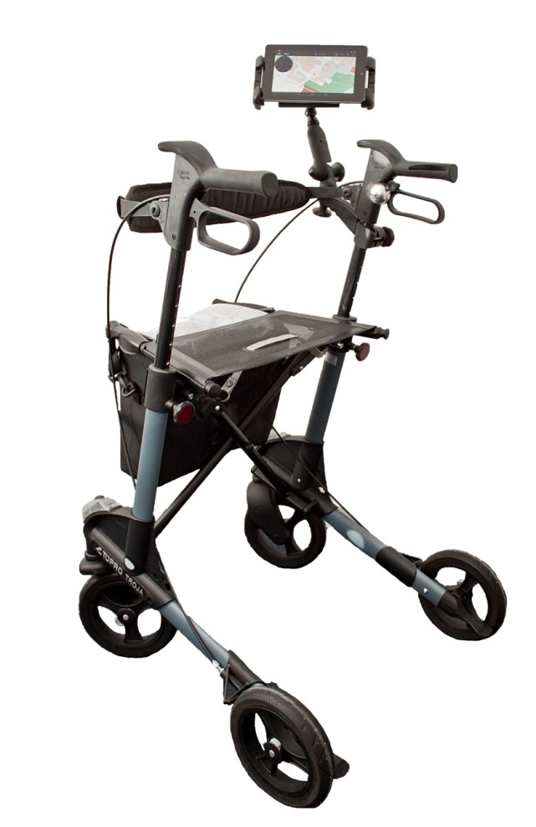
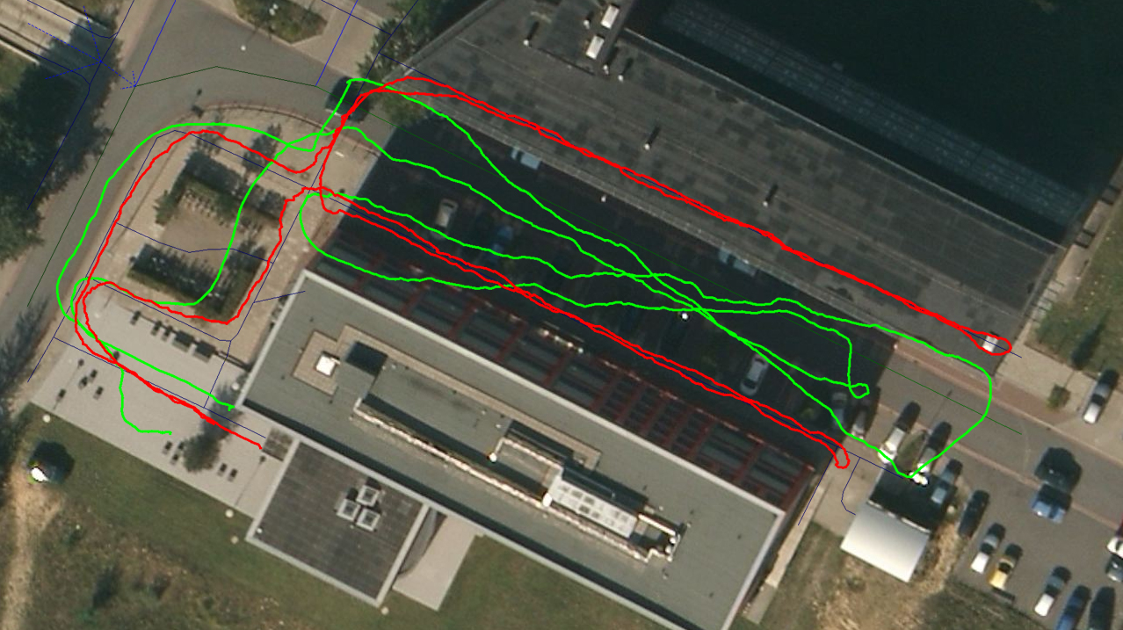
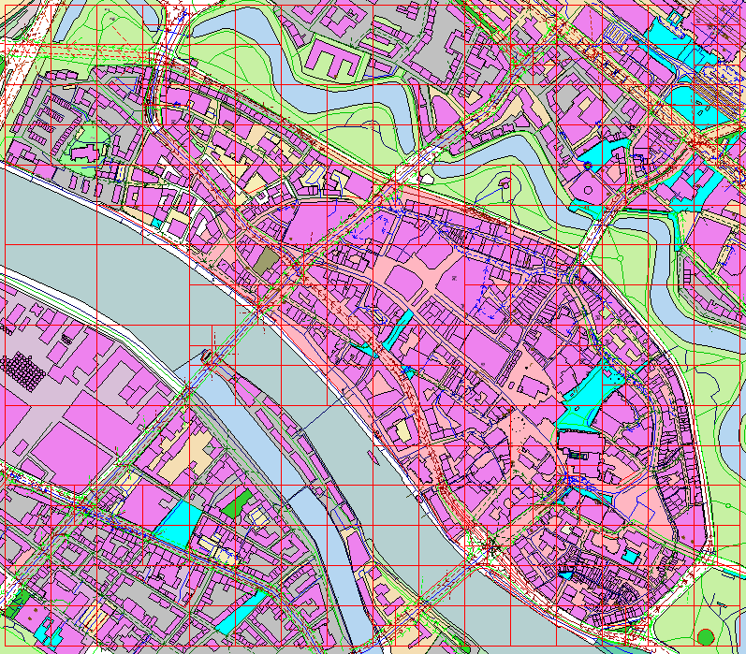
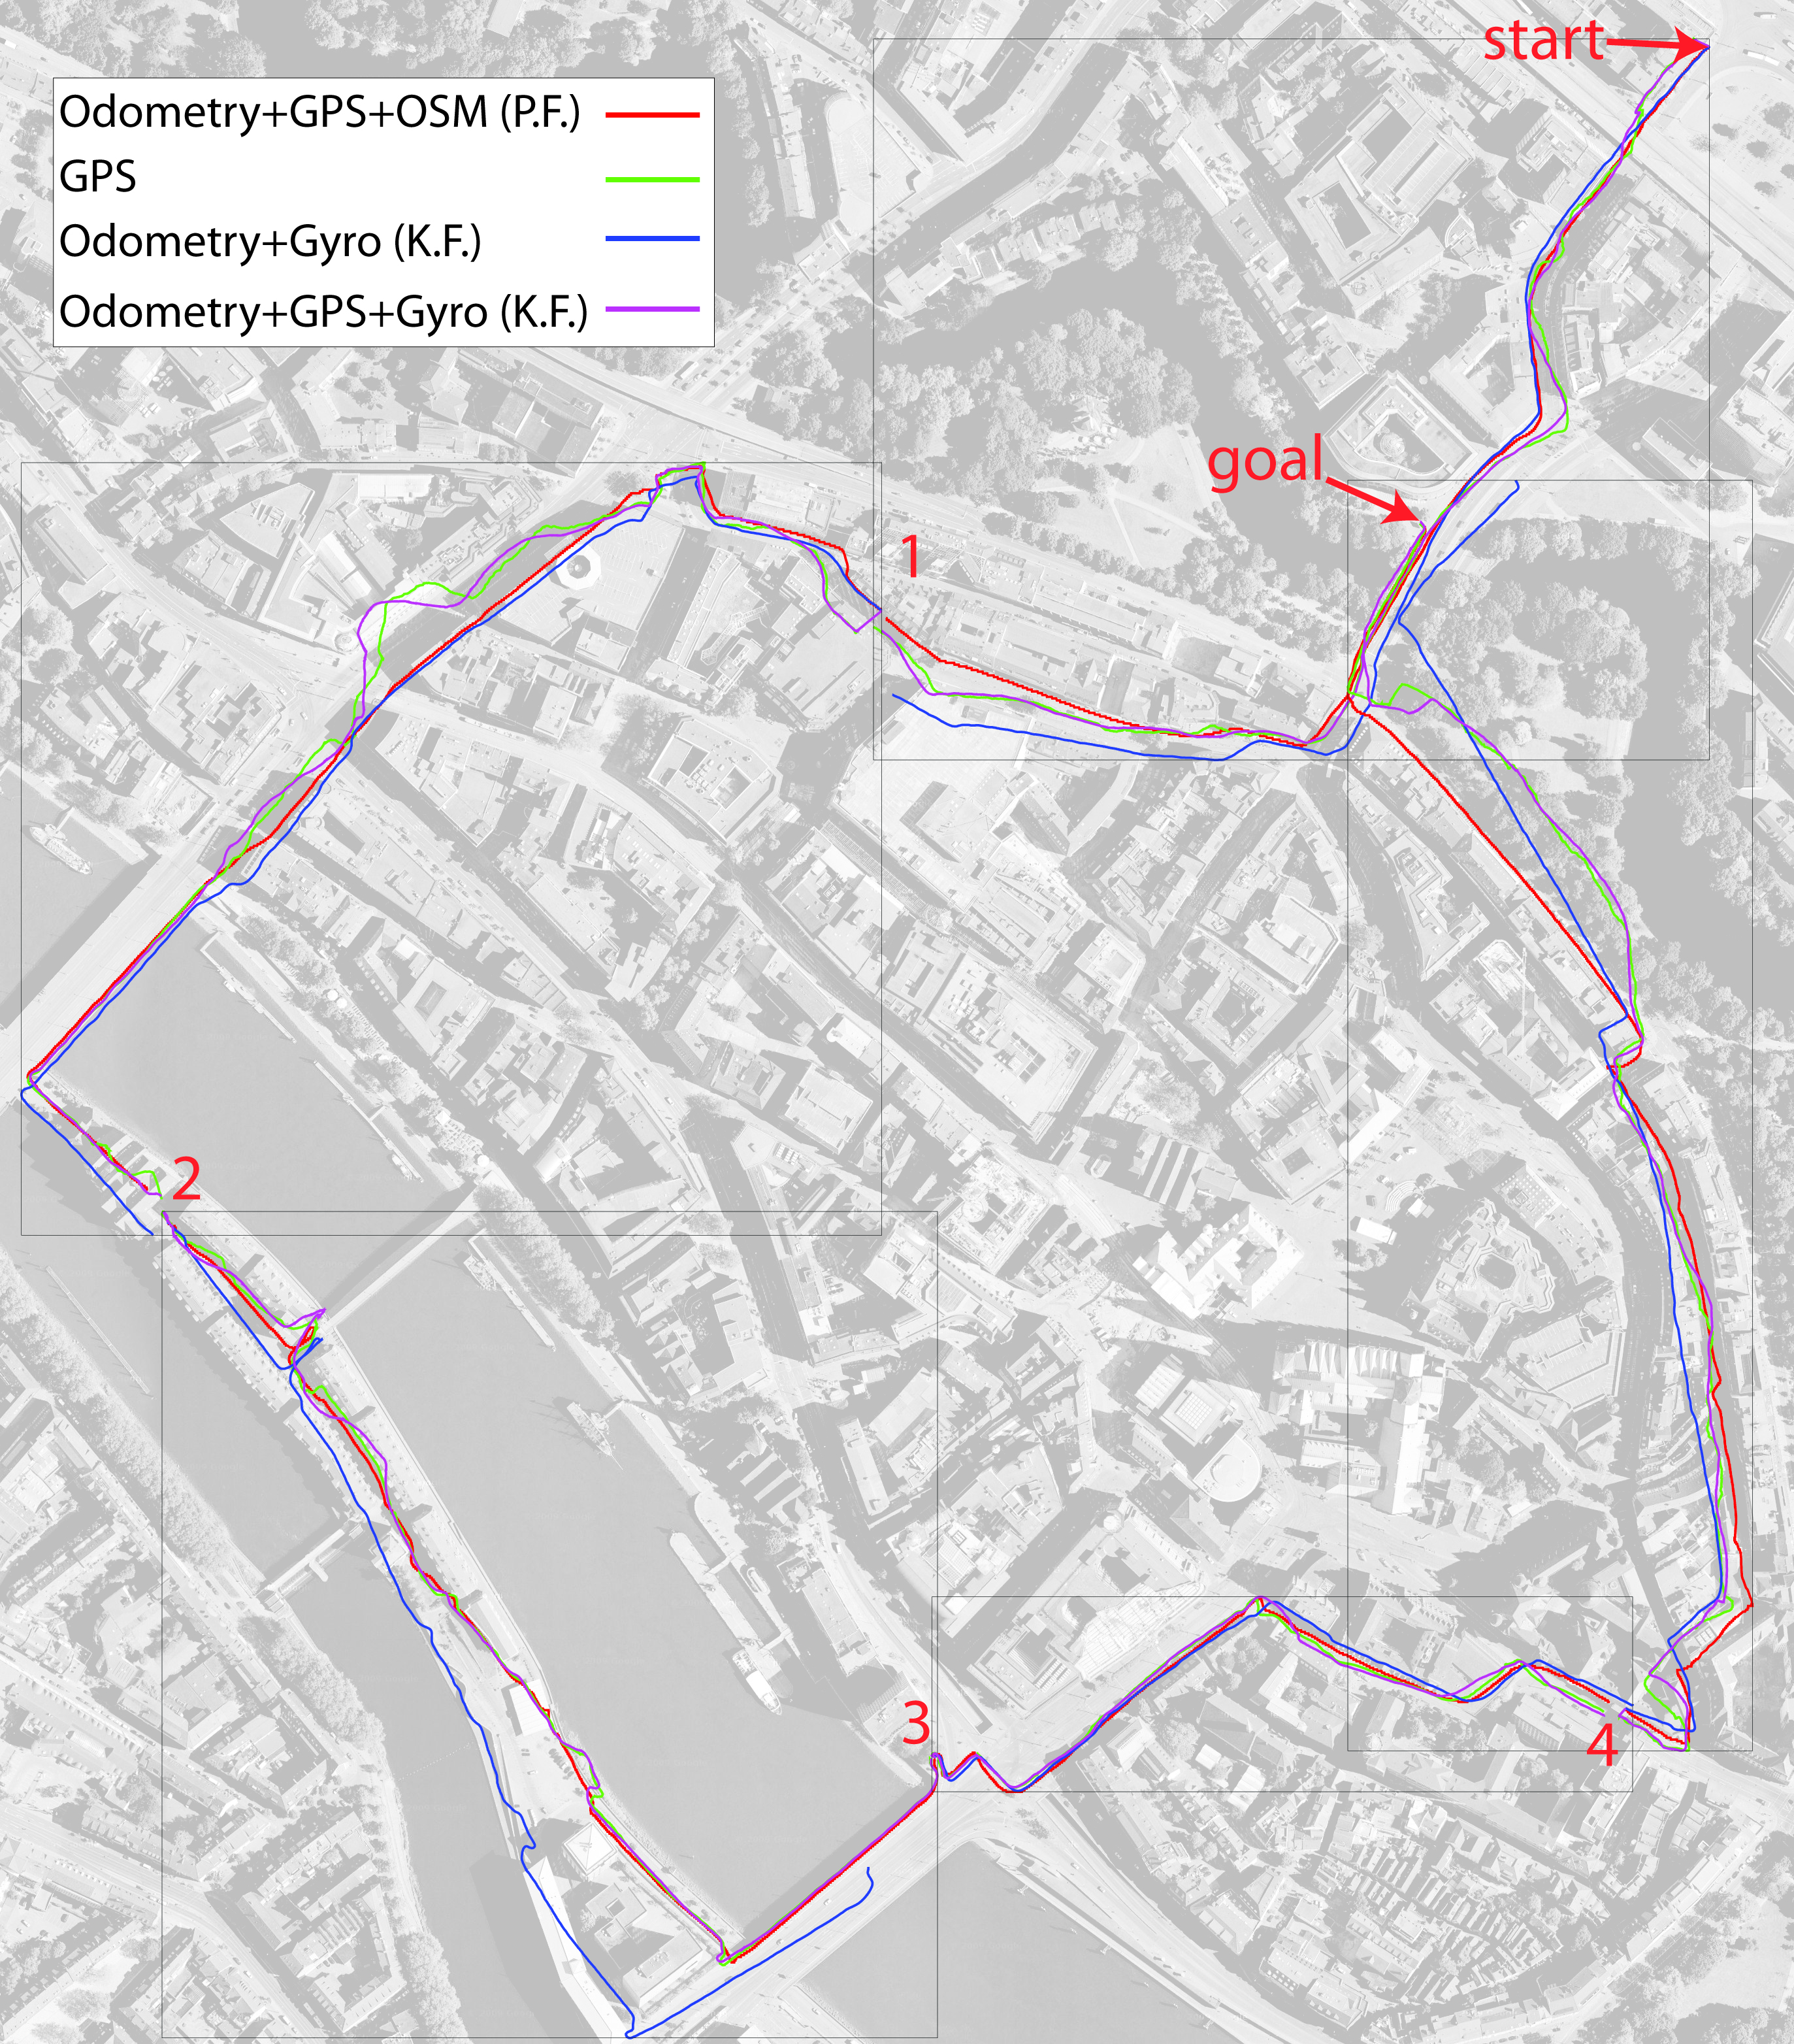
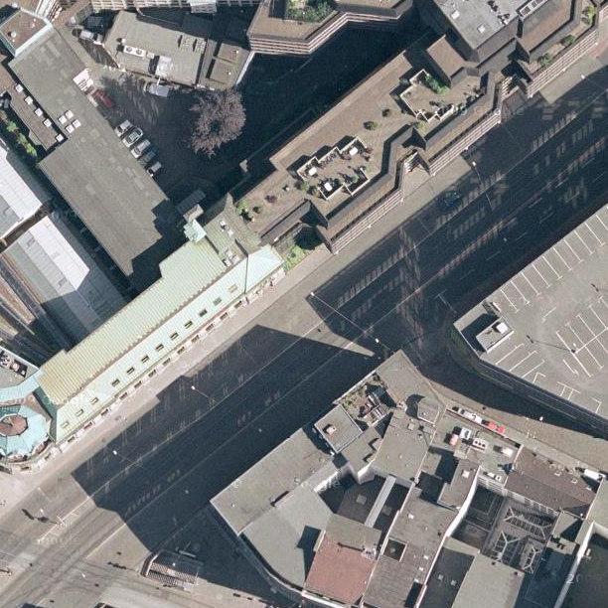
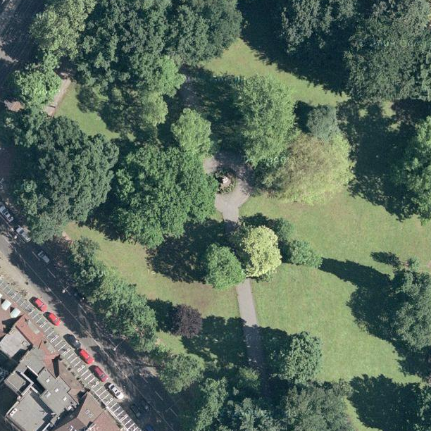
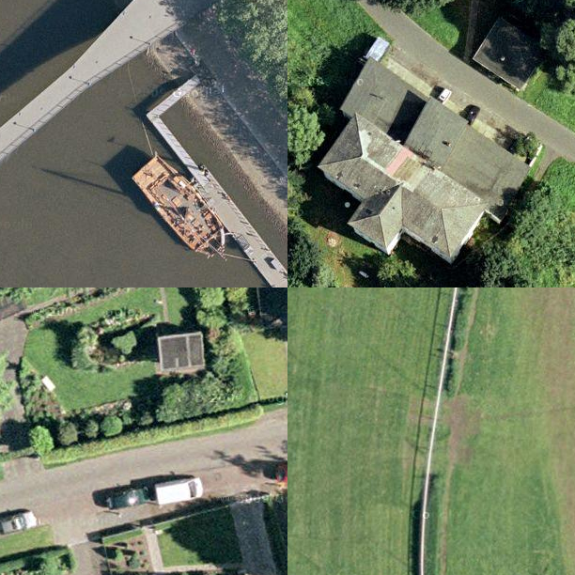
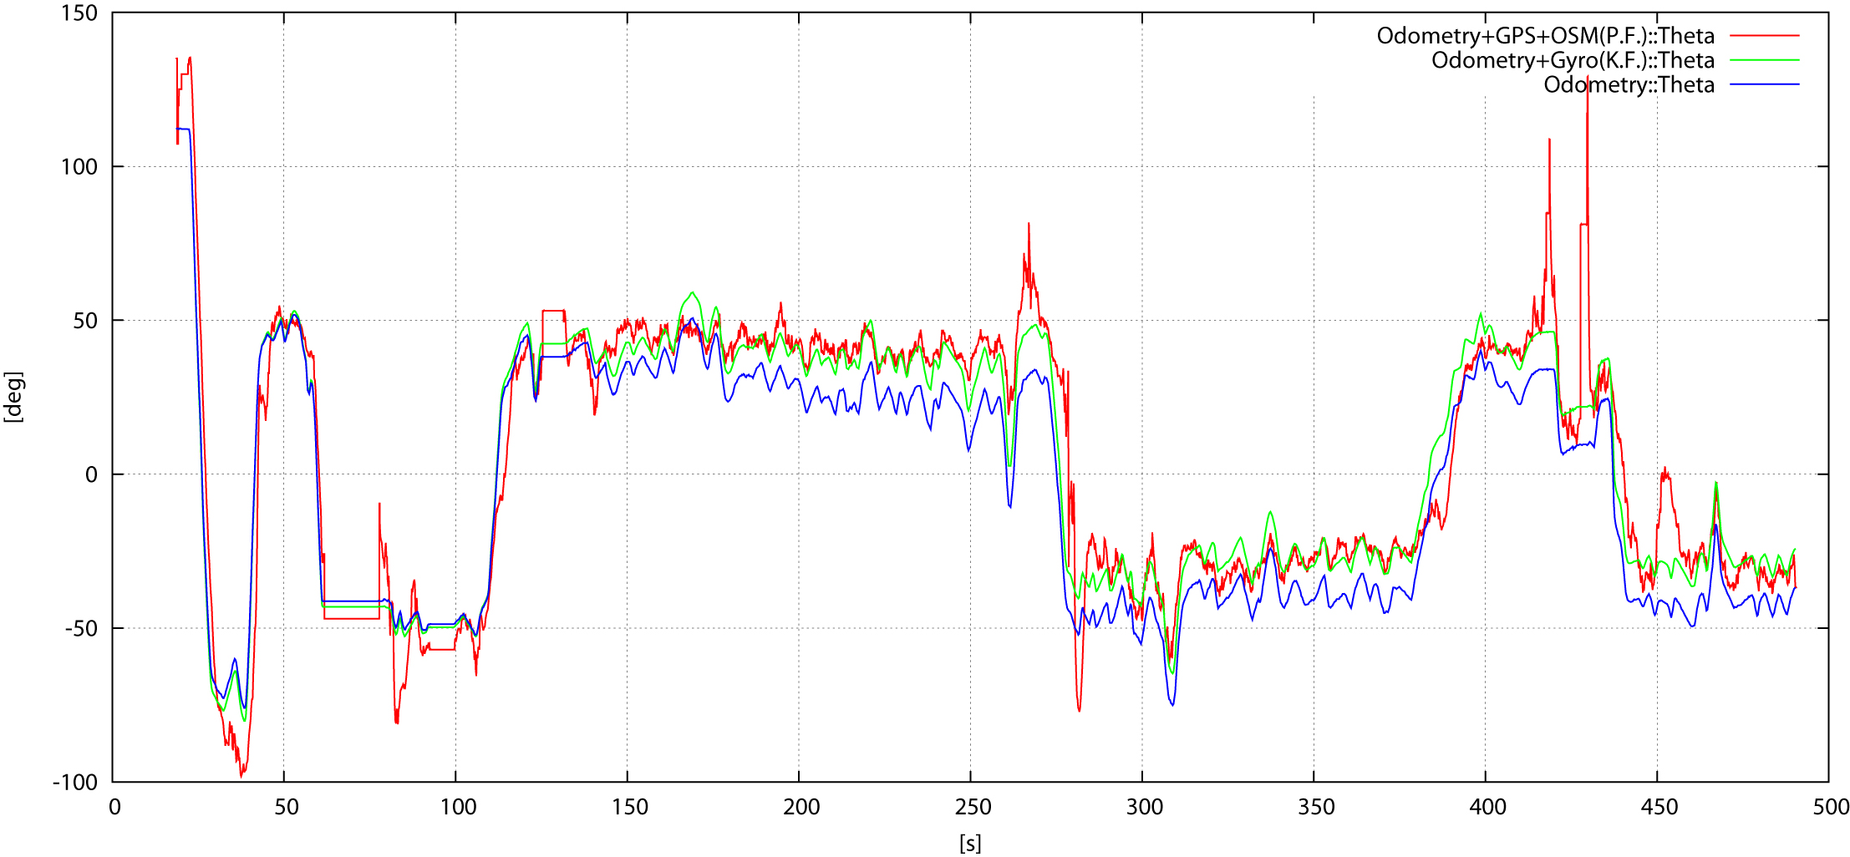

Localization in Urban Environments
by Matching Sensor Data to Map Information
Christian Mandel
Oliver Birbach
ffffffffffffffffffffffff
ffffffffffffffffffffffff
Experimental Platforms
Experimental Evaluation
Wheelchair Rolland (Fig.1) based on the model Xeno by Otto Bock Healthcare
Walker (Fig.2) based on the
Topro Troja frame
Additional hardware components used:
Wheel encoders (~2mm/tick)
OdoWheel IMU
GPS (μBlox6 / WAAS / EGNOS)
Netbook-class PC for data recording
Manually given start-poses for both experiments
Initial evaluation with hand-pushed walker (Fig.2)
Localizer trajectory in Fig.7 (red) compared against pure GPS trajectory (green) reveals reasonable tracking performance
Primary evaluation with Rolland (Fig.1) on ~3.5km long course in the city center of Bremen, Germany
Trajectories in Fig. 8 compare localizer output (red) against pure GPS (green), Kalman Filter-based fusion of odometry and gyro (blue) and GPS (pink)
Estimated orientation along 4th segment (wp 3-4 in Fig.9) given by the proposed particle filter (red), the contrasted Kalman filter (green), and by odometry (blue)
Fig.1
OpenStreetMap as Environment Representation
Fig.2
OSM data describes:
Path network including road types, surface classification, inclination, …
Geographic entities such as forests, lakes, mountains, rivers, …
Physical entities such as buildings, fences, steps, traffic lights, …
Path network modelled by PMR Quadtree in order to speed up closest point to path queries
Fig.7
Fig.3
Particle Filter based Map Matching
Goal: Increase accuracy of pose estimates by means of OSM data
State to be estimated
Motion Model
Sensor Model
Fixed penalty values for pose hypothesis attached to various road types (modelled in )
Fig.8
Fig.4
Fig.5
Fig.6
cycleway footpath pedestrian area | 0 | bridleway living street service way unclassified | 0.5 | steps primary road | 0.99
 |  |  |  | motorway motorway link | 0.999
path track | 0.2 | tertiary road | 0.97
 |  | secondary road | 0.98
Fig.9
Contact: German Research Center for Artificial Intelligence,
Bremen/Germany
{Christian.Mandel, Oliver.Birbach}@dfki.de
The project Assistants for Safe Mobility is funded under the AAL Joint Programme
by the European Commission and the national funding organizations
Bundesministerium für Bildung und Forschung (GE),
Ministerio de Industria, Turismo y Comercio (ES),
and the Ministry of VWS (NL)

