Slide 1
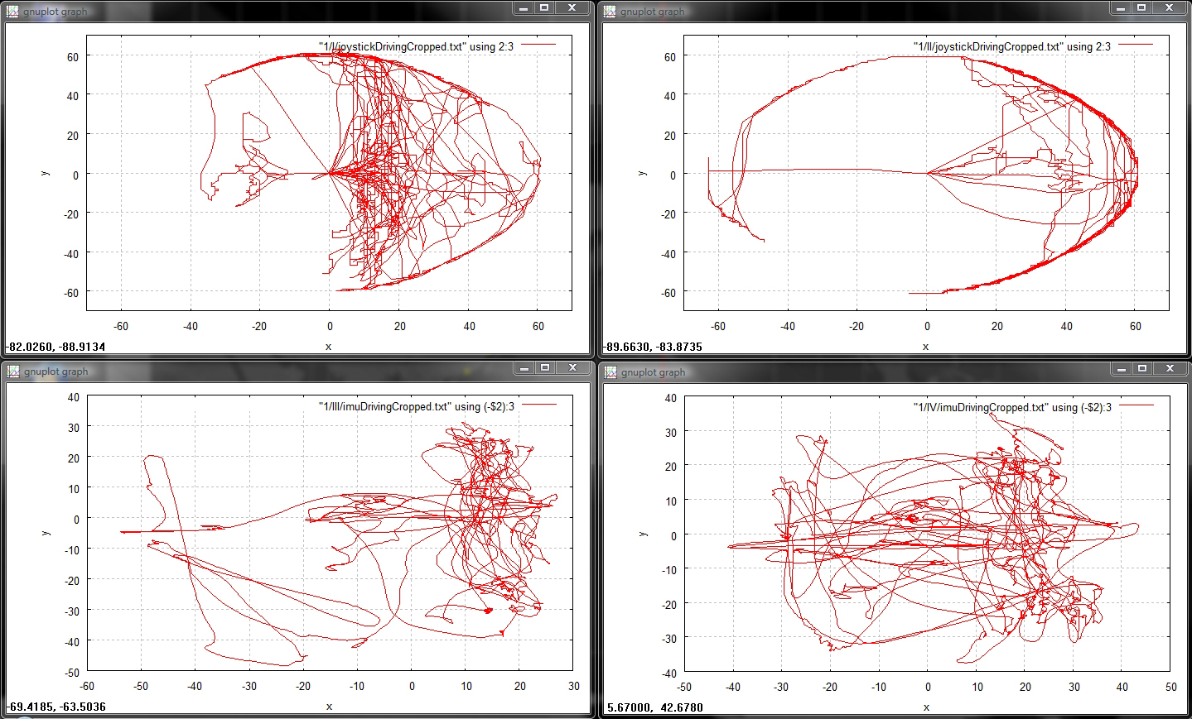
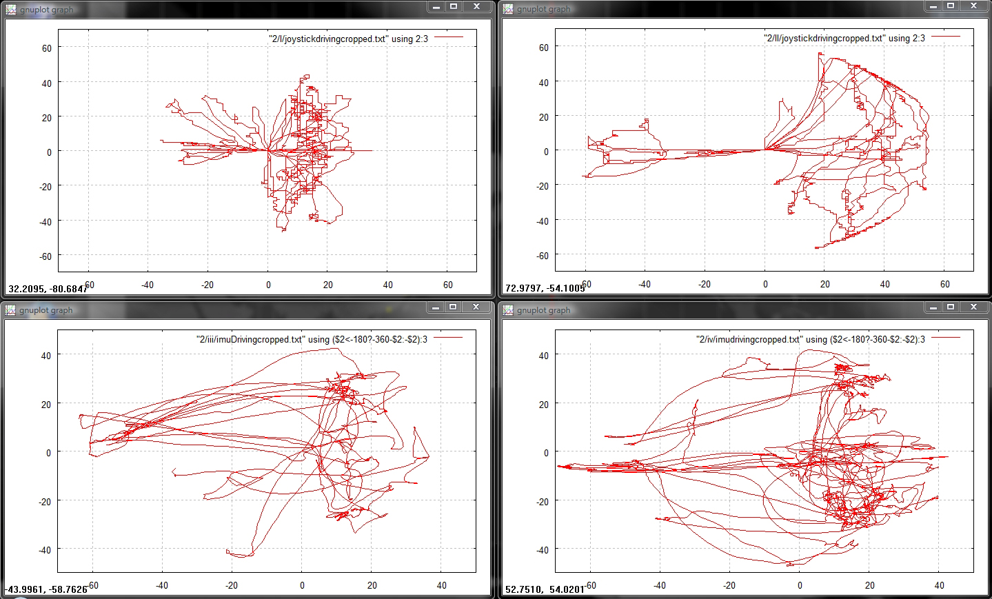
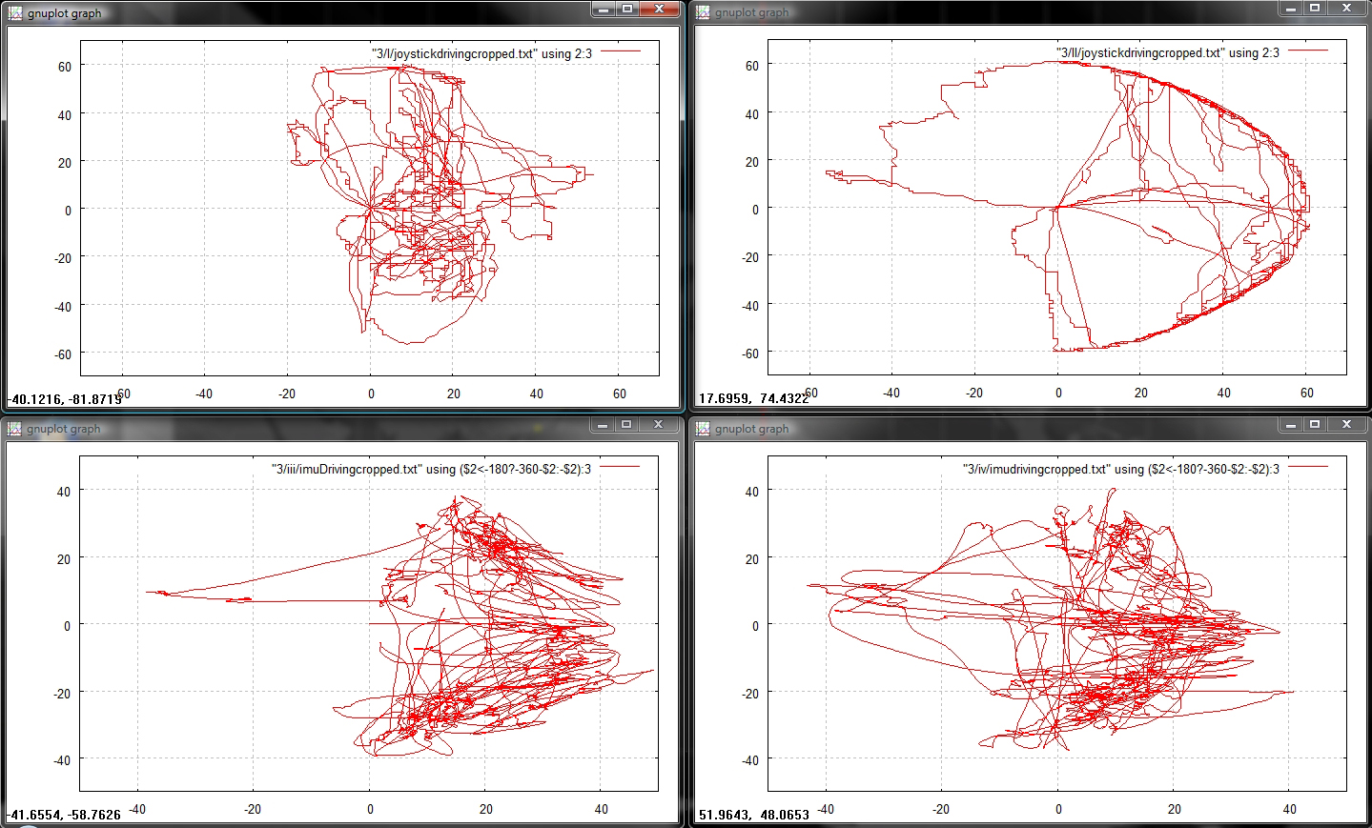
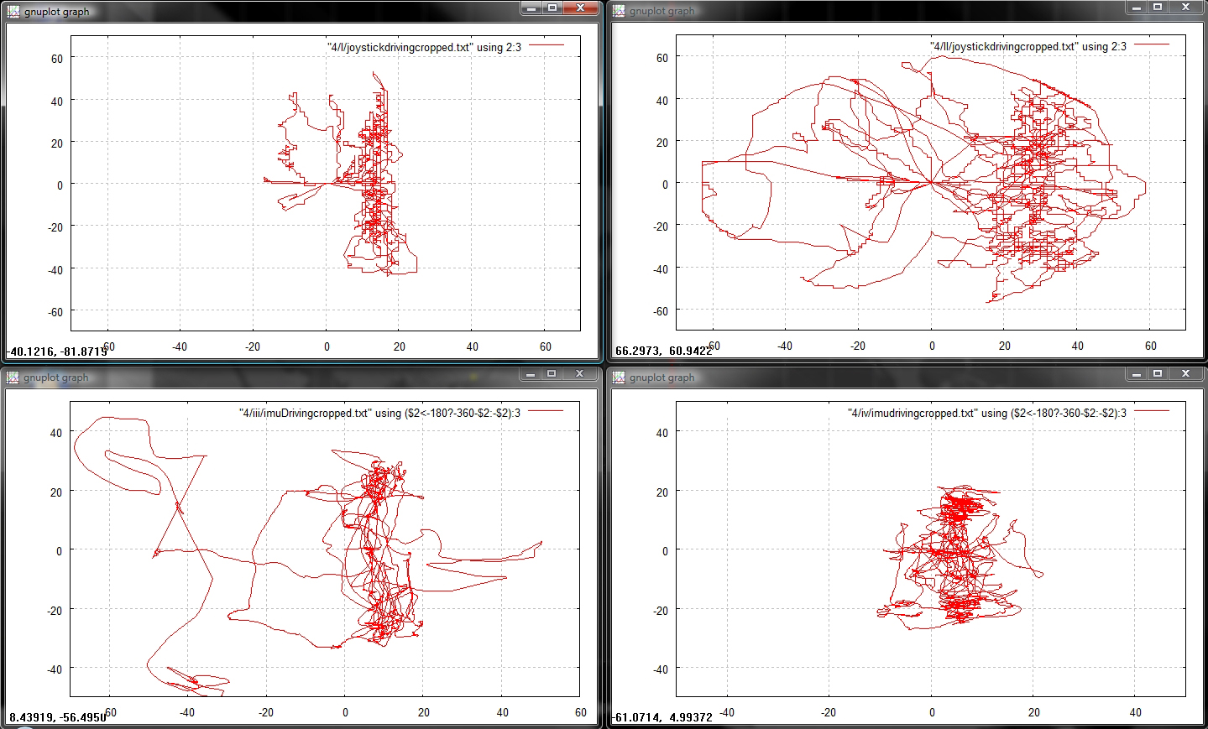
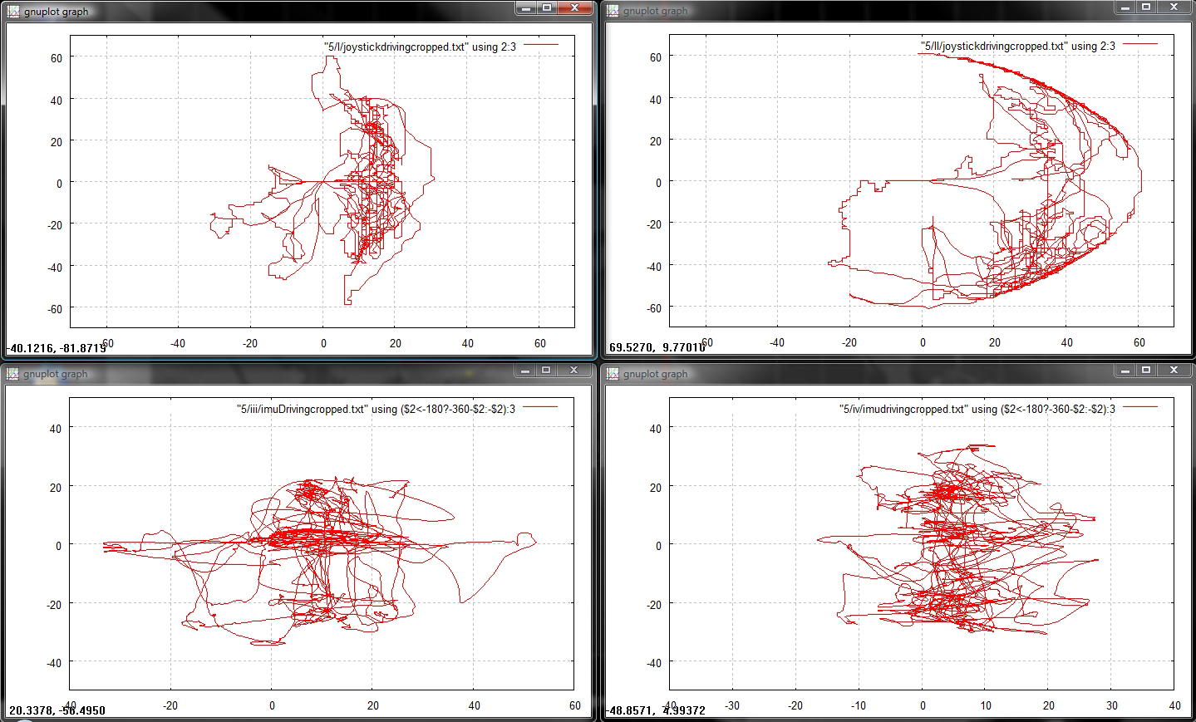
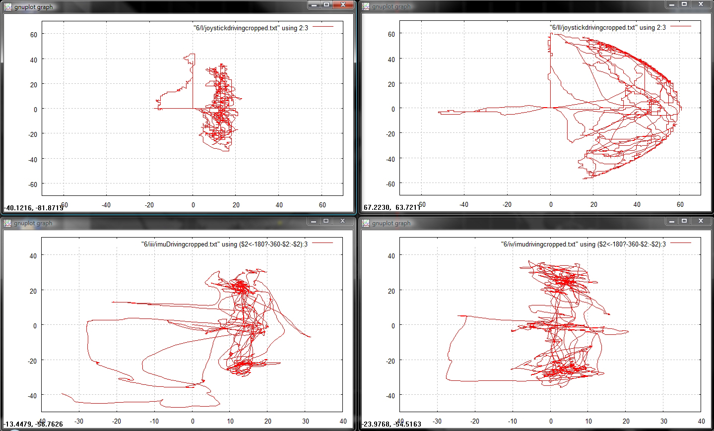
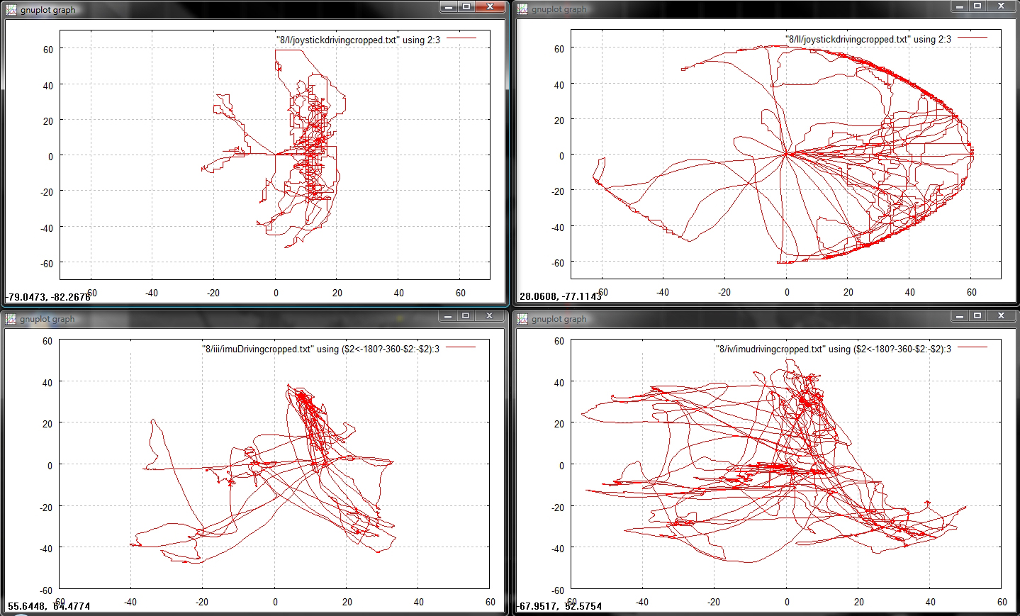
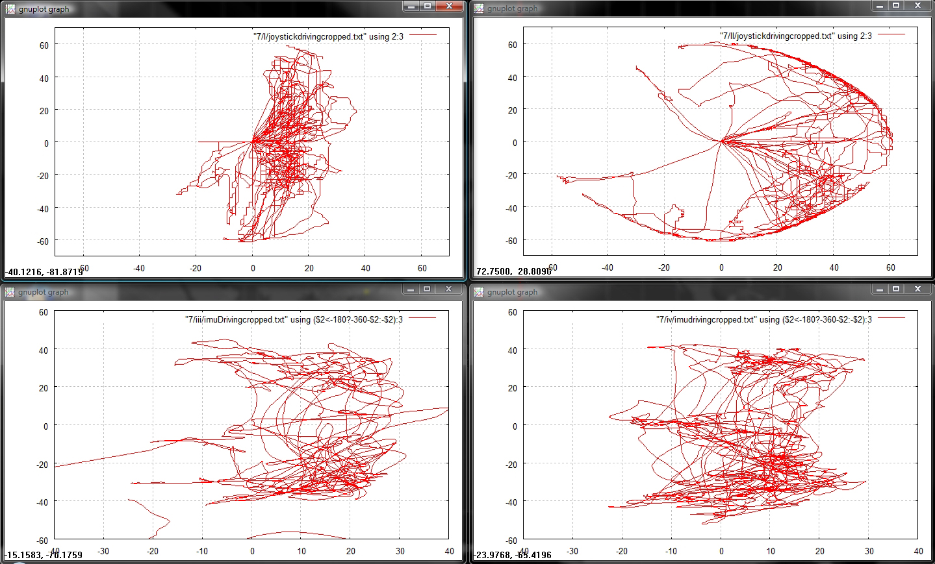
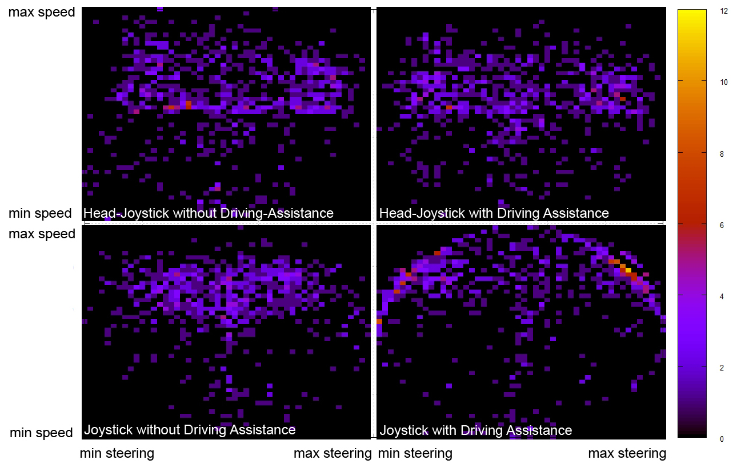
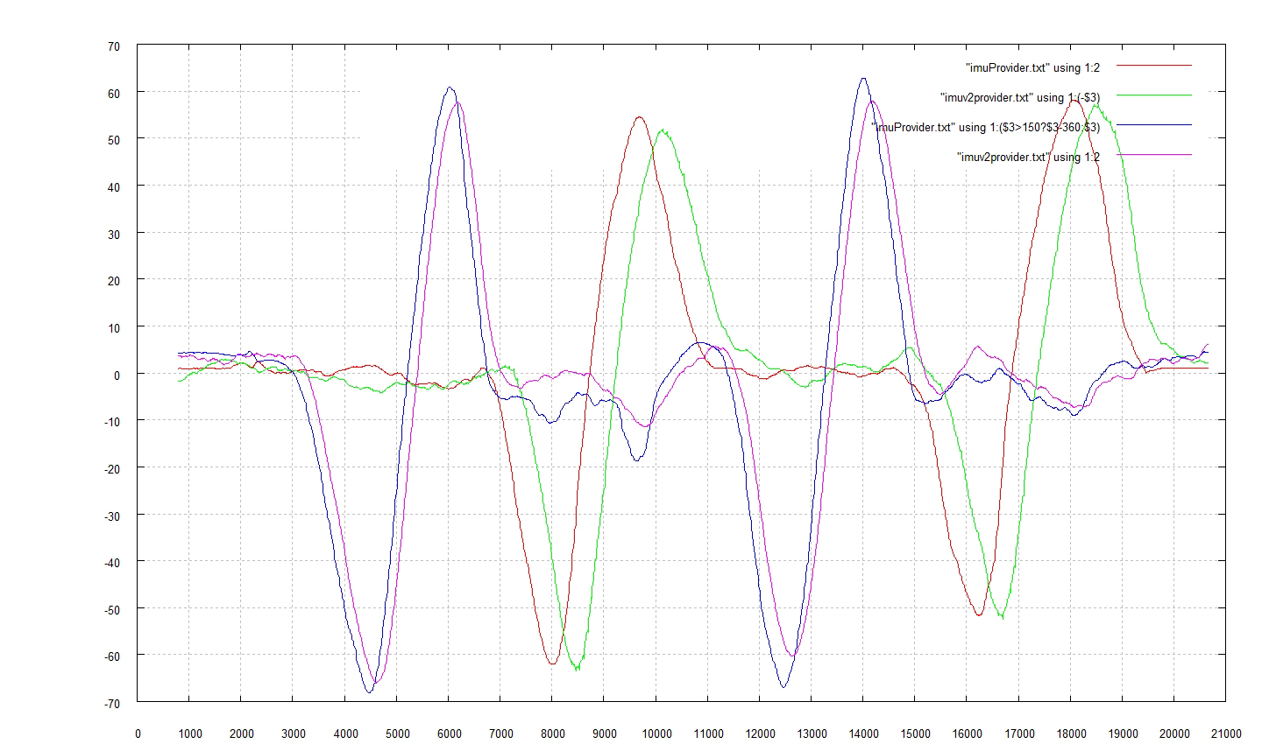
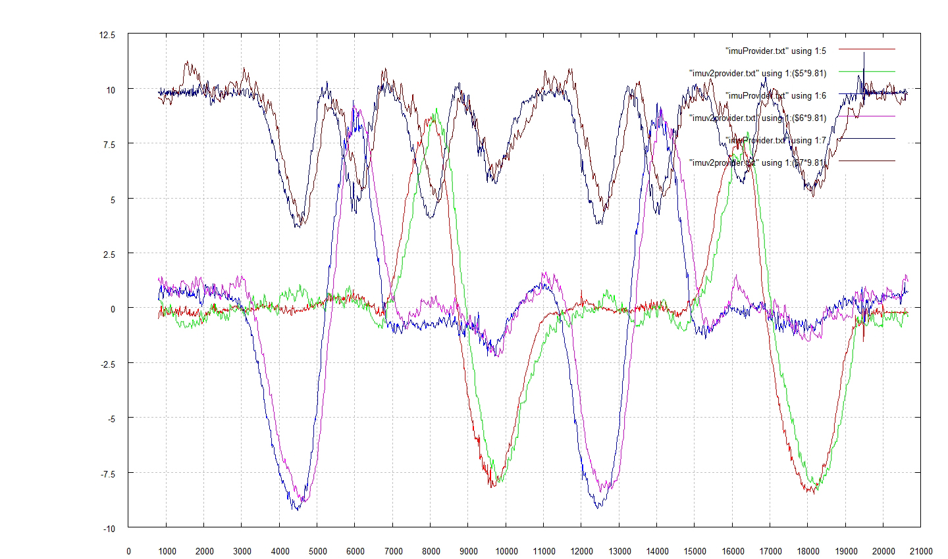
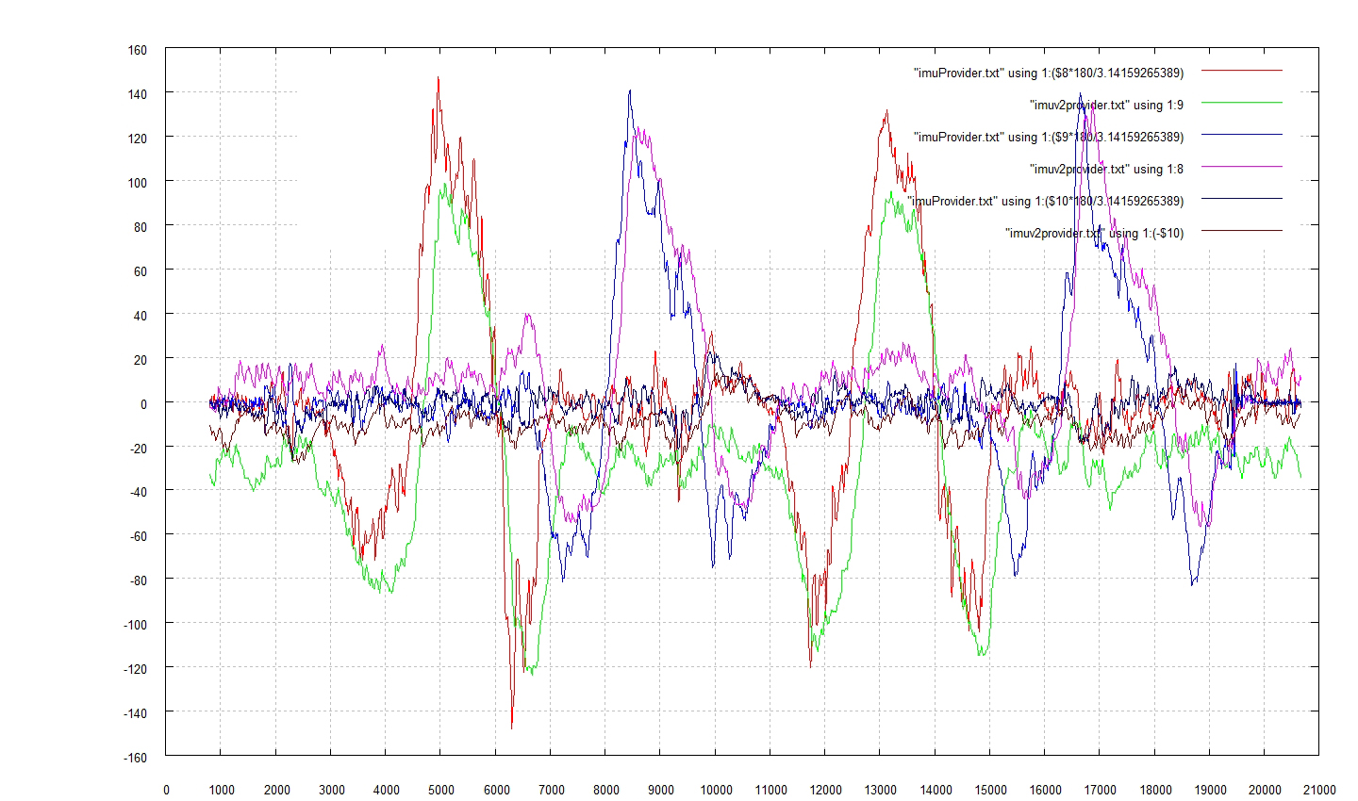

Controlling an Automated Wheelchair via Joystick/Head-Joystick
Supported by Smart Driving Assistance
Thomas Röfer ¹
Christian Mandel ²
Tim Laue ¹
ffffffffffffffffffffffff
Experimental Evaluation: Speed vs. Steering
subject 1
subject 2
subject 3
subject 4
subject 5
subject 6
subject 7
subject 8
Experimental Evaluation: XSens IMU vs. Proprietary IMU
time [ms] vs. pitch/roll [°]
time [ms] vs. acceleration [m/s²]
time [ms] vs. angular speed [°/s]
Acknowledgements
Thanks to Bernd Gersdorf for setting up Rolland III and its hardware components, Christoph Budelmann for designing the proprietary IMU-board, and Modar Ibraheem for implementing the EKF-based attitude estimation.
Contact¹: German Research Center for Artificial Intelligence,
Bremen/Germany
{thomas.roefer, tim.laue}@dfki.de
Contact²: Transregional Collaborative Research Center for Spatial Cognition, Bremen/Germany
cmandel@uni-bremen.de

