Slide 1
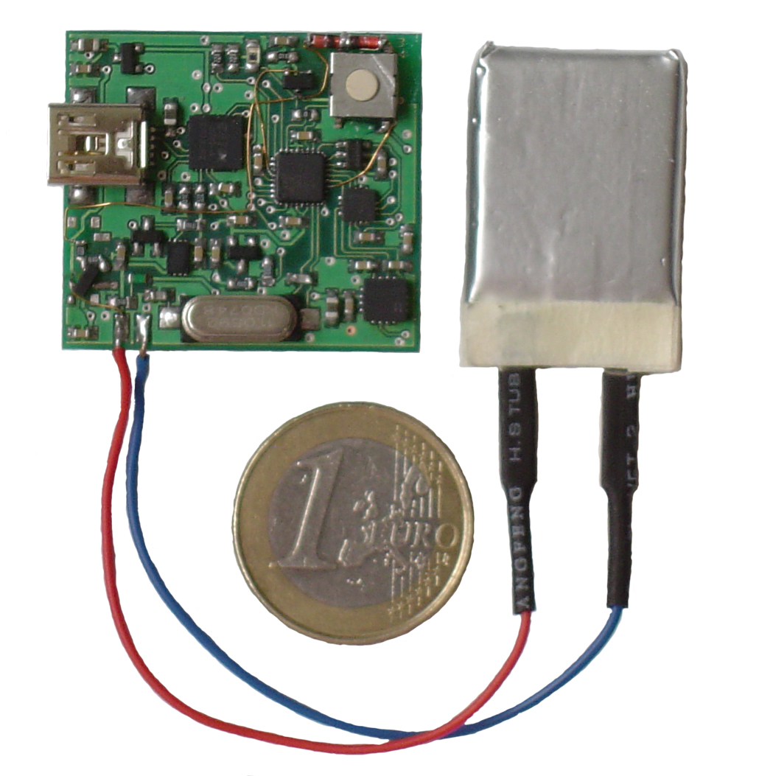
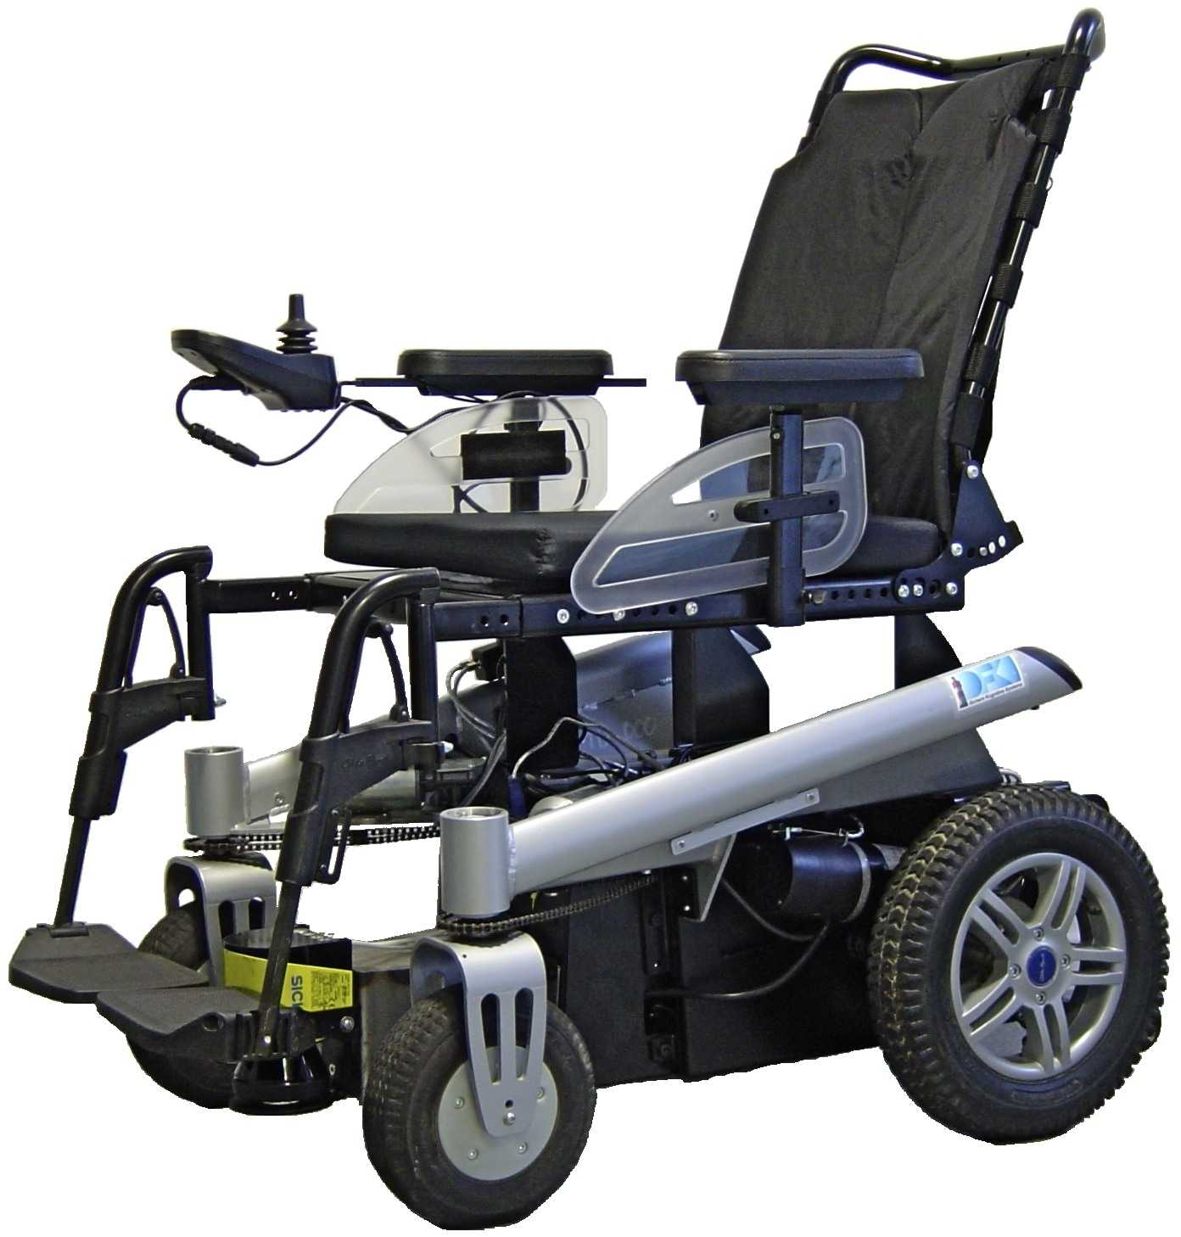
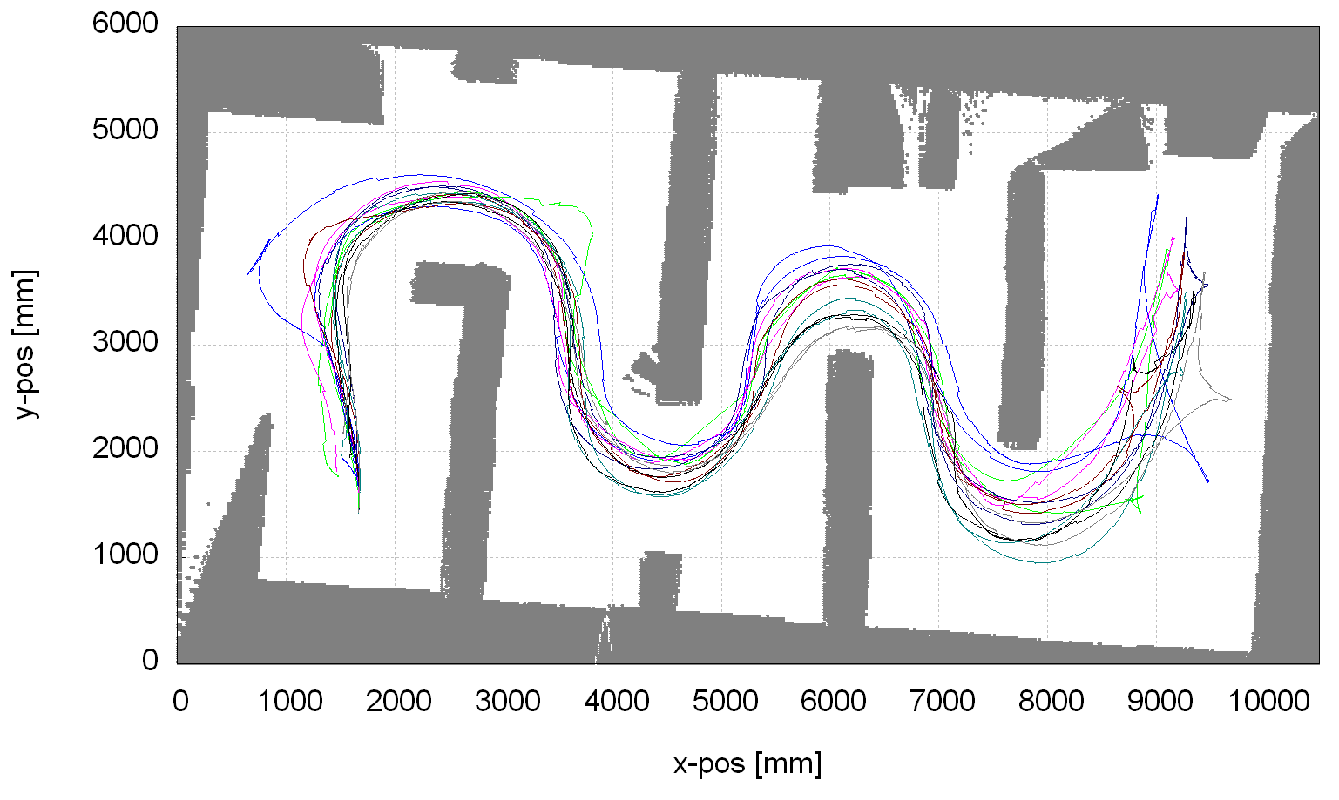
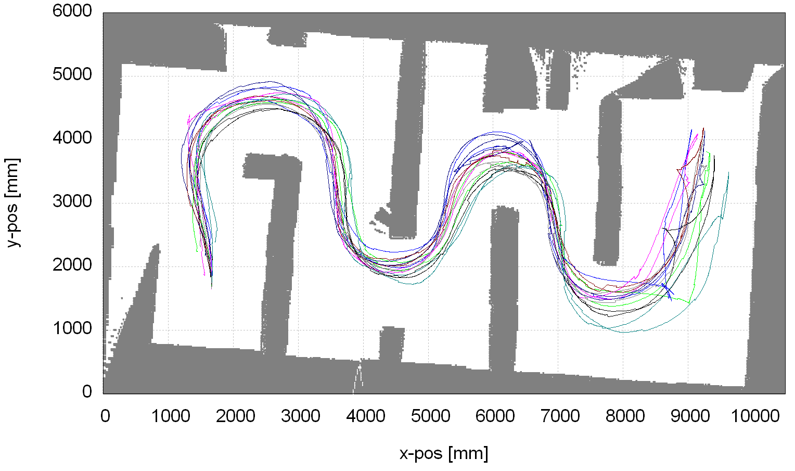
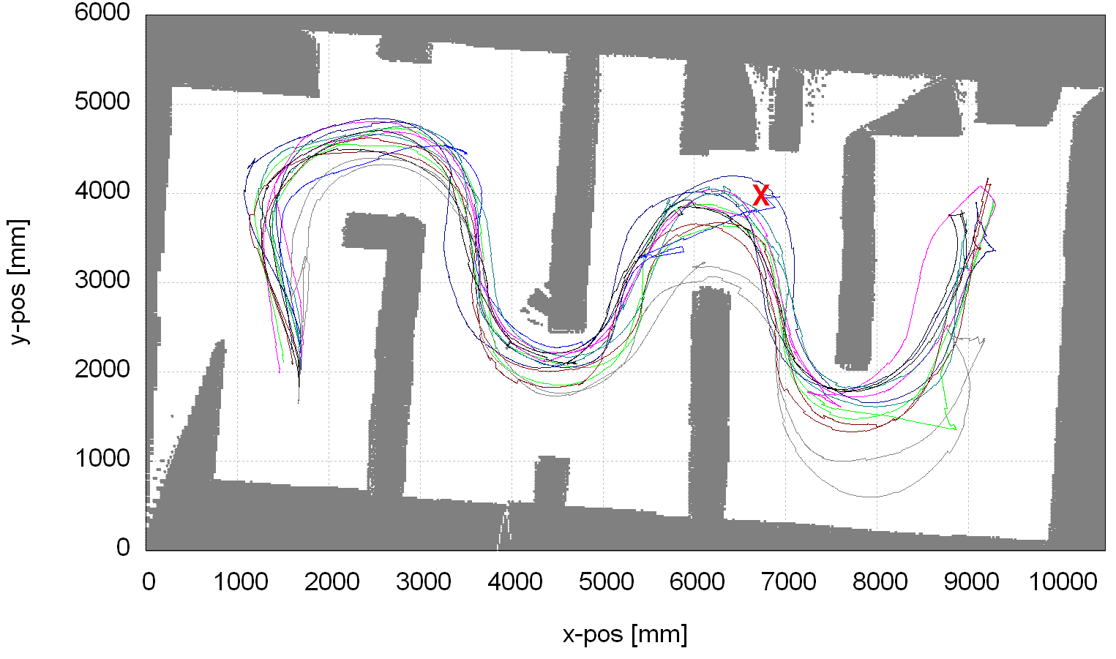
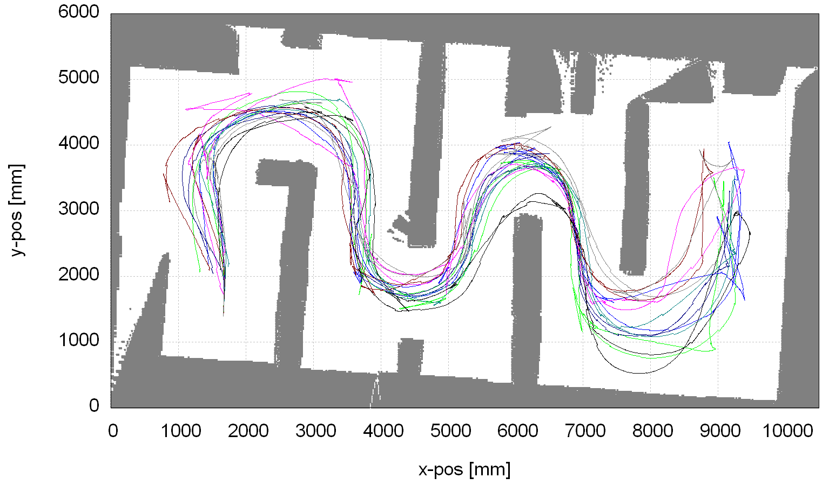
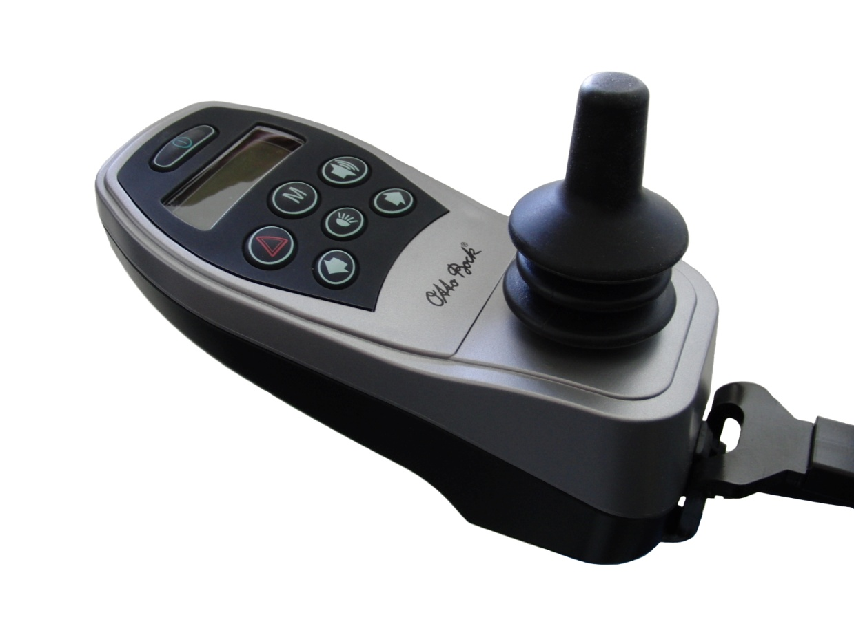
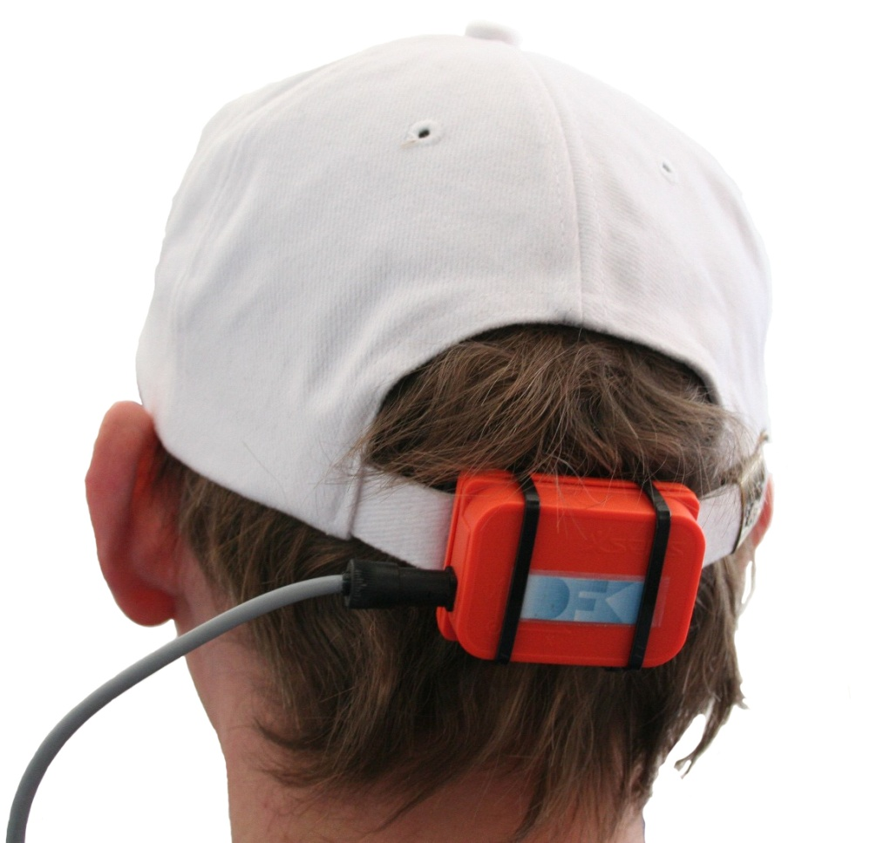
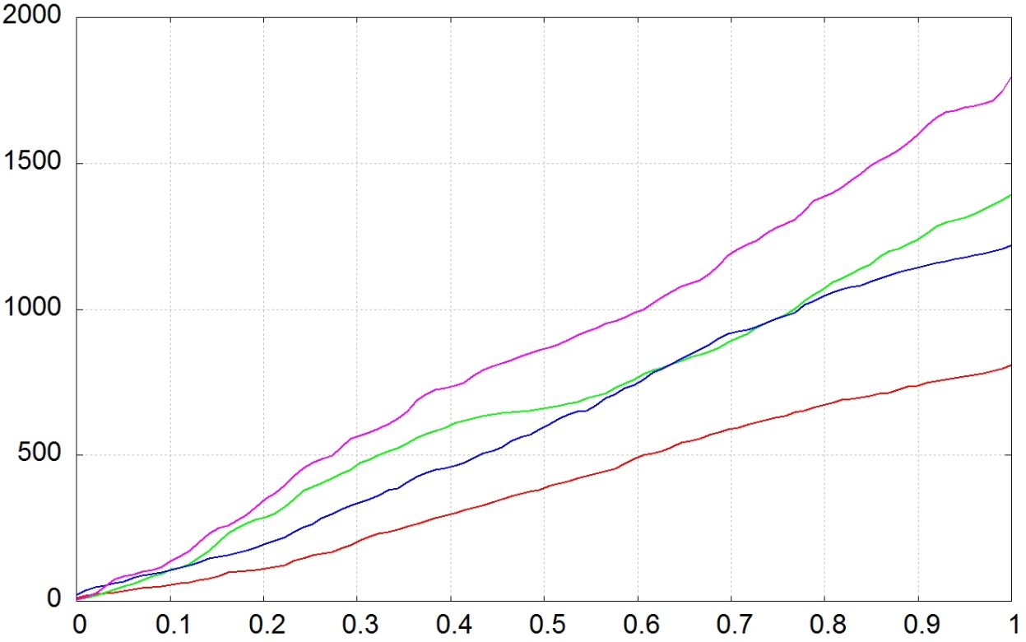
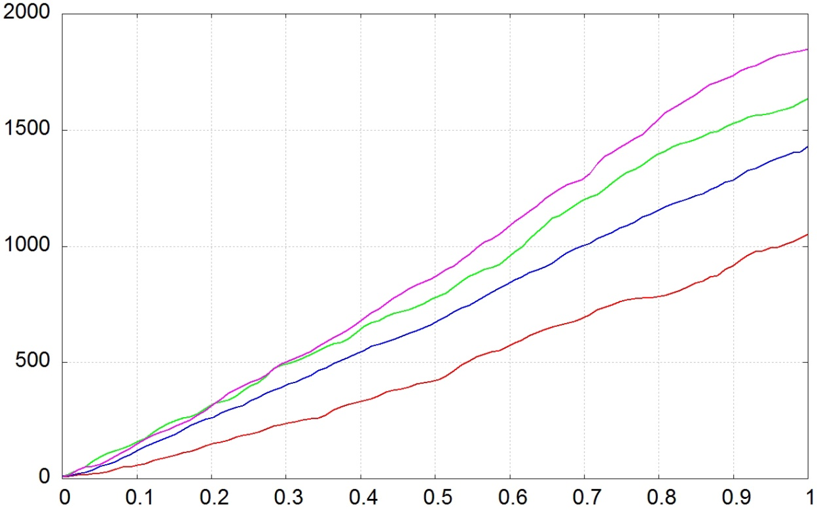

Controlling an Automated Wheelchair via Joystick/Head-Joystick
Supported by Smart Driving Assistance
Thomas Röfer ¹
Christian Mandel ²
Tim Laue ¹
ffffffffffffffffffffffff
The Bremen Autonomous Wheelchair Rolland
Proprietary head-joystick^{[Fig.5]} features:
battery operation up to 9 hours
bluetooth communication to PC
3-DOF accelerometer Analog Devices XL 330
3-DOF gyrsoscopes
Invensense IDG300 / LISY300AL
Extended Kalman Filter based computation of global attitude
Based on the power wheelchair Xeno^{[Fig.1]} by Otto Bock Healthcare
Differential drive with steered castors
Wheel encoders measuring ~2mm/tick
Two laser range finders Sick S300 sensing ~12cm above the ground with 270° opening angle each
Netbook class controller PC
Fig.1
Fig.5
Driving Assistance
Experimental Evaluation
Local occupancy grid as environmental representation
Safety regions^{[Fig.2]} describe the braking path, defined by:
translational speed/acceleration (ν/ν’)
rotational speed/acceleration (ω/ω’)
latency of command execution
shape of the wheelchair
max. expected errors of measurements ν, ν’, ω, ω’
max. deceleration
steering behavior during braking
Pre-computed safety regions indexed
over direction of motion:
Cells of safety regions contain minimum speed norm
, indicating speed of the wheelchair
before braking, necessary to reach these cells
Avoidance direction depends on the closest obstacle’s position within a given safety region, relative to the centre of the wheelchair’s driving axle
Initial driving direction is restored after circumvention of obstacle in open space
Eight healthy test persons navigated Rolland four times through a given parcours: by hand-operated joystick without^{[Fig.6]} and with^{[Fig.7]} driving assistance, and by
head-joystick without^{[Fig.8]} and with^{[Fig.9]} driving assistance
Fig.2
Fig.6
Fig.7
Fig.8
Fig.9
Data from driven trajectories indicates:
execution time increased about 41.9% (joystick) and 35.3% (head-joystick) when performed with driving assistance
length of test runs increased about 4.4% (joystick) and 28.6% (head-joystick) when performed with driving assistance
0.25 (joystick) / 0.42 (head-joystick) collisions per test run without driving assistance
sum of normalized control movements increased for standard-joystick^{[Fig.10]} and head-joystick^{[Fig.11]} when performed with driving assistance
User Interfaces
Standard joystick^{[Fig.3]} translates hand movements into
translational and rotational velocities (v, ω)
Head-joystick^{[Fig.4]} interprets pitch and roll movements of the user`s head as translational and rotational velocities (v, ω)
First version of head-joystick applies Xsens MTx 3DOF Orientation Tracker
Head-joystick features individual calibration, free yaw movements, static pitch dead zone, dynamic roll dead zone depending on v, and various transfer functions
Fig.3
Fig.4
speed without driving assistance
steering
speed with driving assistance
steering
Fig.10
speed without driving assistance
steering
speed with driving assistance
steering
Fig.11
Contact¹: German Research Center for Artificial Intelligence,
Bremen/Germany
{thomas.roefer, tim.laue}@dfki.de
Contact²: Transregional Collaborative Research Center for Spatial Cognition, Bremen/Germany
cmandel@uni-bremen.de

