Slide 2
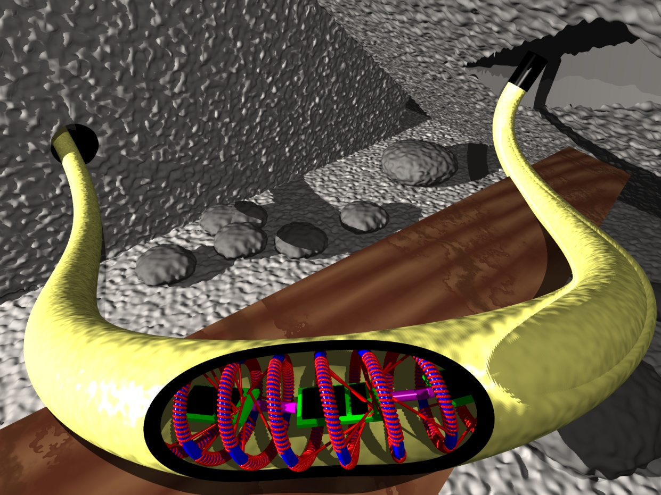
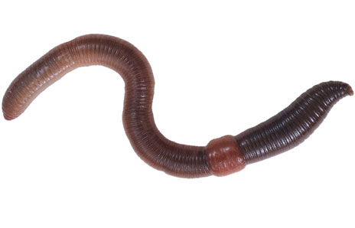
Simulation Overview | Construction | Thermal Model | Locomotion | Conclusion
Simulation Overview I
Basic idea & concepts
spring-style skeleton & flexible skin
shape memory alloy (SMA): skeleton heats up → body length extends, diameter decreases
prestressing skin: skeleton cools down → body length contracts, diameter increases
peristaltic movement compares to locomotion of “Annelida”

Slide 3
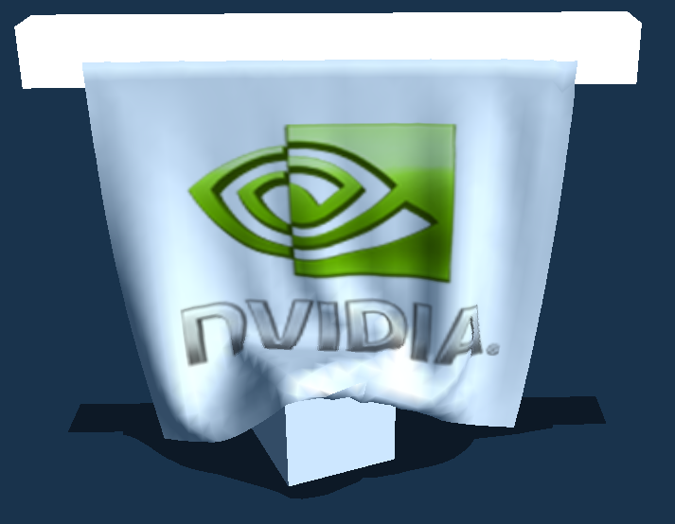
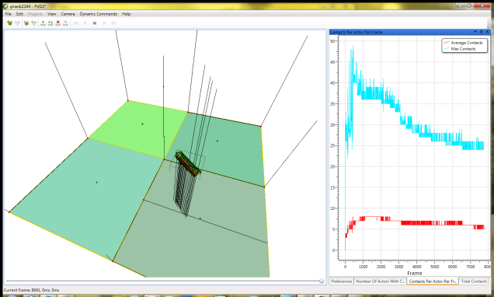
Simulation Overview | Construction | Thermal Model | Locomotion | Conclusion
Simulation Overview II
Tools and methods
NVIDIA PhysX SDK provides basis for
rigid body dynamics → behaviour of SMA-skeleton
cloth simulation → elastic skin
collision detection → environment interaction and friction
NVIDIA PhysX Visual Debugger
online scene analysis for each actor: velocity, force, energy, contact, ...
solve thermodynamic equations
adding, transfer, and dissipation of thermal energy

Slide 4
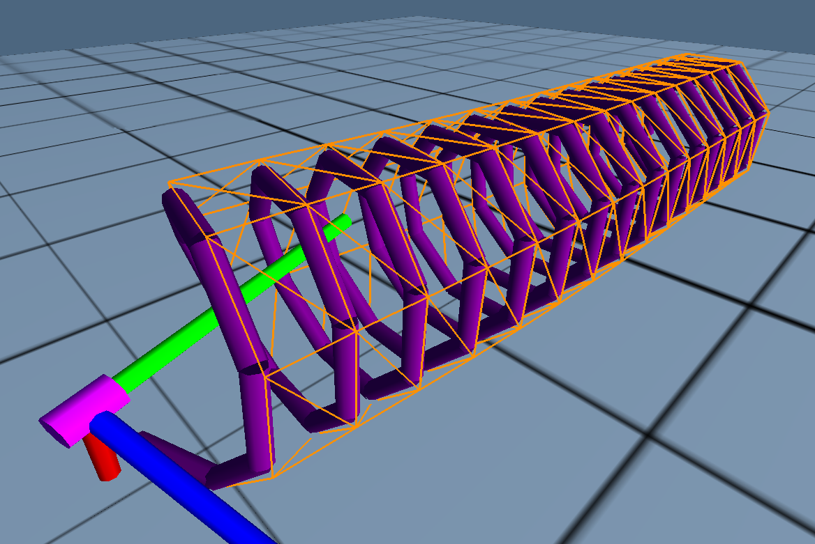
Simulation Overview | Construction | Thermal Model | Locomotion | Conclusion
Construction I
Components of simulated Annelid
not geometrically modeled:
heating wires attached to framework
cooling fan integrated into tail
central back bone wires for control & power supply
electronics controlling heating coils
reference
pose
atomic skeleton element
for thermal simulation
1 dof twist joint between two consecutive skeleton elements
mesh of simulated springs mimics flexible outer skin

Slide 5
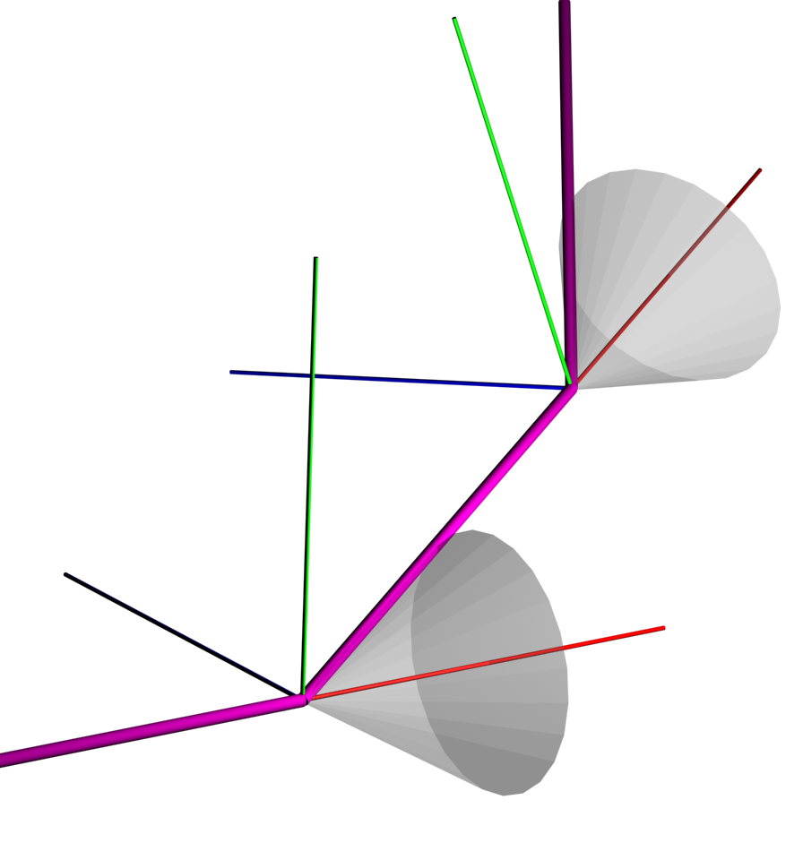
Simulation Overview | Construction | Thermal Model | Locomotion | Conclusion
Construction II
Simulation of spring-style skeleton
compression spring like behaviour: single elements twist around x-axis of joint connecting to predecessor
twisted segments induce restoring force modelled by: PhysX spring-, damping-, and restitution-coefficients
SMA properties:
couple restoring force with segment`s thermal energy
segment_{n+2}
segment_{n}
segment_{n+1}
joint_{n}
joint_{n+1}
Notes:
By PhysX spring damping and restut...

Slide 6
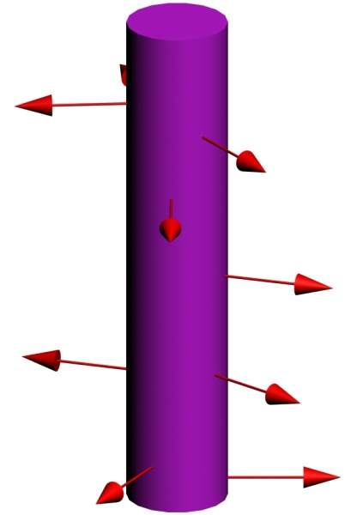
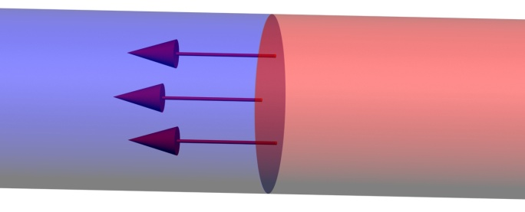
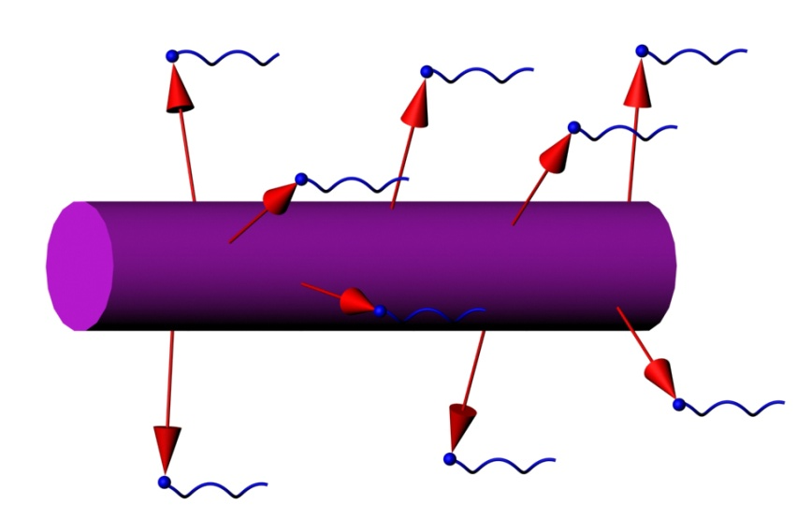
Simulation Overview | Construction | Thermal Model | Locomotion | Conclusion
Thermal Model I
Thermodynamic equations
thermal radiation:
heat conduction:
thermal transfer:

Slide 7
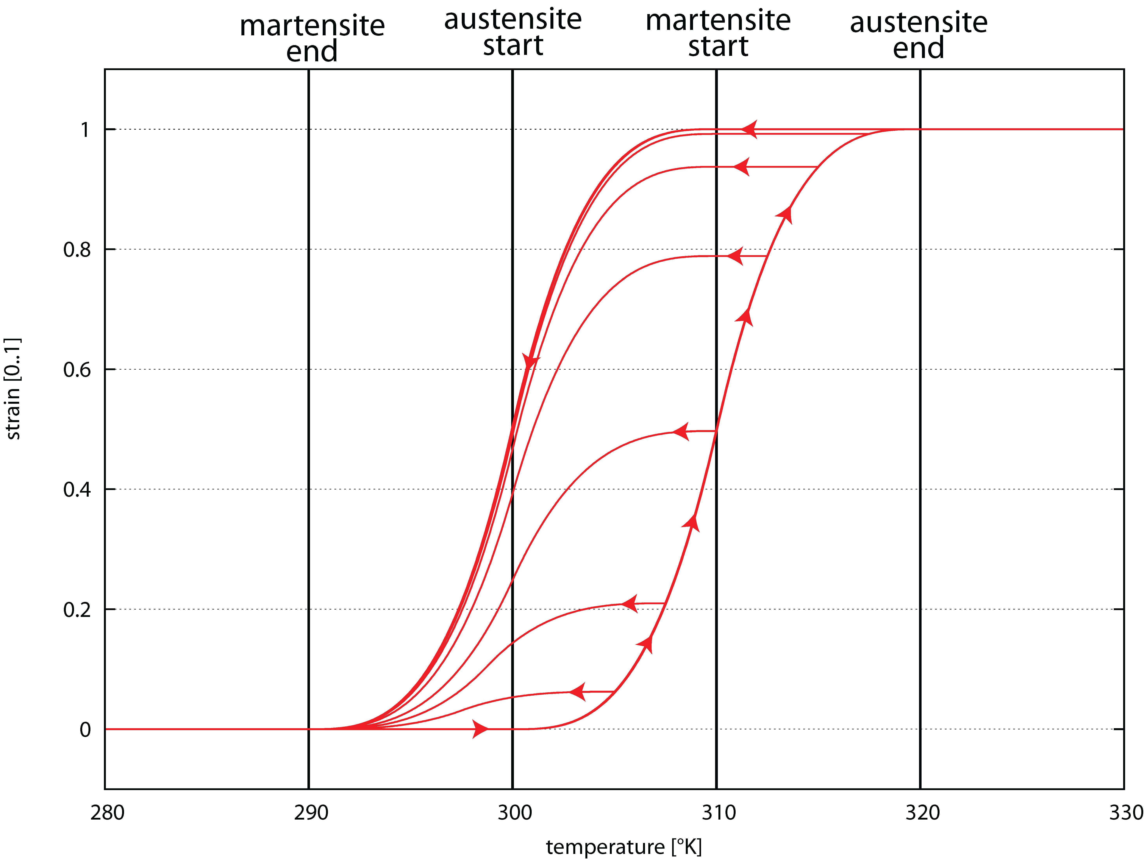
Simulation Overview | Construction | Thermal Model | Locomotion | Conclusion
Thermal Model II
Austensite (AS) Martensite (MS) hysteresis
high temperature phase (AS): internal strain deforms material
low temperature phase (MS): external force deforms material
hysteretic relation between temperature and strain
cubic slopes
Z. Zhu, J. Wang, and J. Xu . Modeling of Shape Memory Alloy Based on Hysteretic Non- linear Theory. Applied Mechanics and Materials, 44–47:537–541, 2011

Slide 8
Simulation Overview | Construction | Thermal Model | Locomotion | Conclusion
Locomotion I
Basic forwards movement
sinusoidal temperature curve of 4π length travels front→back (1cycle / 1.5s)
low temperature windings (min: 85°C) contract and increase diameter
high temperature windings (max: 103°C) stretch and decrease diameter
Video 1
simulation time X 0.06

Slide 9
Simulation Overview | Construction | Thermal Model | Locomotion | Conclusion
Locomotion II
Bending - sidewards movement
sinusoidal temperature curve as during forwards movement
superimpose thermal energy to lateral flanking segments
curvature varies with
Video 1
simulation time X 0.06

Slide 10
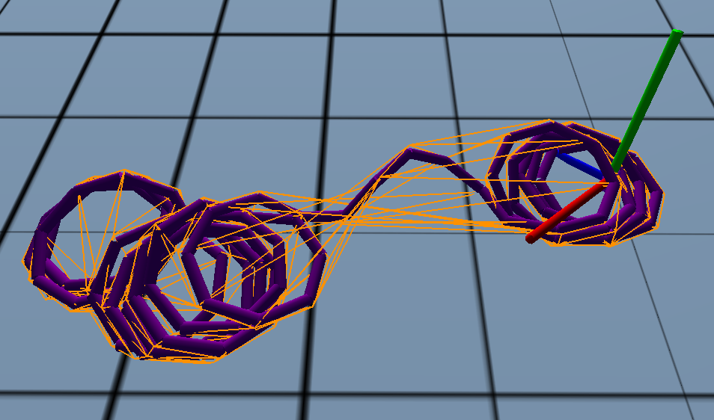
Simulation Overview | Construction | Thermal Model | Locomotion | Conclusion
Conclusion I
Lessons learned
PhysX iterative solver:
hard to find parameter for stable simulation

Slide 11
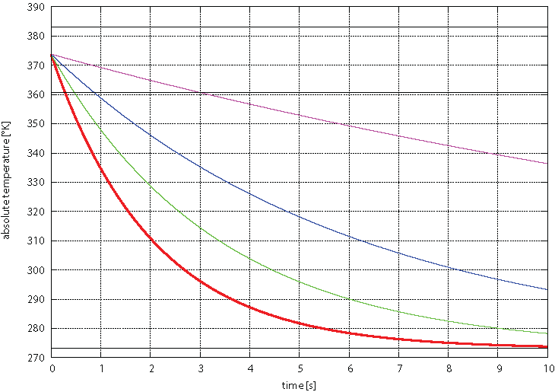
Simulation Overview | Construction | Thermal Model | Locomotion | Conclusion
Conclusion I
Lessons learned
 | red | green | blue | pink
cooling air | 10.5 | 5.5 | 2.5 | 0.5
main challenge:
fast dissipation of thermal energy
realistic exhaust air speed: 0.05

Slide 12
Simulation Overview | Construction | Thermal Model | Locomotion | Conclusion
Conclusion II
Future work
physical workbench version of Annelid
mounted SMA spring with skin and external control
evaluate cooling problem
investigate potential skin materials
simulation of Annelid
complex locomotion

