Slide 1














Using Gated Recurrent Unit Networks for the Prediction of
Hemodynamic and Pulmonary Decompensation
Dr.-Ing. Christian Mandel
Research Department
Cyber-Physical Systems (CPS)
German Research Centre for
Artificial Intelligence (DFKI)
Bremen site
https://www-cps.hb.dfki.de/about/staff/chma02
http://www.informatik.uni-bremen.de/~cmandel

Slide 2
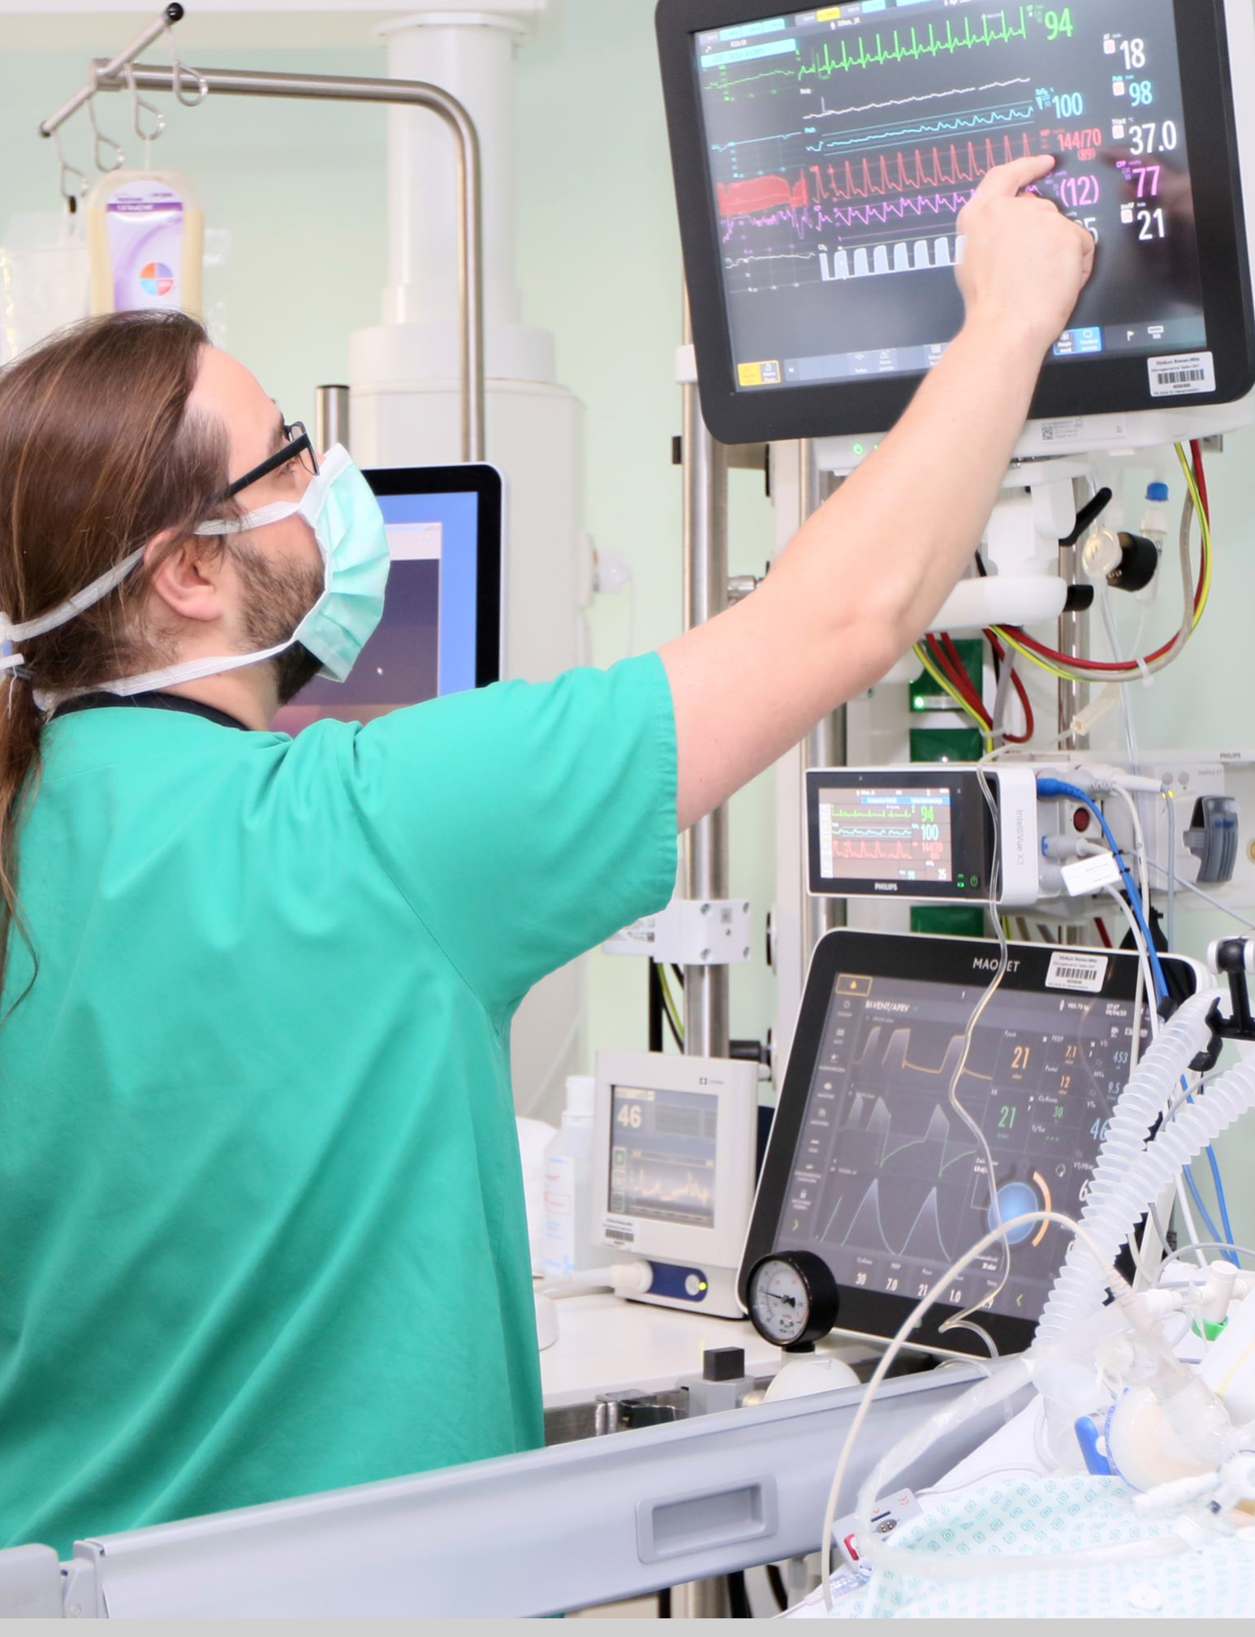
Overview
1/11
Hemodynamic and pulmonary decompensation
describe the progressive deterioration of the
heart’s and lung’s functionality
Effects of underlying disease can be compensated
for a certain time
Incipient decompensation might lead to
life threatening situation
It is highly desirable to support physicians in
predicting decompensation
Notes:
Hem./Pul. Dec. = life threatening deteriorations of heart’s & lung’s functionality with different underlying diseases
=> predict Hem. & Pul. Dec. by solving classification & regression tasks
1st: define Hem. & Pul. Dec. as functions over biosignals/medication
2nd: train neural networks and evaluate

Slide 3
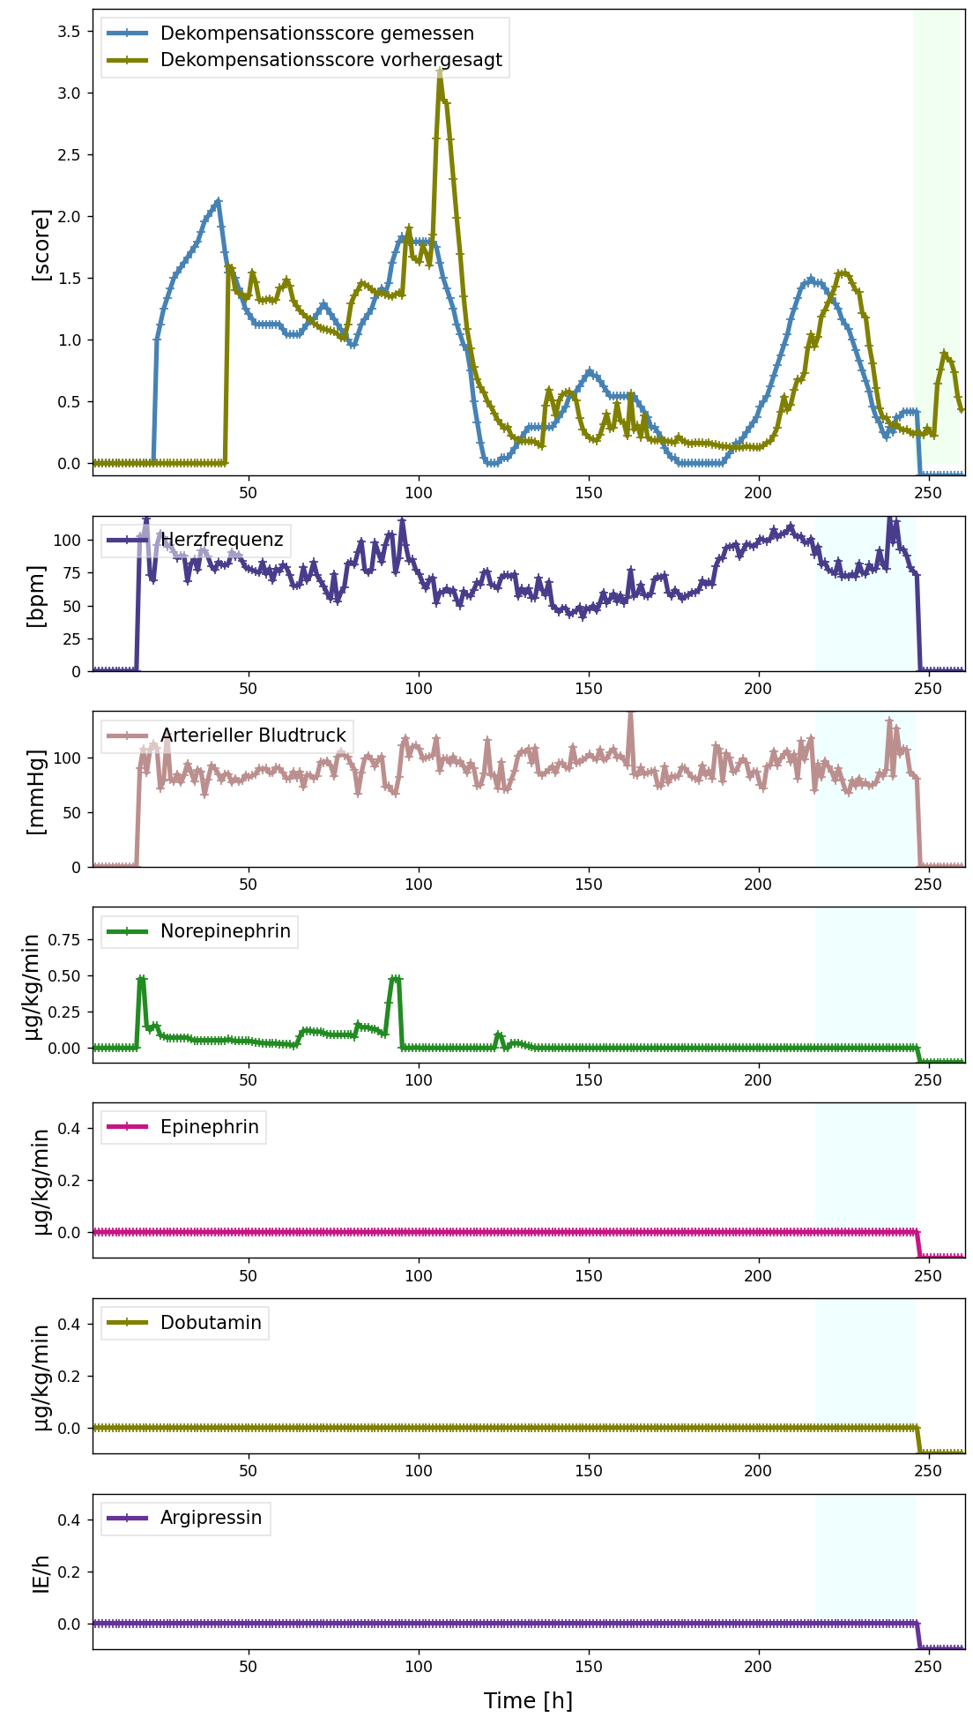
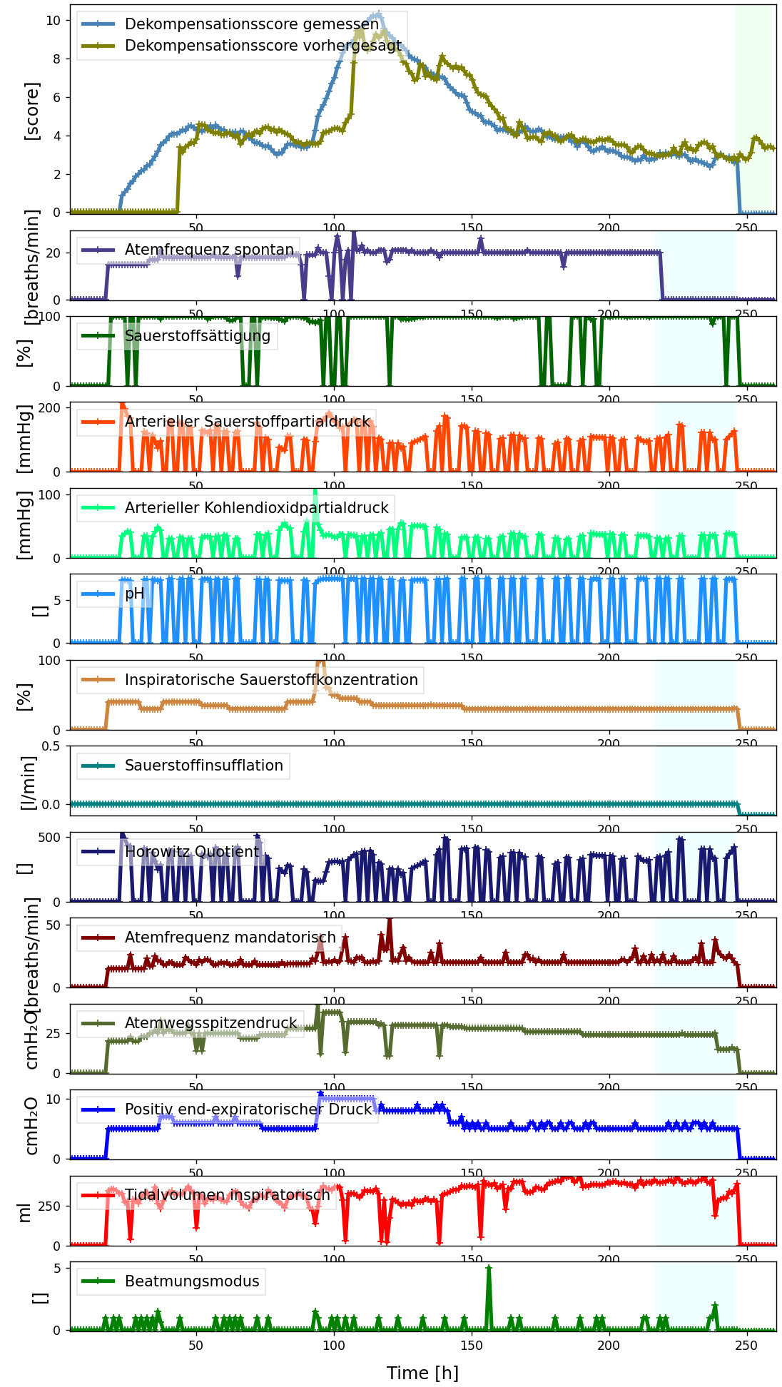


Research Questions
2/11
Definition of hemodynamic and pulmonary
decompensation as severity score time series
Prediction of the maximal decompensation
severity class until a given time horizon (classification)
Estimation of decompensation scores for a given
point in future time (regression)
Notes:
Hem./Pul. Dec. = life threatening deteriorations of heart’s & lung’s functionality with different underlying diseases
=> predict Hem. & Pul. Dec. by solving classification & regression tasks
1st: define Hem. & Pul. Dec. as functions over biosignals/medication
2nd: train neural networks and evaluate

Slide 4
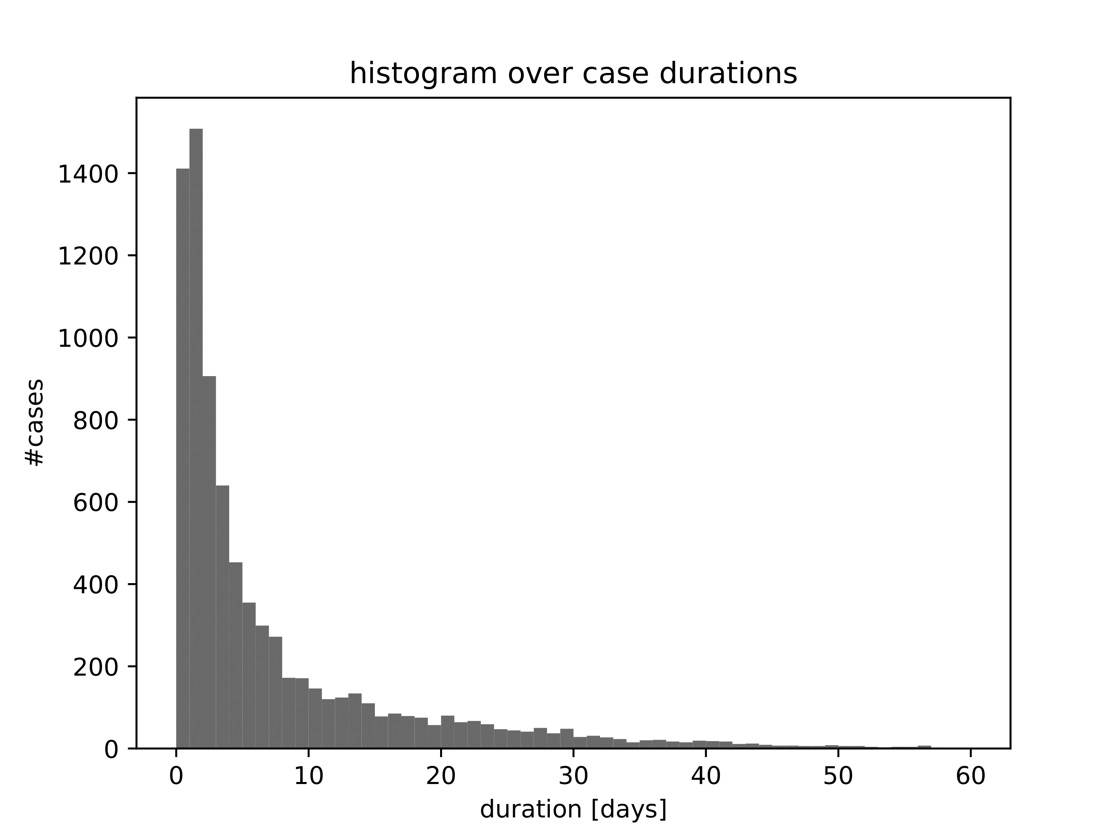
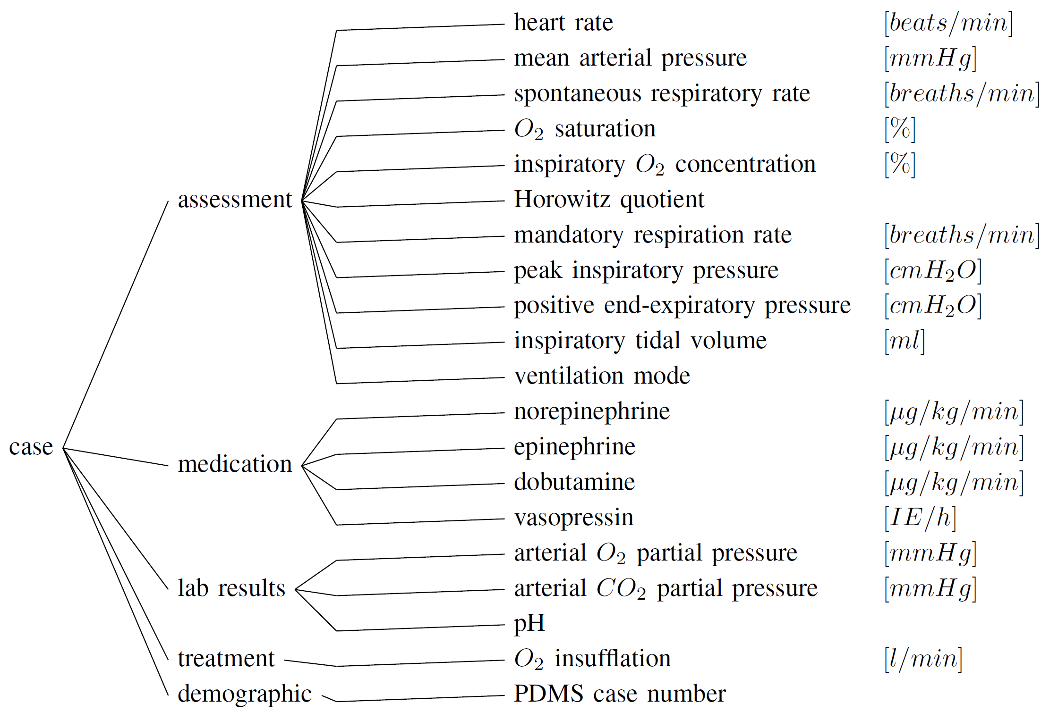
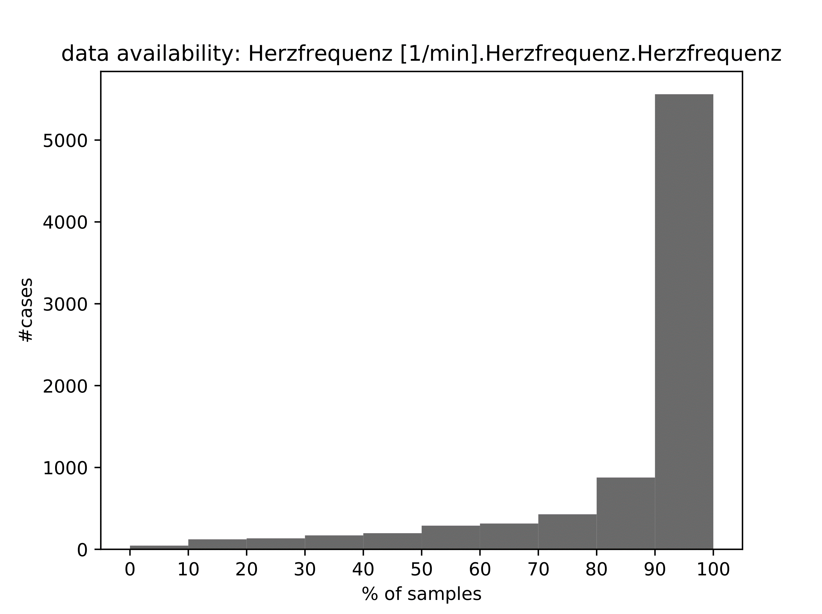
Dataset
3/11
Data from 10,283 cases collected between 2013 and 2021
at ICU of Klinikum Bremen-Mitte in Germany
case durations
heart frequency
Notes:
We build our work on >10k cases from Bremen ICU
We were allowed to use 106 anonymized data entries for each case (whitelist)
… from which we chose 19 (13+6)
data entries are bundled in data groups such as assessment & medication

Slide 5
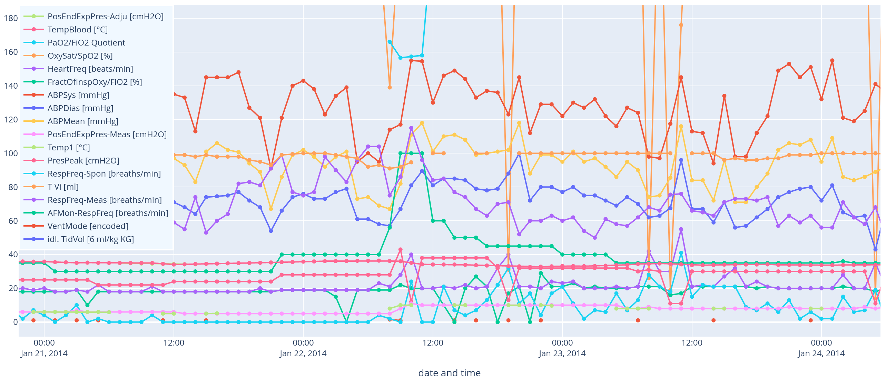
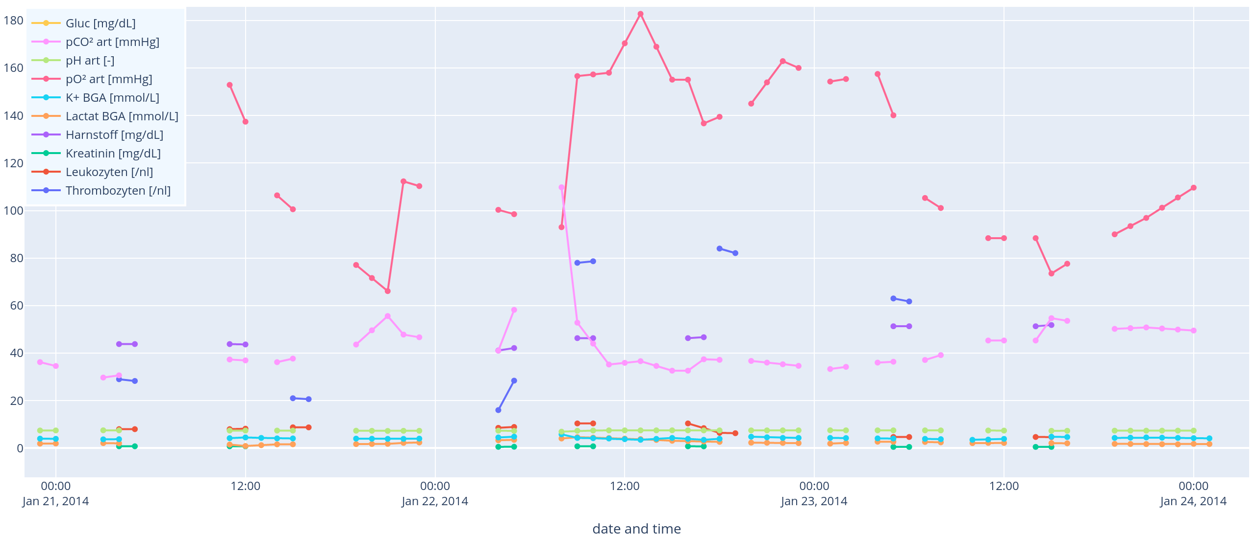
Data Filtering and Preprocessing
4/11
Padding
Corrupt Case Removal
Start- / Endtime Alignment
Resampling
Missing Value Imputation
(Standardization)
assessment
lab results
Notes:
Straightforward preprocessing steps
Corrupt Case Removal: no PDMS number || < obs time & pred time || missing data entries for decomp score calc.

Slide 6
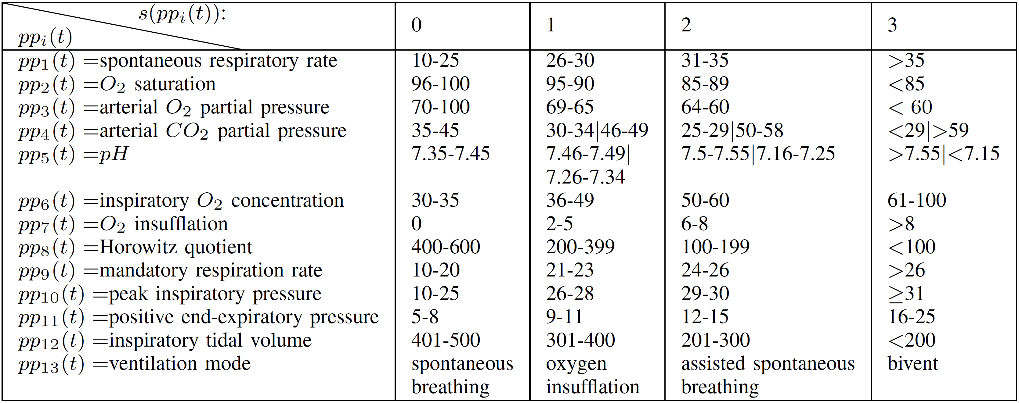
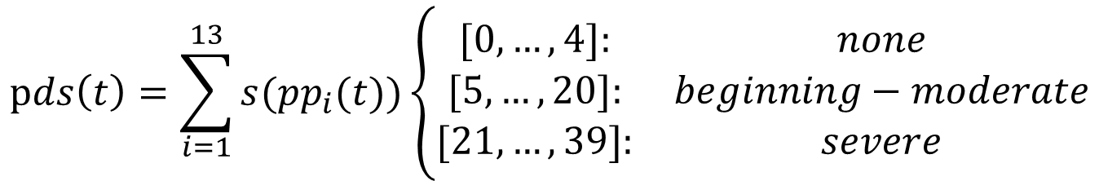
Decompensation Score: Pulmonary Example
5/11
$$pds\left(t\right)=\sum_{i=1}^{13}{s(pp_{i}(t))}\left\{\begin{matrix}[0,…, 4]: & none \\ [5,…,20]: & beginning−moderate \\ [21,…,39]: & severe\end{matrix}\right.$$
Notes:
Decomp. Score as sum over parameter value assessments
Discrete intervals of Decomp. Score = severity classes
here: not only measured biosignals but also “Ventilation mode” chosen by med. Doc.

Slide 7
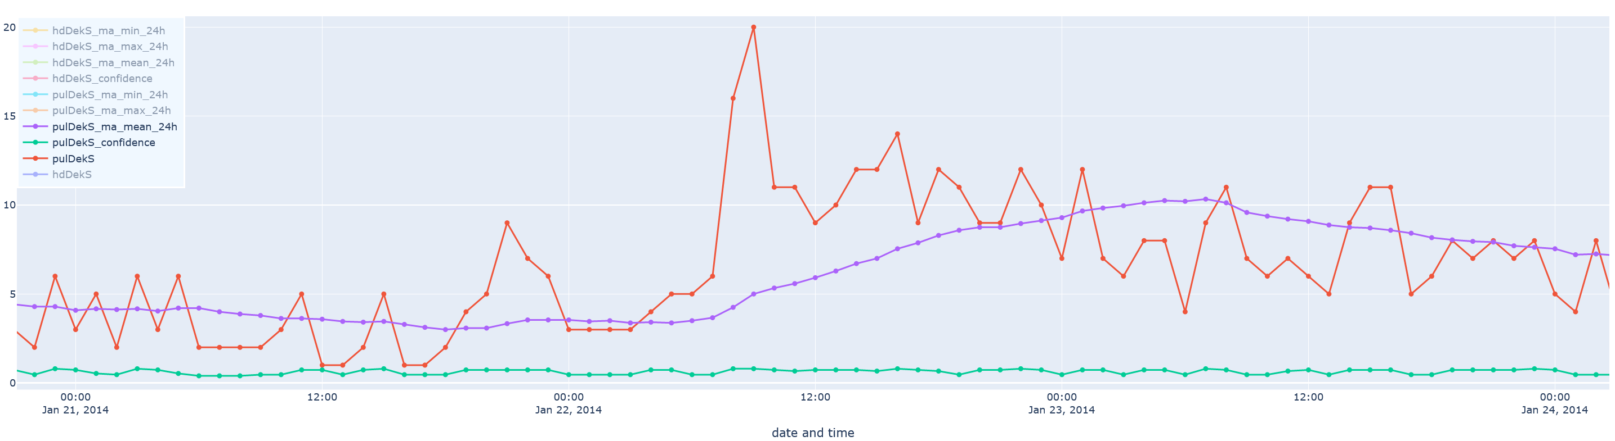
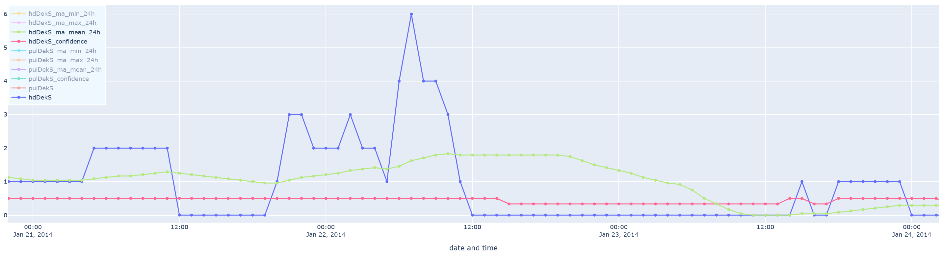
Decompensation Scores: exemplary time series
6/11
Decomp. Score
24h m.a. Decomp Score
Confidence
pulmonary
Decomp. Score
24h m.a. Decomp Score
Confidence
hemodynamic
Notes:
Exemplary decompensation score time series, please note:
24h moving averaged time series and
Confidence time series

Slide 8
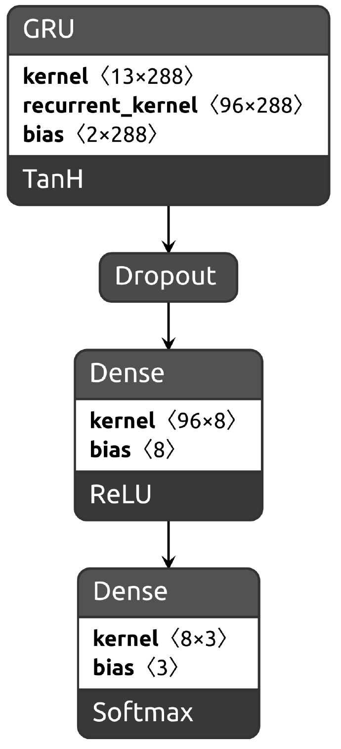
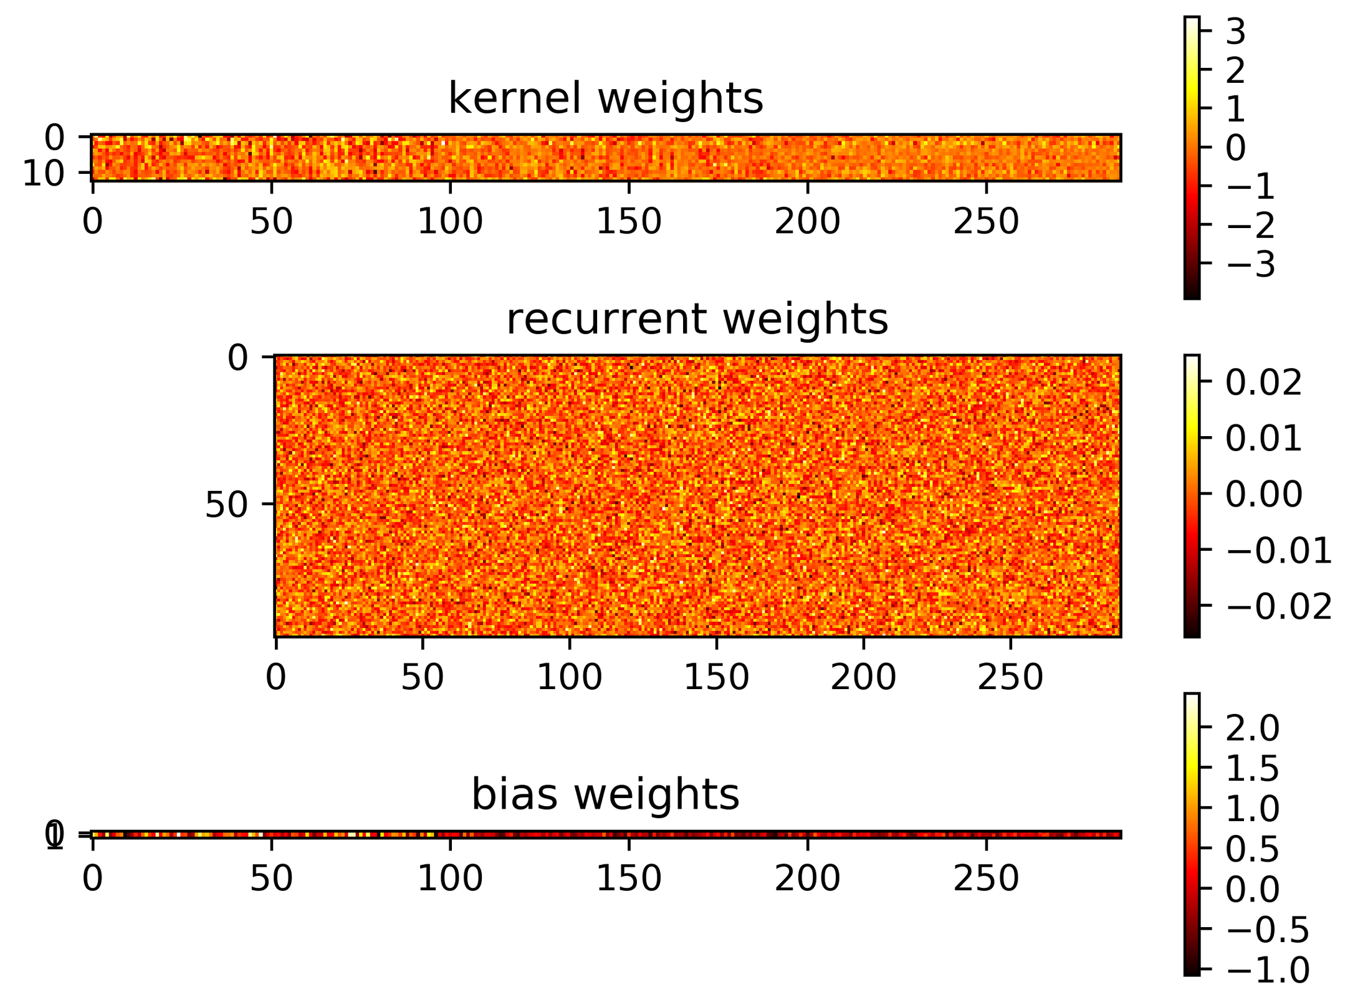

Gated Recurrent Unit-based Network for Pulmonary Classification
7/11
GT-label
number of cases
GT-label
GT-label
number of observed
parameters
length of observation
time frame
input data
Prob – no decompensation
Prob – beginning/moderate decompensation
Prob – severe decompensation
pulmonary
classification network
output data
$$\sum{=1}$$
Notes:
Main predictive tool: GRU-layer based recurrent artificial neural network
Example here: training for pulmonary classification
Input data: parameter time series & ground truth labels from calculated decomp score time series
Network: Unfolded GRU-layer + Dropout + Dense + Dense
Output data: 3-valued probability vector that sums up to 1
Exemplary kernel/bias matrices after training

Slide 9
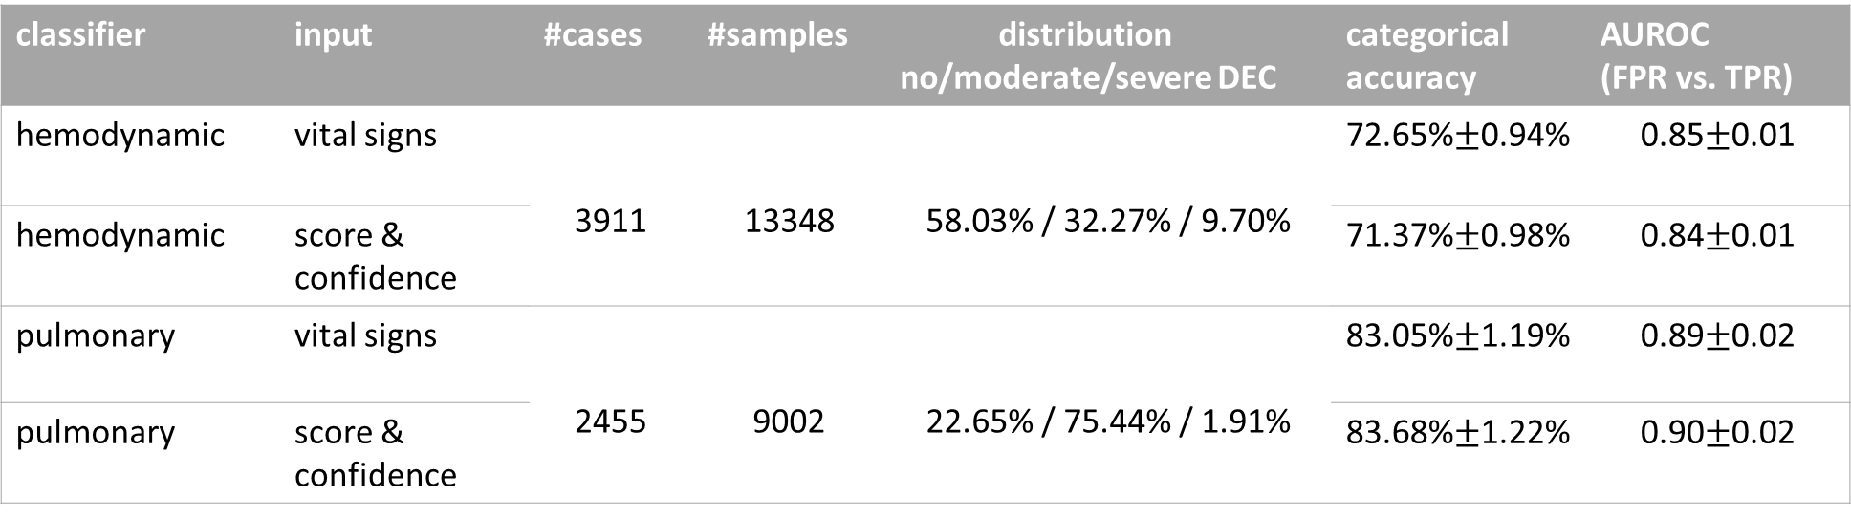
Evaluation: max. Decompensation Class Prediction
8/11
Observation time: 60h; prediction time: 24h
10× repeated stratified 10-fold cross-validation
Training on vital sign vs. decompensation score/confidence time series
classifier | input | #cases | #samples | distribution no/moderate/severe DEC | categorical accuracy | AUROC (FPR vs. TPR)
hemodynamic | vital signs | 3911 | 13348 | 58.03% / 32.27% / 9.70% | 72.65%$±$0.94% | 0.85$±$0.01
hemodynamic | score & confidence | 3911 | 13348 | 58.03% / 32.27% / 9.7% | 71.37%$±$0.98% | 0.84$±$0.01
pulmonary | vital signs | 2455 | 9002 | 22.65% / 75.44% / 1.91% | 83.05%$±$1.19% | 0.89$±$0.02
pulmonary | score & confidence | 2455 | 9002 | 22.65% / 75.44% / 1.91% | 83.68%$±$1.22% | 0.90$±$0.02
Notes:
Results indicate that
Training on biosignals TS vs. Score/Conf TS doesn’t make much of a difference
Categorical accuracy is OK given the non-balanced distribution (over- and undersampling could not significantly improve results!)
AUROC score is good (compared to binary classification results from literature (death vs. no death))

Slide 10
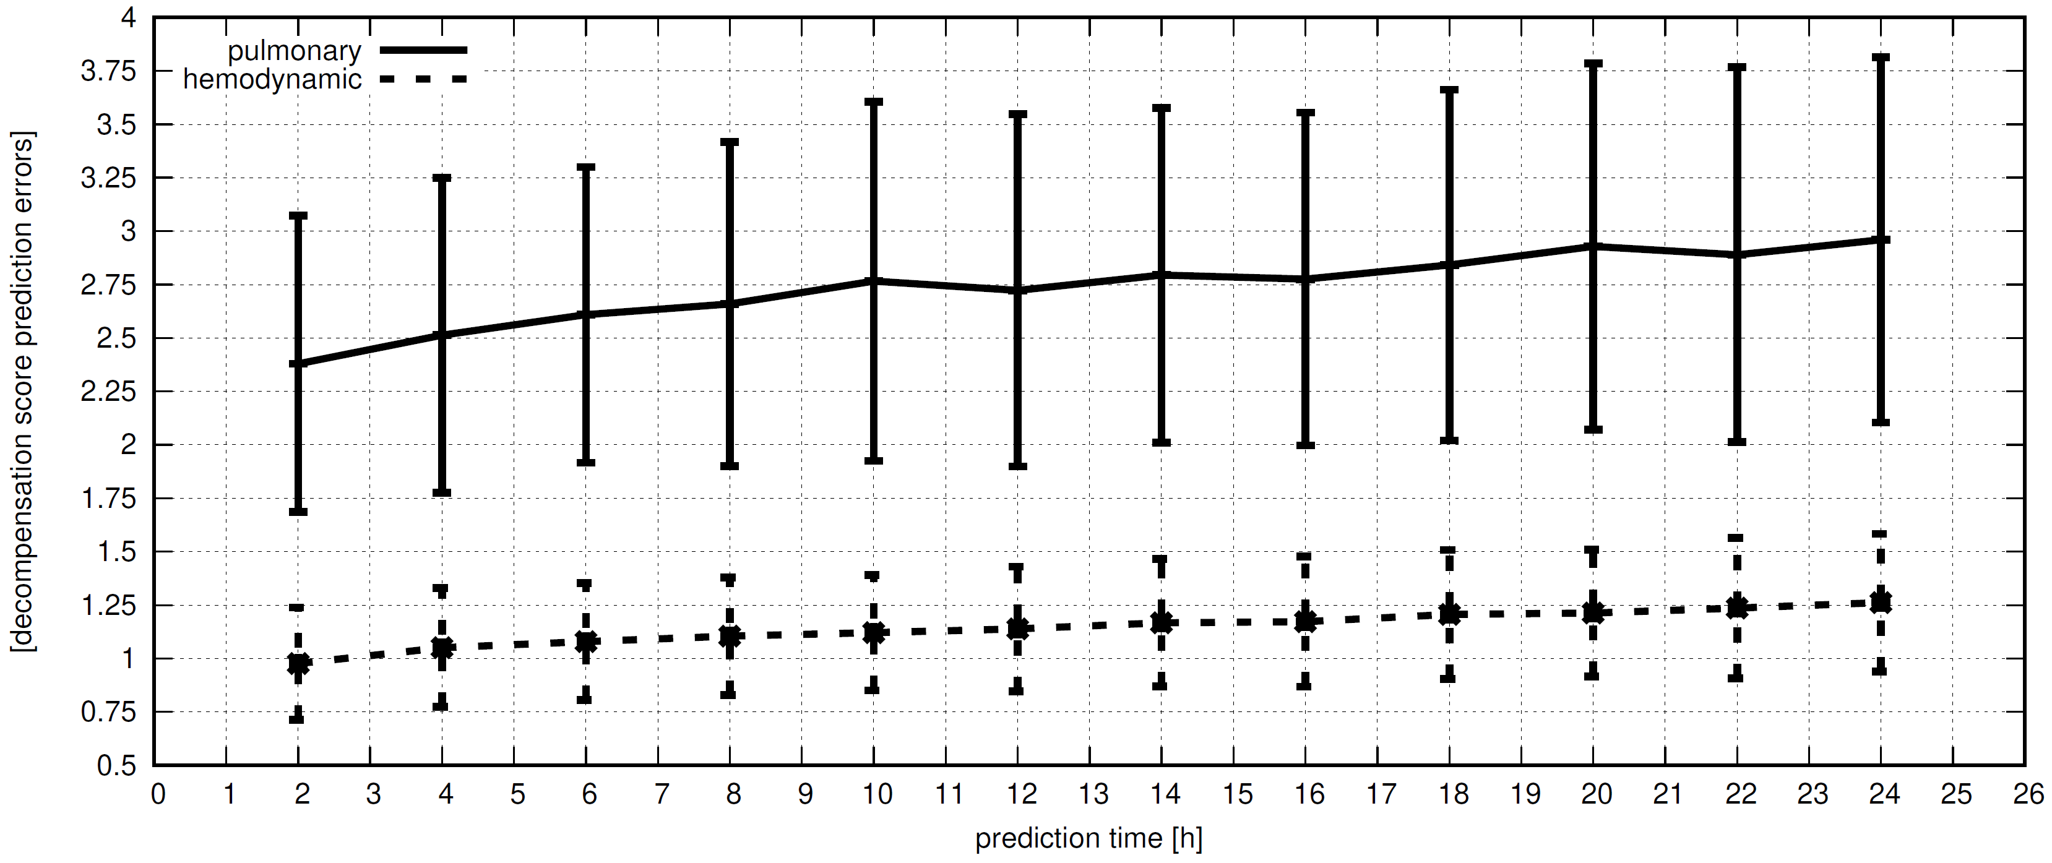
Evaluation: mean Decompensation Score Prediction Errors
9/11
Observation time: 60h; prediction time 2h-24h
10× repeated 10-fold cross-validation
Notes:
Mean Dec. Score Pred. Errors increase with prediction time horizon
Pulmonary: mean error ~= 6.3% of max score
Hemodynamic: mean error ~= 9.6% of max score
Current work suggests significant improvement when working on mov. avg. filtered decomp score TS

Slide 11
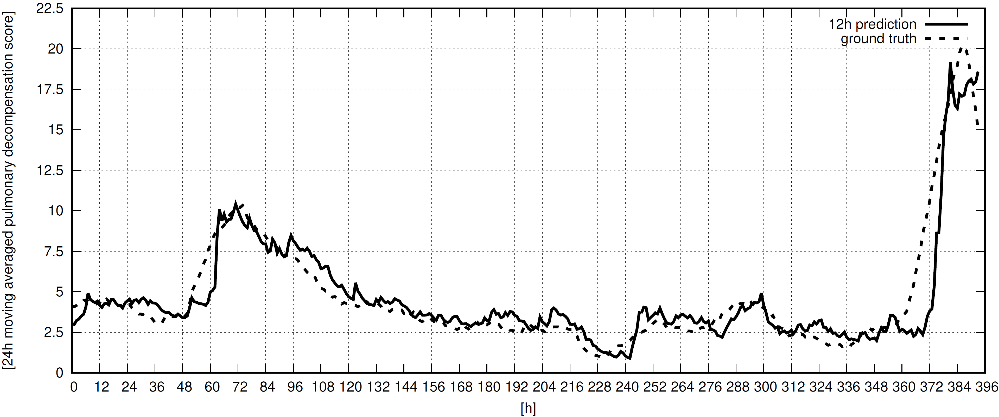
Evaluation: Exemplary Pulmonary Decompensation Score - Case 944
10/11
Observation time: 30h; prediction time 12h

Slide 12




Summary and Future Work
11/11
Decent classification and regression results during 1st evaluation
Reasonable Formulation of Decompensation Score rules
2nd evaluation end of 2022
  Prospective observational study in live operation
  using data models from 1st evaluation
  Validation of prediction performance
  Relation of medical outcomes to decompensation
  scores, e.g. intubation, resuscitation, or death
Explainability of data models
Notes:
Live evaluation for a) Validation of Dec. Score Definitions
b) Validation of Prediction Results

Slide 13
Using Gated Recurrent Unit Networks for the Prediction of
Hemodynamic and Pulmonary Decompensation
Thank you for your attention!

