Slide 1
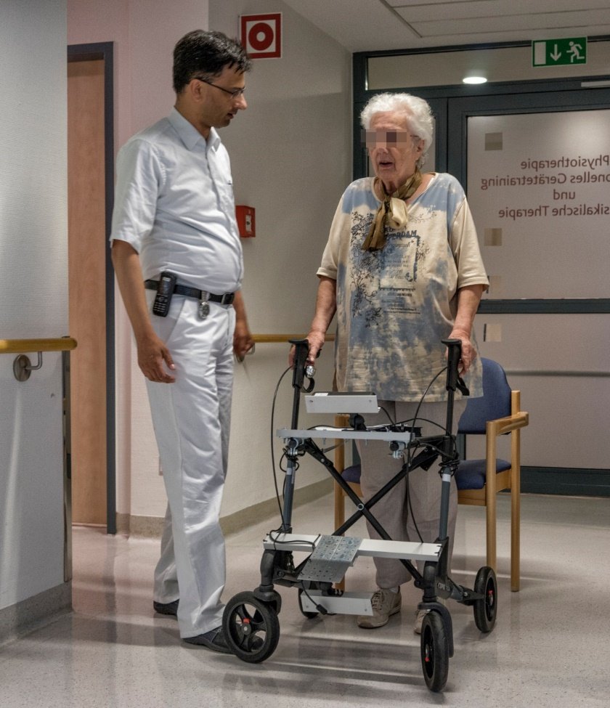


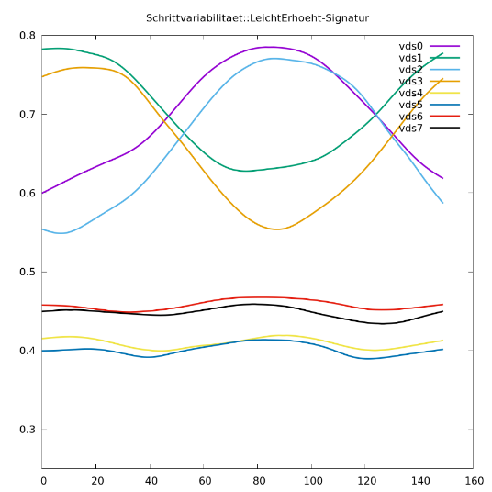
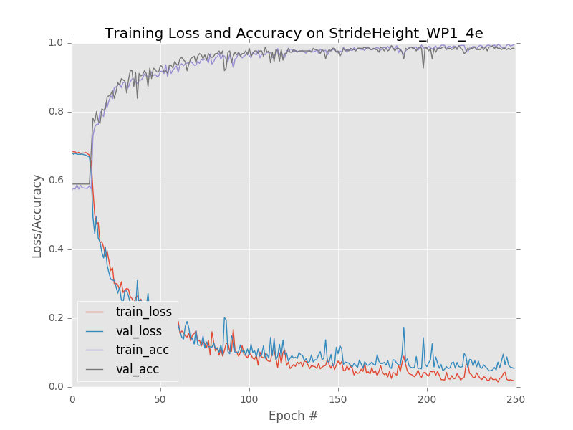
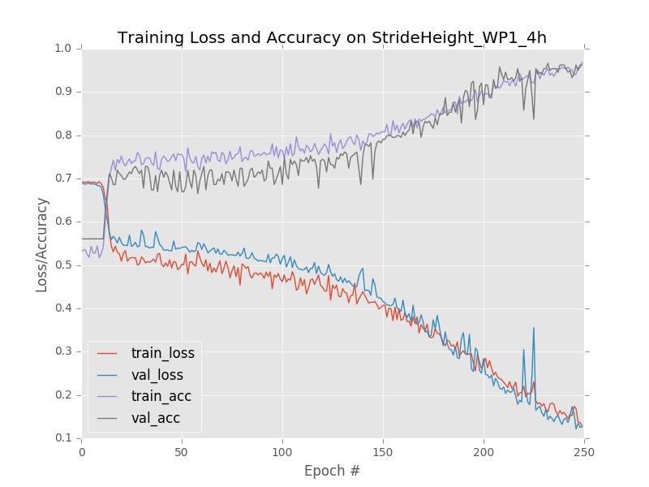
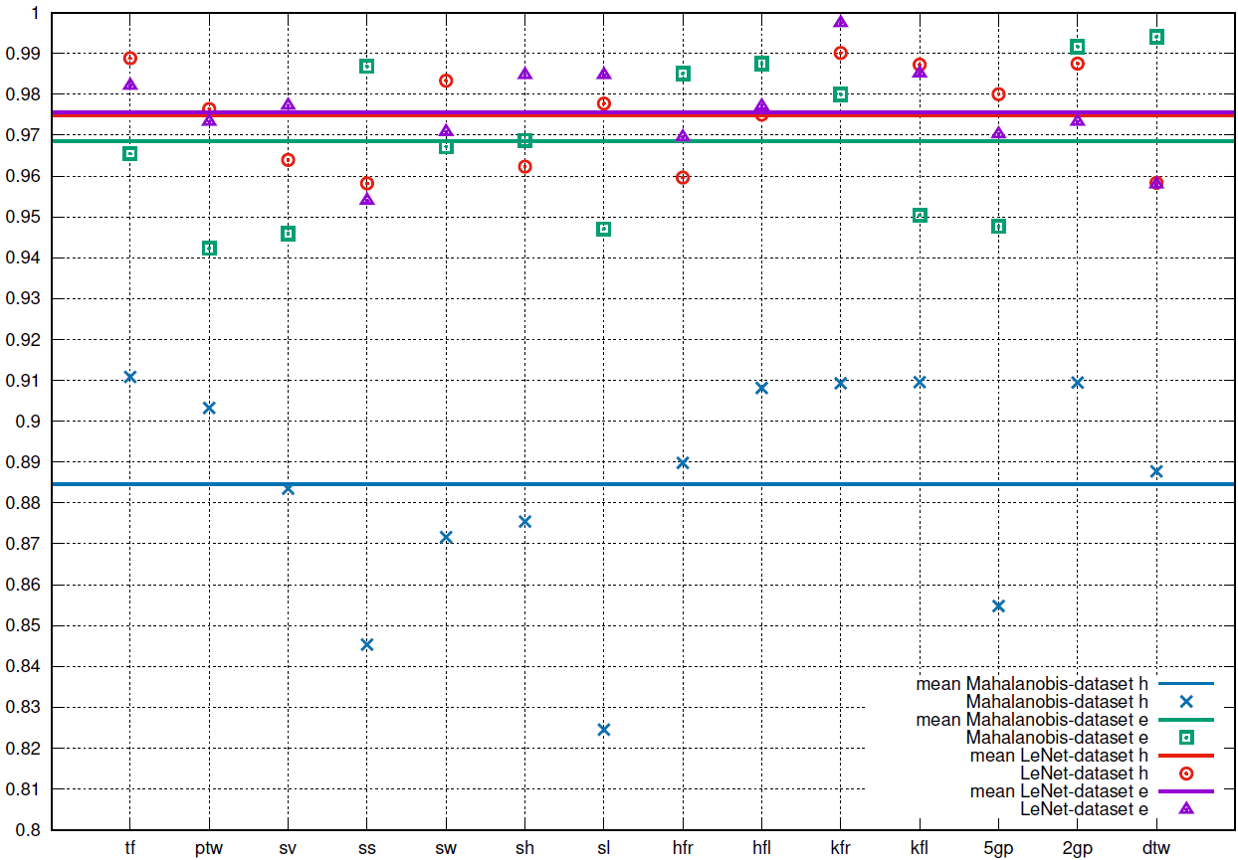
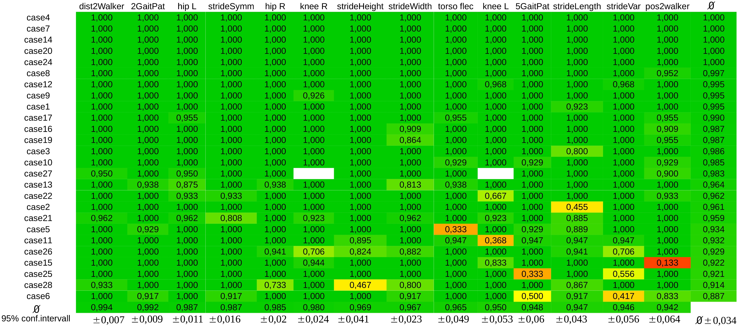
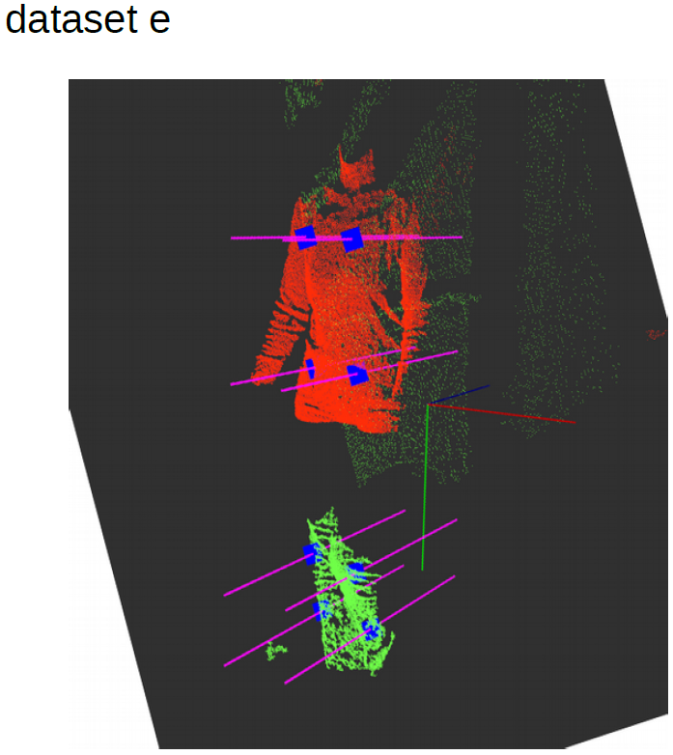
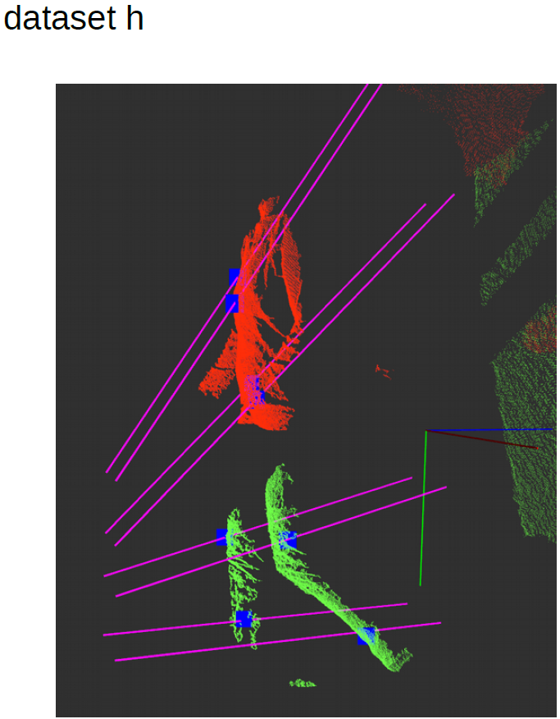
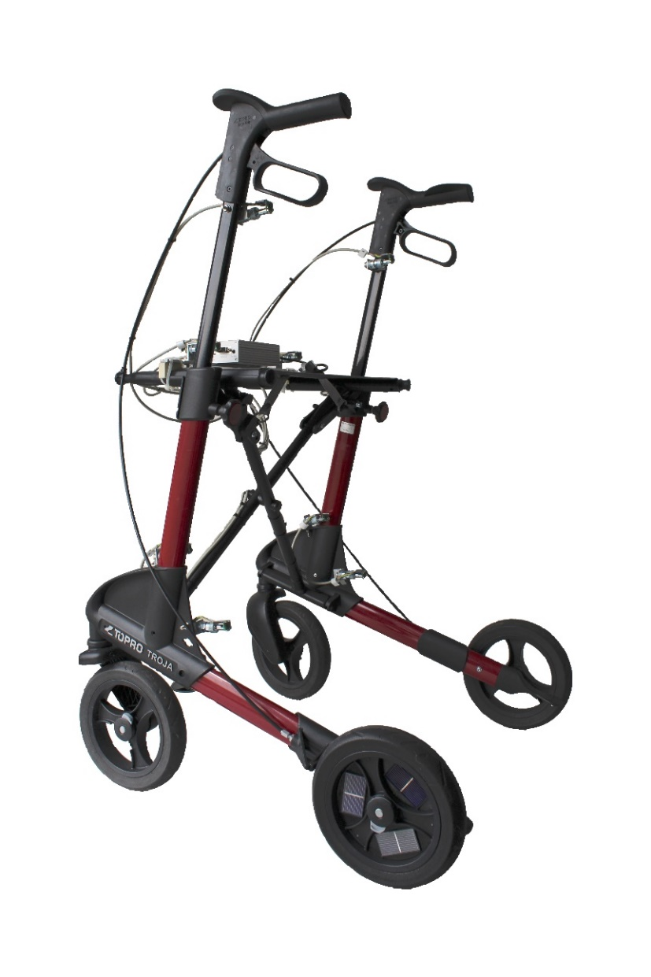
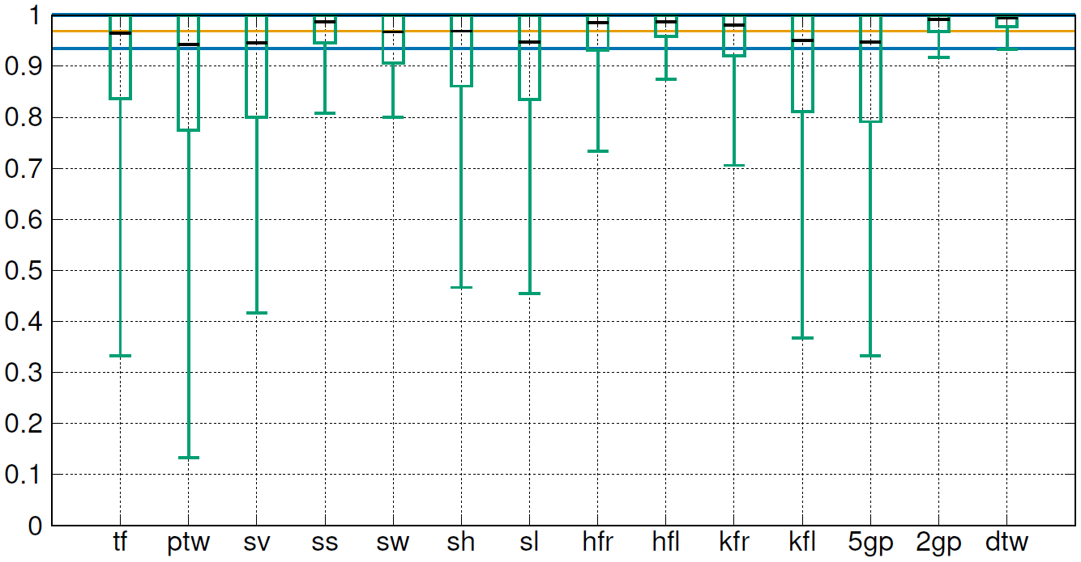
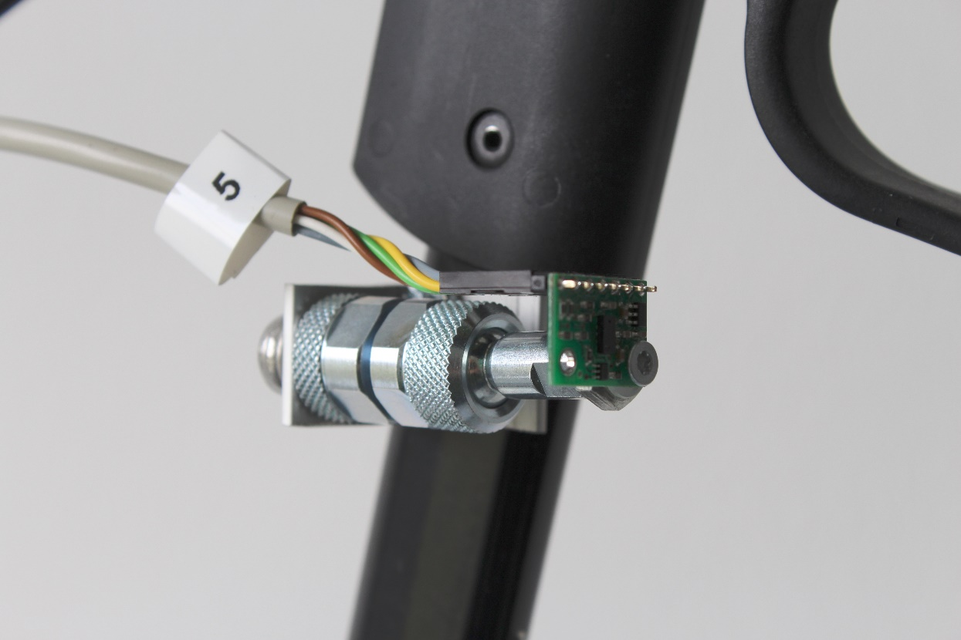




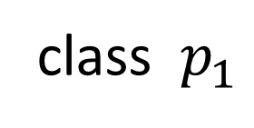
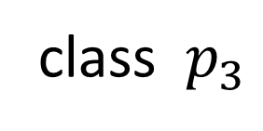
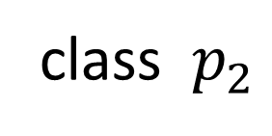
Experimental Evaluation
Ongoing and Future Work
Study Design
Observational study involving 24 stationary and out-patients aging from 47 to 93 years (Ø 74.3 years) + 5 healthy subjects
Each patient walked up and down an approx. 12m long hallway while being supported by the instrumented walker
During each trial, physiotherapists and a physician observed the gait properties under scope, and completed case report form that served as ground truth database for subsequent data classification
Gait Cycle Classification: Convolutional Neural Networks
Alternative to Mahalanobis distance-based classification method
Current implementation interprets time series of vds-readings as single/multi-channel images
Simple LeNet-architecture realized with and
Convergence rate of training/validation loss and accuracy depends on mounting configuration of (virtual) distance sensors
Classification rates outperform Mahalanobis distance-based classification method
Hard to embed into Microcontroller-based on-walker system
class $p_{1}$
class $p_{2}$
class $p_{3}$
Analysis and Discussion
Evaluable datasets from 26 cases show ground truth distribution for 14 gait properties
Classification rates and 95% confidence intervals for individual subjects and gait properties allow for assessment of single case observations
Average classification rate over all gait properties and cases is given by 96.9%
Mean cadence rate measurement error is given by 1.86% over all cases
Gait Property | Class 1 |  | Class 2 |  | Class 3 |  | Class 4 |  | Class 5
2 gait pattern (2gp) | physiological | 28.6% | pathological | 71.4% | ― |  | ― |  | ―
5 gait pattern (5gp) | physiological | 28.6% | antalgic | 20.4% | protective | 30.6% | atactic | 8.2% | paretic | 12.2%
position to walker (ptw) | centered | 51.0% | left deviating | 40.8% | right dev. | 8.2% | ― |  | ―
distance to walker (dtw) | normal | 57.1% | increased | 42.9% | ― |  | ― |  | ―
hip flection left (hfl) | 0°-10° | 59.2% | 10°-30° | 38.8% | >30° | 2.0% | ― |  | ―
hip flection right (hfr) | 0°-10° | 44.9% | 10°-30° | 44.9% | >30° | 10.2% | ― |  | ―
Knee flection left (kfl) | <0° | 12.8% | 0°-10° | 72.3% | 10°-30° | 10.6% | >30° | 4.3% | ―
knee flection right (kfr) | <0° | 12.8% | 0°-10° | 63.8% | 10°-30° | 23.4% | ― |  | ―
torso flection (tf) | upright | 36.7% | anteflexed | 59.2% | retroflexed | 4.1% | ― |  | ―
stride symmetry (ss) | uniform | 46.9% | left deviating | 24.5% | right dev. | 28.6% | ― |  | ―
stride width (sw) | normal | 69.4% | narrow | 16.3% | broad | 14.3% | ― |  | ―
stride variability (sv) | regular | 61.2% | slightly incr. | 20.4% | irregular | 18.4% | ― |  | ―
stride length (sl) | normal | 61.2% | reduced | 34.7% | increased | 4.1% | ― |  | ―
stride height (sh) | normal | 65.3% | reduced | 34.7% | ― |  | ― |  | ―
Ratio of hand-measured and estimated cadence rate
New Walker Prototype
Replace virtual distance sensors that sample from depth camera output by 1D Lidar sensors mounted on ball heads
On-walker computation using ARM-based microcontroller running embedded Linux
Second evaluation with new walker prototype started in May 2018
¹German Research Center for Artificial Intelligence
Department for Cyber Physical Systems
Bremen, Germany
²Hospital Bremen Nord, Clinic for Geriatrics
³Gesundheit Nord gGmbH
Bremen, Germany
⁴Budelmann Elektronik GmbH
Münster, Germany
⁵Topro GmbH
Fürstenfeldbruck, Germany

