Slide 1
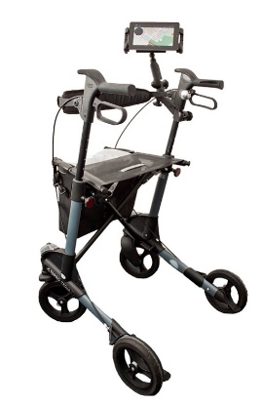
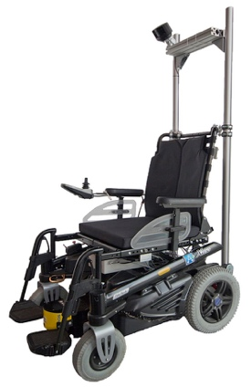
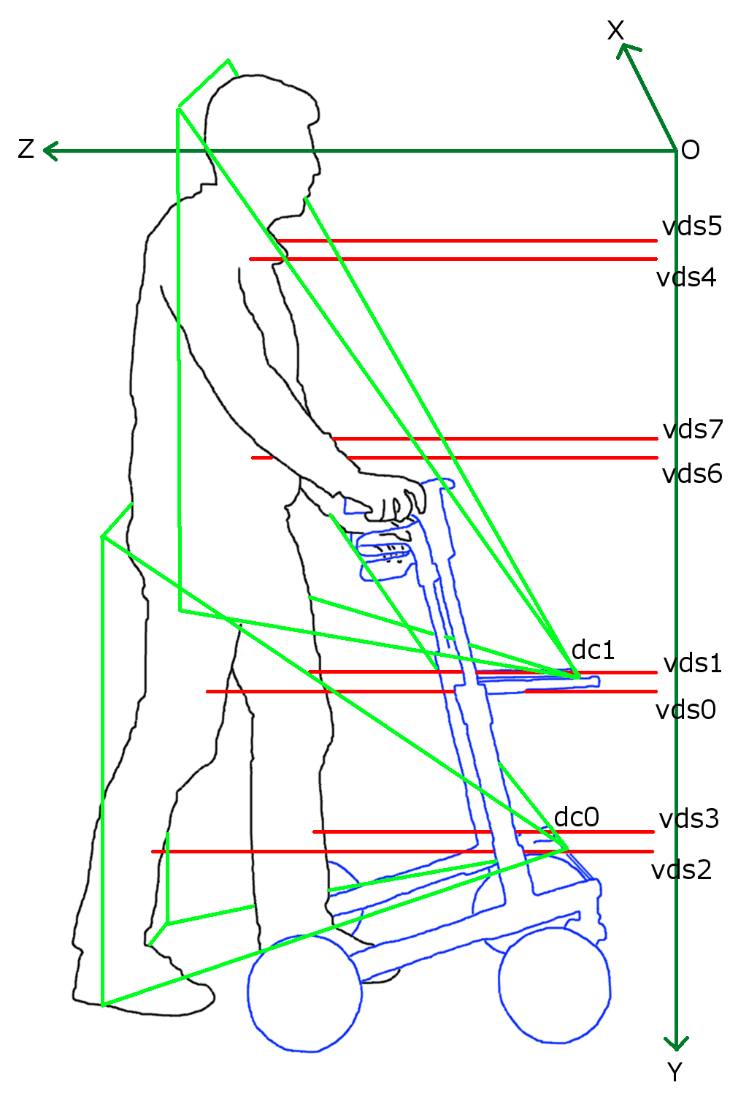
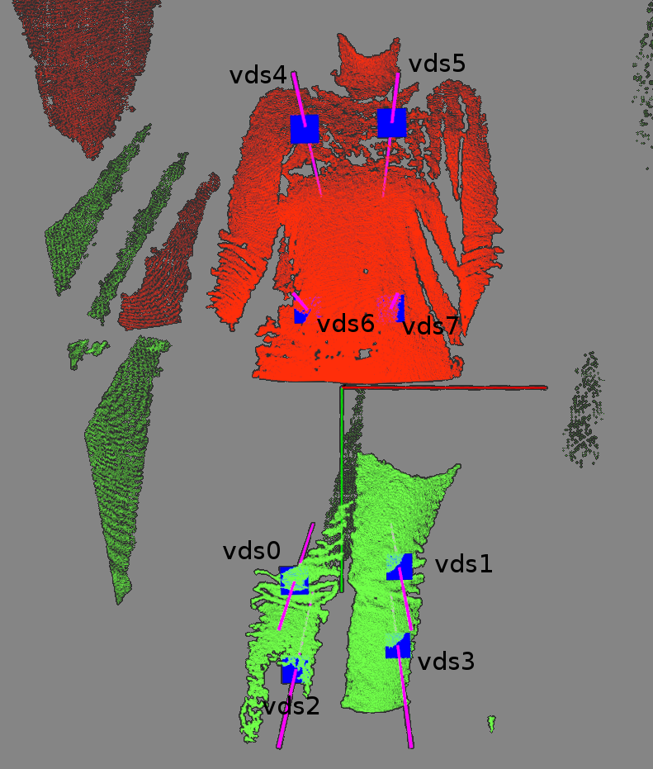
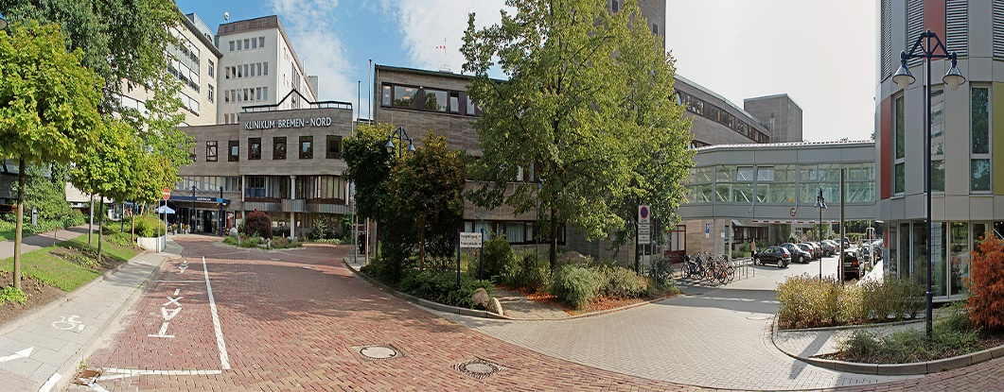

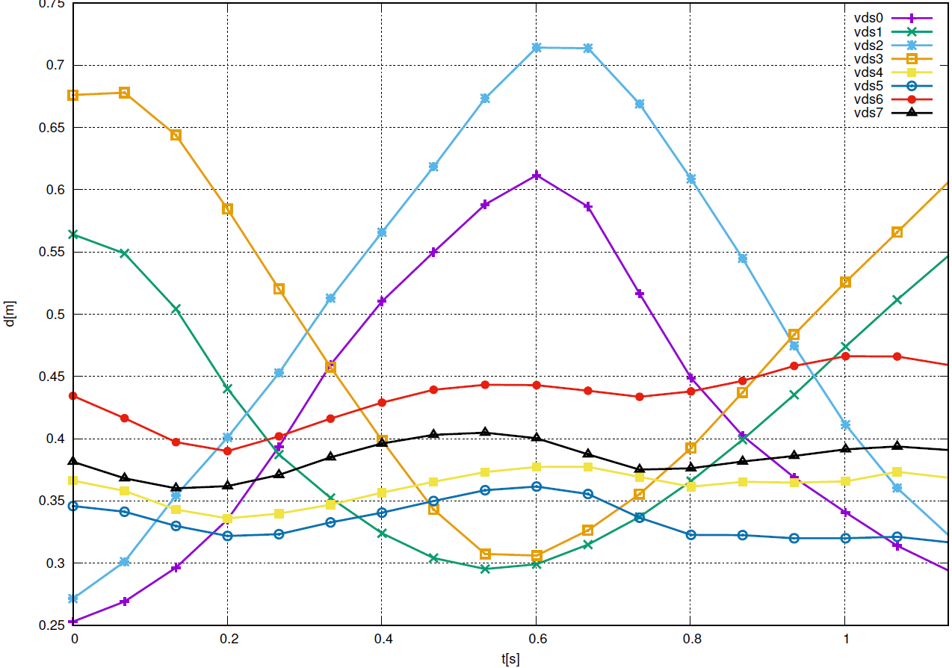
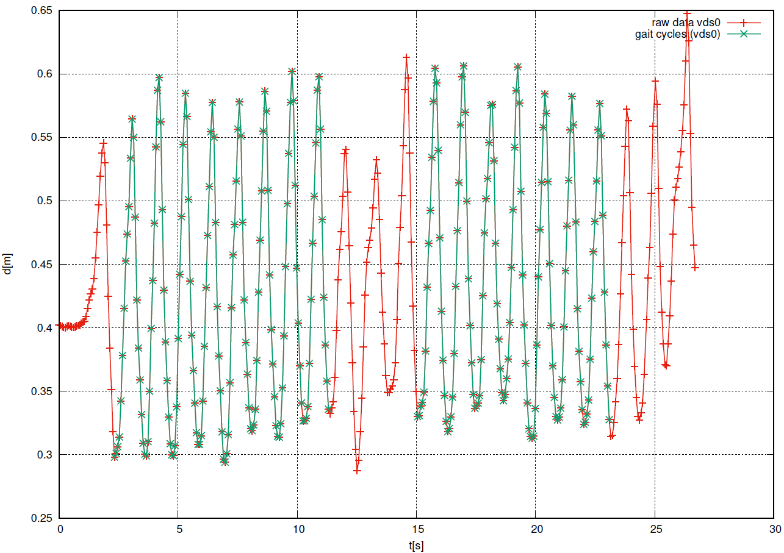
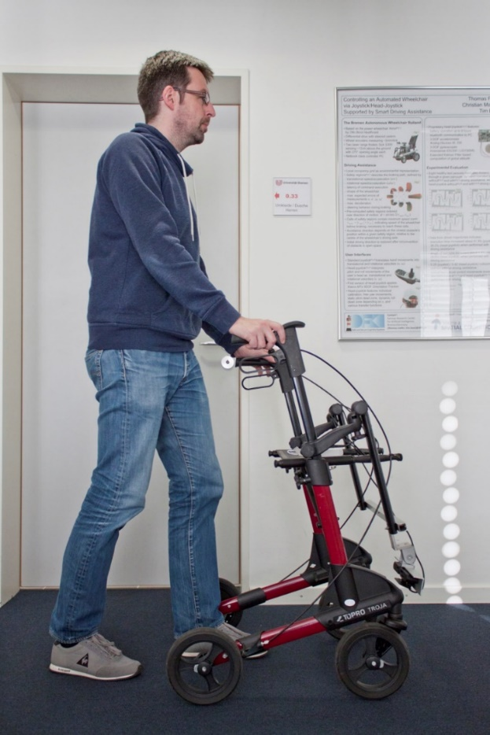
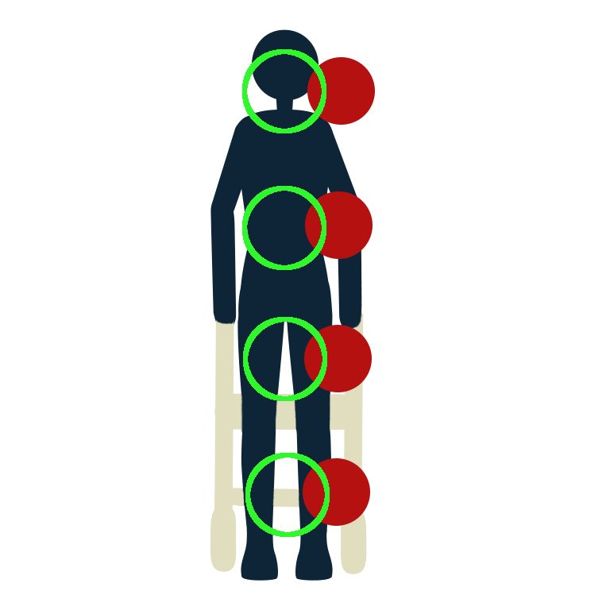
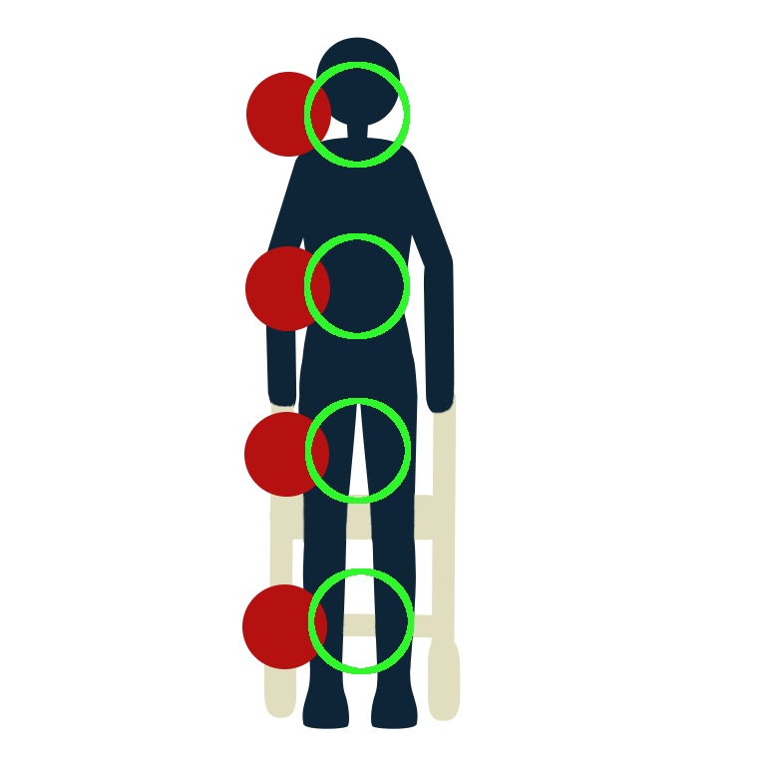
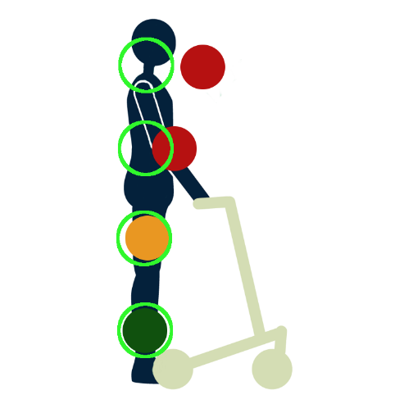
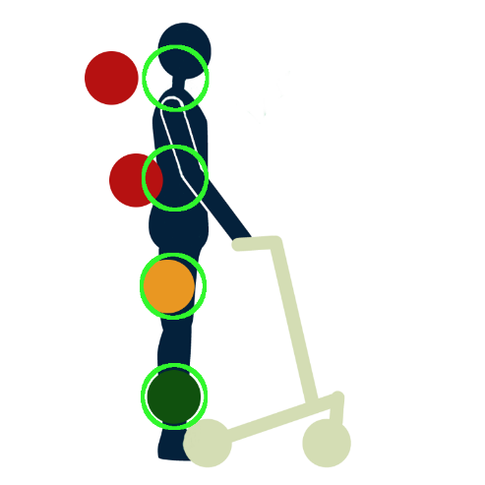
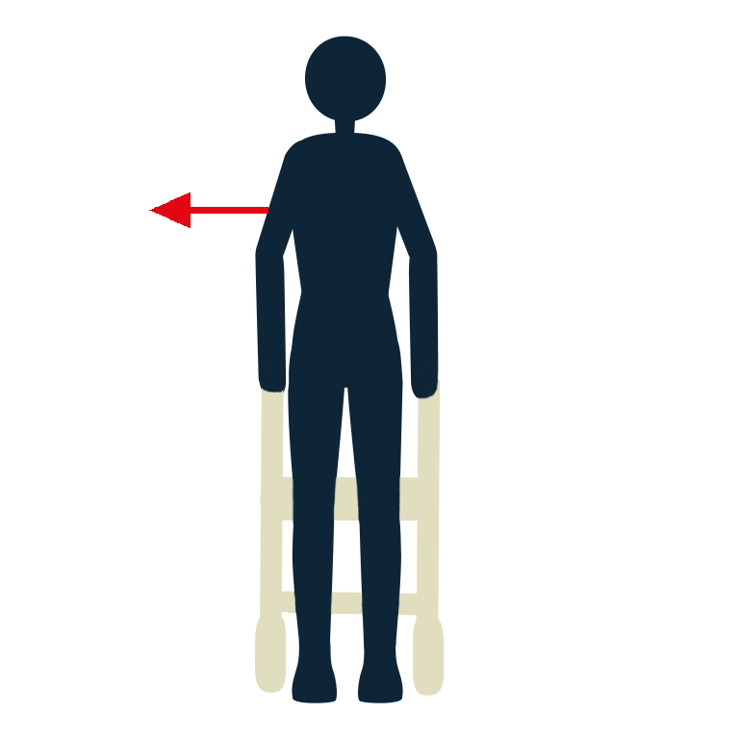
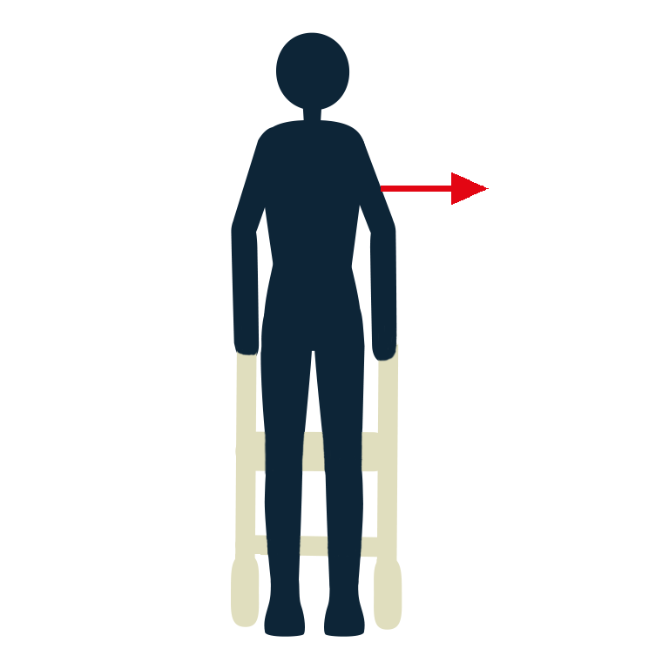
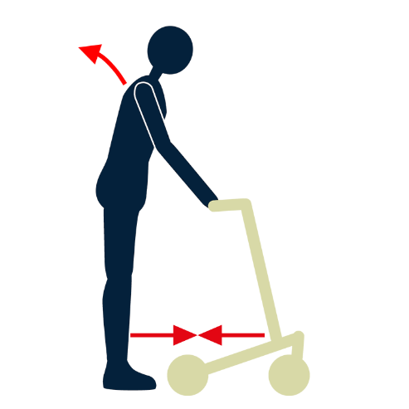
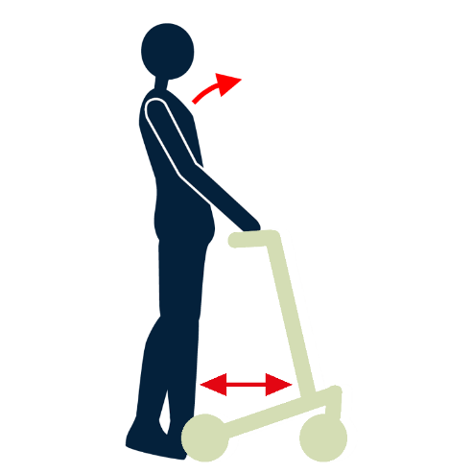

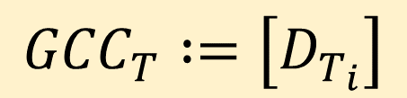
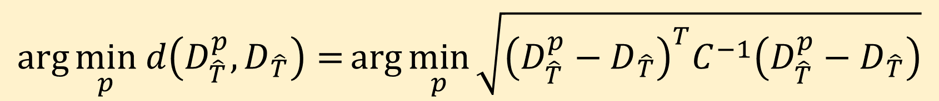
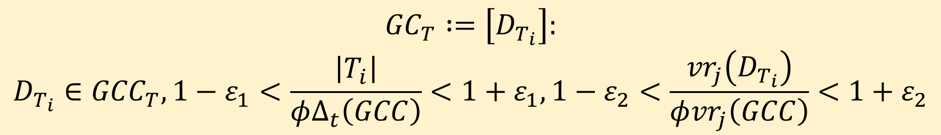

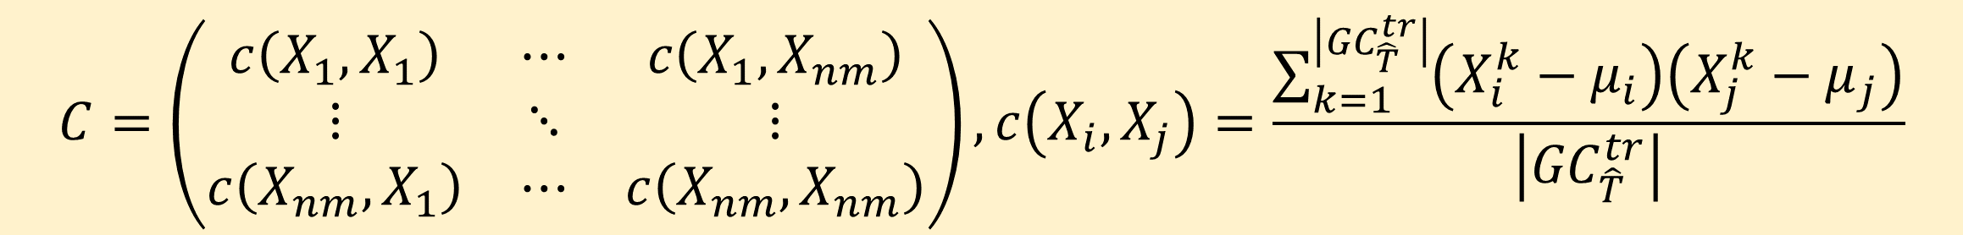
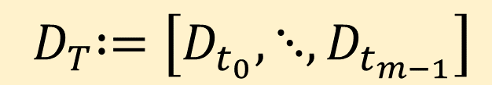
Gait Cycle Classification for Wheeled Walker Users by Matching Time Series Of Distance Measurements
Christian Mandel¹, Amit Choudhury², Serge Autexier¹, Karin Hochbaum³, Jeannine Budelmann⁴, Petra Wedler⁵
Project: Walker Module for Posture Detection and Fall Prevention - ModESt
Methods
Methods
Consortium
DFKI GmbH: Non-profit PPP research center on Artificial Intelligence
Research department Cyber Physical Systems explores AAL solutions and intelligent mobility devices, such as indoor/outdoor walkers & wheelchairs
Gesundheit Nord gGmbH: Municipal hospital network in Bremen
Specialized in geriatric disciplines, e.g. stroke, traumatology, dementia, diagnosis and therapy of gait disorders, and assistive equipment
Budelmann Elektronik GmbH: Small to mid-sized enterprise
Specialized in embedded systems: development of customized electronic solutions, from compact microcontroller-assemblies to complex industrial PCs
Topro GmbH: Subsidiary of Norwegian company Topro AS
Topro produces and markets broad range of assistive equipment, e.g. wheeled walkers and stand up chairs
Data Acquisition and Representation
Two Asus Xtion Pro depth cameras mounted at the walker’s front sense distance to the user’s body
Eight virtual distant sensors (vds) sample time-series of distances from point clouds
vds are defined in dependence of the person’s body height and aim roughly at body surface in height of tibia, femoral, iliac crest, and shoulder
Measurements taken at time t: and during period T:
$$D_{t}∶=\left[d_{t}^{0},⋯,d_{t}^{n−1}\right]$$
$${ D}_{T}∶=\left[D_{t_{0}},⋱,D_{t_{m−1}}\right]$$
Gait Cycle Extraction and Filtering
Human gait cycle is defined by timespan between two consecutive ground contacts of the same foot → not measurable by vds
Instead, partition movement pattern at points in time where vds aiming at tibia is maximal
Set of resulting gait cycle candidates given by:
For later classification, filter out gait cycle candidates that result from unusual walking behavior, e.g. turning on the spot duration of gait cycles value range of gait cycles
$${GCC}_{T}∶=\left[D_{T_{i}}\right]$$
Problem Description
Gait disorders and falls rank amongst the most frequent functional disorders of elderly patients
Declining muscular strength, degenerating visual perception, decreasing nerve conduction velocity, muscular-skeletal system illness → typical changes of the human gait pattern
Gait disorders and falls represent significant challenges in geriatric diagnostics and therapy
Wheeled walkers are commonly deployed to support walking
Proper utilization is an essential prerequisite
$${GC}_{T}∶=\left[D_{T_{i}}\right]:$$
$$D_{T_{i}}∈{GCC}_{T}, 1−ε_{1}<\frac{\left|T_{i}\right|}{φΔ_{t}\left(GCC\right)}<1+ε_{1},1−ε_{2}<\frac{{vr}_{j}\left(D_{T_{i}}\right)}{φ{vr}_{j}\left(GCC\right)}<1+ε_{2}$$
Gait Cycle Classification: Mahalanobis Distance on Time Series
Resample measurements for all gait cycles in ${GC}_{T}$, e.g. 30 distance values for each vds
Specify discrete valued gait cycle properties to be classified, e.g. stride height:
For each class $p$ of a given gait cycle property $P$, compute centroid $D_{\hat{T}}^{p}$ and covariance matrix $C$ from training dataset, e.g. for normal stride height:
For each gait cycle $D_{\hat{T}}$ from test dataset, to be evaluated against gait property $P$, minimize Mahalanobis distance
Solution Approach
Monitor gait properties with walker-mounted simple sensorial equipment
Classify time series of distance measurements w.r.t. set of gait properties
Provide user-feedback about insecure gait properties to be corrected
Possible user interface designs will be evaluated in the next project phase
UI design proposals differentiate between visualization of false posture and hints for correction
$$P_{sh}\left(D_{\hat{T}}\right)∈\left\{normal,reduced\right\}$$
$$C=\left(\begin{matrix}c\left(X_{1},X_{1}\right) & ⋯ & c\left(X_{1},X_{nm}\right) \\ ⋮ & ⋱ & ⋮ \\ c\left(X_{nm},X_{1}\right) & ⋯ & c\left(X_{nm},X_{nm}\right)\end{matrix}\right), c\left(X_{i},X_{j}\right)=\frac{\sum_{k=1}^{\left|{GC}_{\hat{T}}^{tr}\right|}{\left(X_{i}^{k}−μ_{i}\right)\left(X_{j}^{k}−μ_{j}\right)}}{\left|{GC}_{\hat{T}}^{tr}\right|}$$
vs.
$$\arg{\min_{p} d\left(D_{\hat{T}}^{p},D_{\hat{T}}\right)={\arg{\min_{p}{\sqrt{{\left(D_{\hat{T}}^{p}−D_{\hat{T}}\right)}^{T}C^{−1}\left(D_{\hat{T}}^{p}−D_{\hat{T}}\right)}}}}}$$

