Slide 2
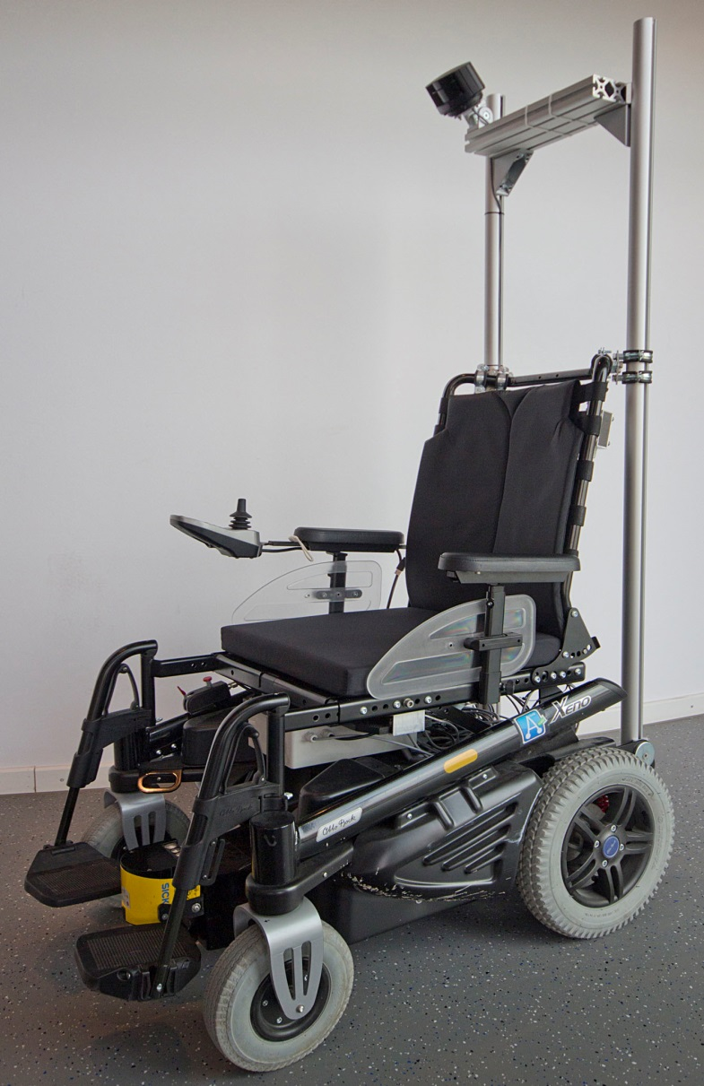
Driving Assistance ^{1,2,3}
Perception
Safety Regions
User Interfaces ^{1,2,3}
Hand Joystick
Head Joystick
Brain-Computer Interface ⁵
Speech Interface ⁶
Evaluation^{1,2,3,4}
Setup
Subjects
Procedure
Criteria
Results
Ongoing/Future Work ^{1,2,3}
3D Driving Assistance
ASSAM Evaluation
¹ Bernd Gersdorf
² Christian Mandel
³ Thomas Röfer
⁴ Insa Lohmüller
⁵ Thorsten Lüth
⁶ Robert Ross

Slide 3
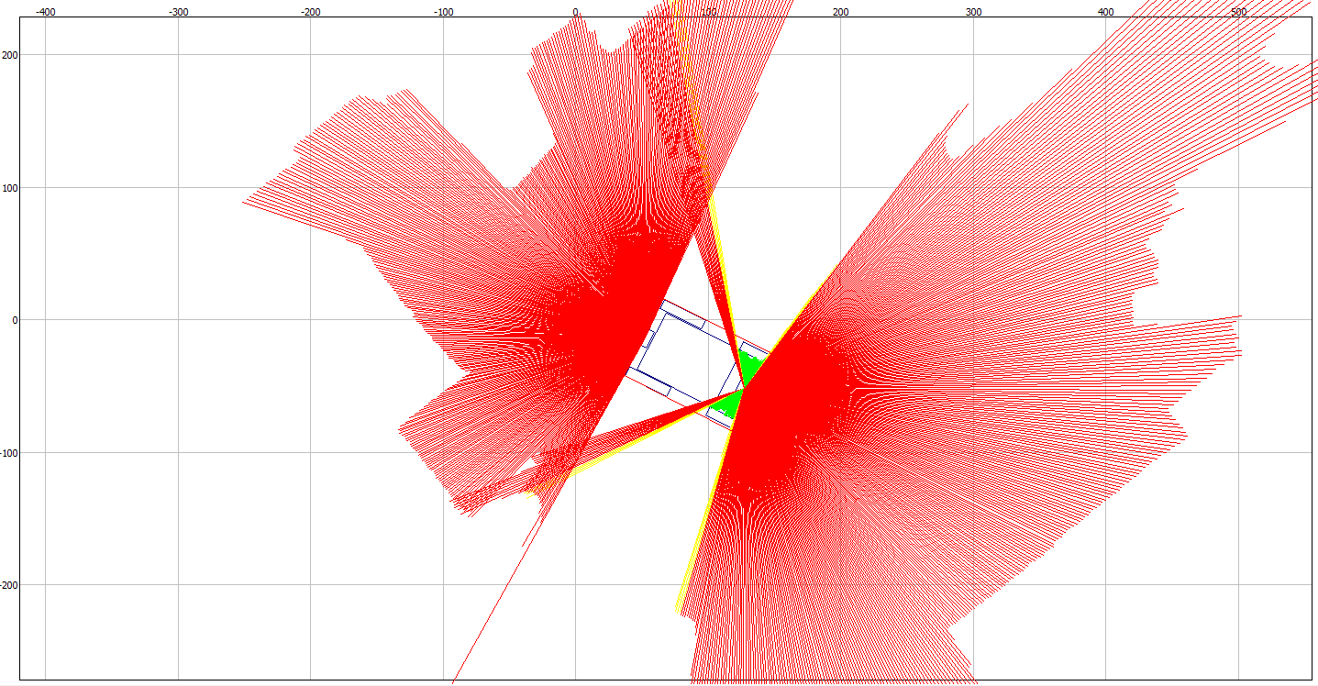
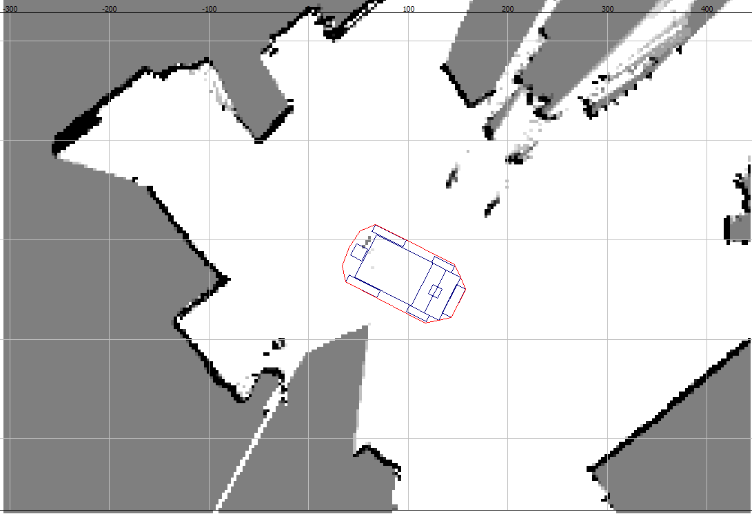
Introduction | User Interfaces | Evaluation | Ongoing/Future Work
Driving Assistance
Perception
Sick S300 sensing 12cm above ground with 270° opening angle each
Wheel encoders with 2mm driving distance/tick
2D laser range finder readings
Local occupancy grid integrated over history of lrf readings & odometry

Slide 4
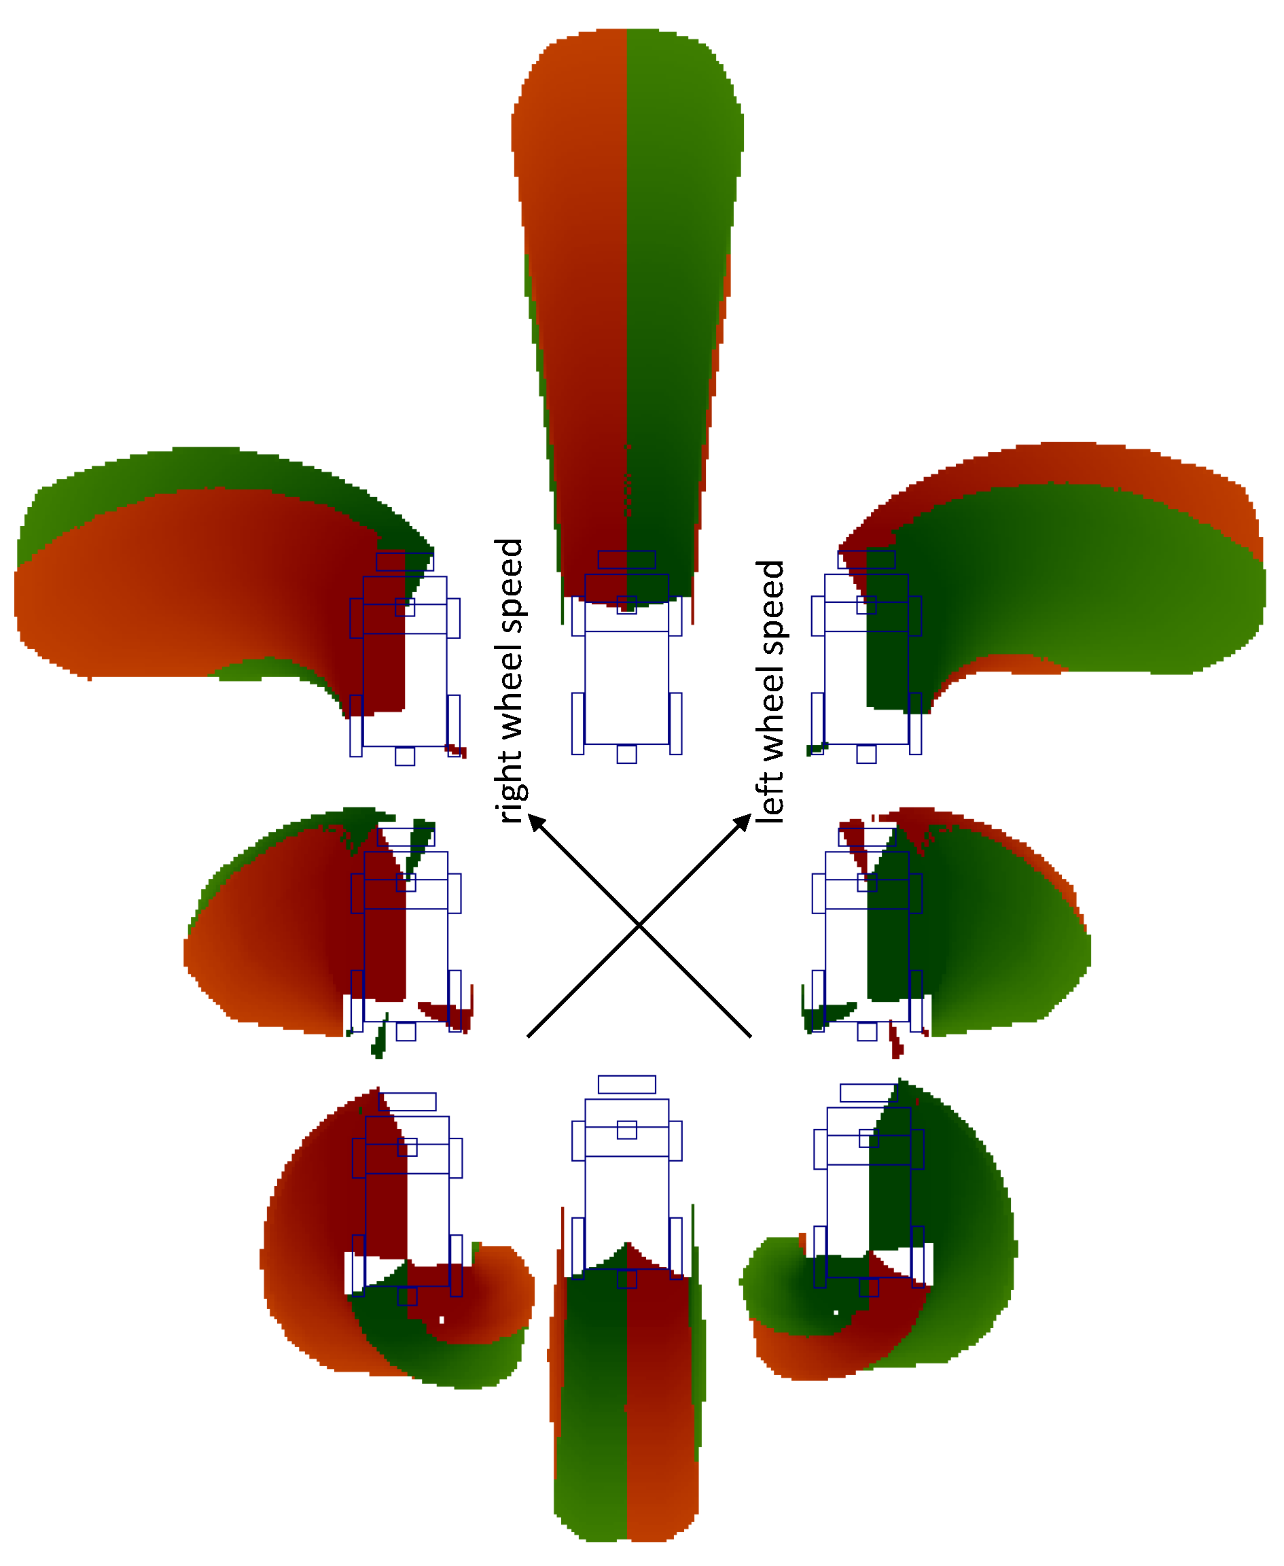
Introduction | User Interfaces | Evaluation | Ongoing/Future Work
Driving Assistance
Safety Regions
Describe the breaking path defined by:
speed & acceleration (v, v’, ω, ω’)
latency of command execution
shape of the wheelchair
max. expected errors for speed & acceleration
max. deceleration

Slide 5
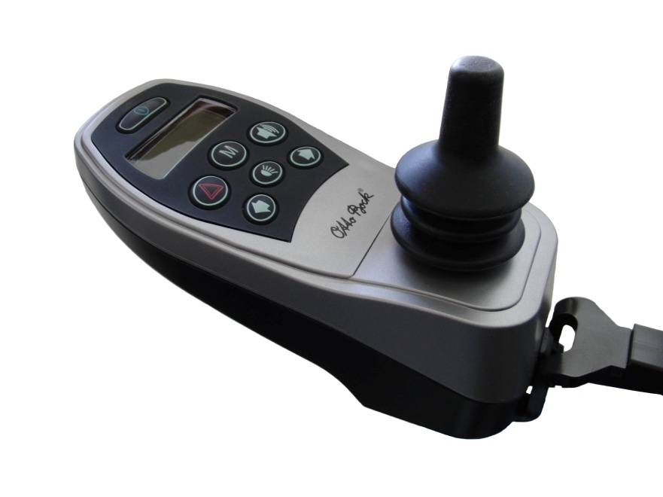
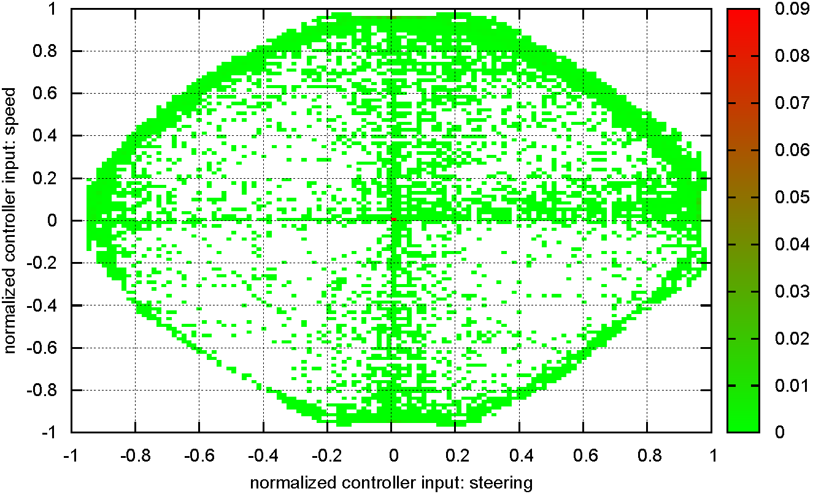
Driving Assistance | User Interfaces | Evaluation | Ongoing/Future Work
User Interfaces
Hand Joystick
Translates hand movements into translational and rotational velocities (v, ω)
Traditional user interface for wheelchair bound persons
Does not suite certain disabilities, e.g. tetraplegia

Slide 6
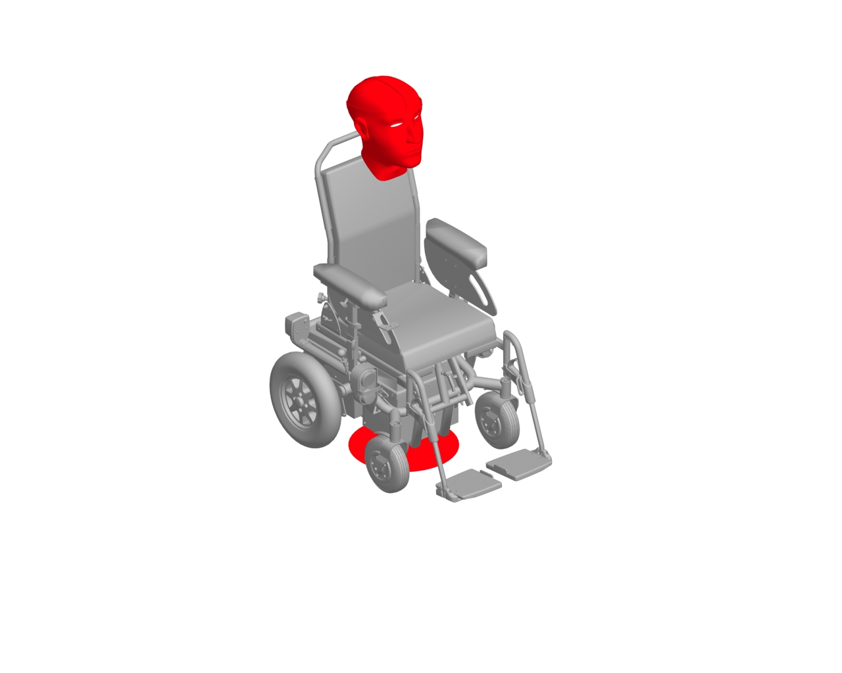
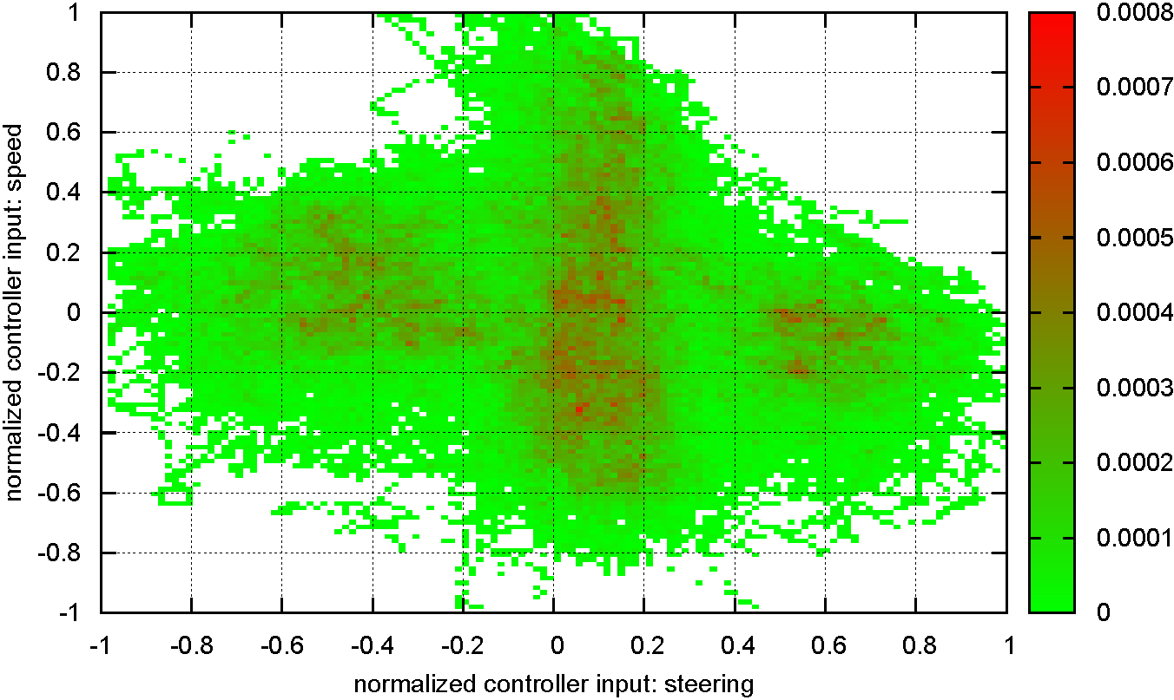
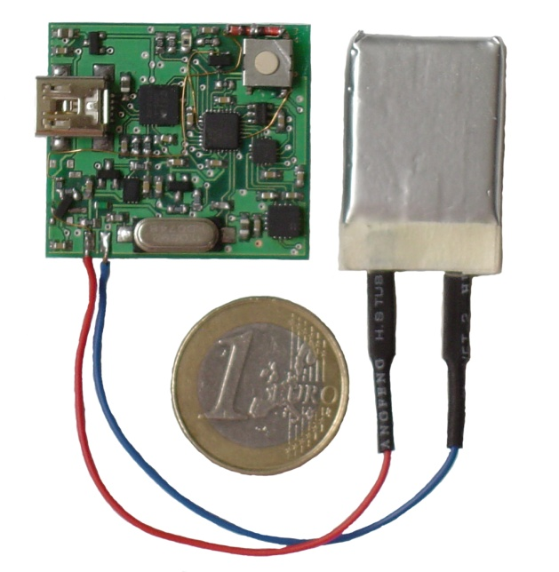
Driving Assistance | User Interfaces | Evaluation | Ongoing/Future Work
User Interfaces
Head Joystick
Interprets pitch and roll movements of the user’s head as translational and rotational velocities (v, ω)
Inertial measurement unit
Cable-bound (XSens)
Proprietary (Bluetooth 2.1/4.0)
Dynamic (roll) dead-zone
[Mandel2009a]

Slide 7
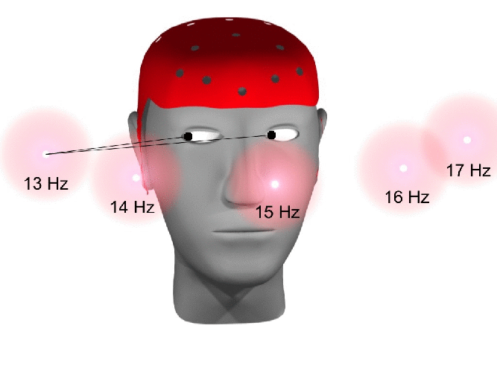
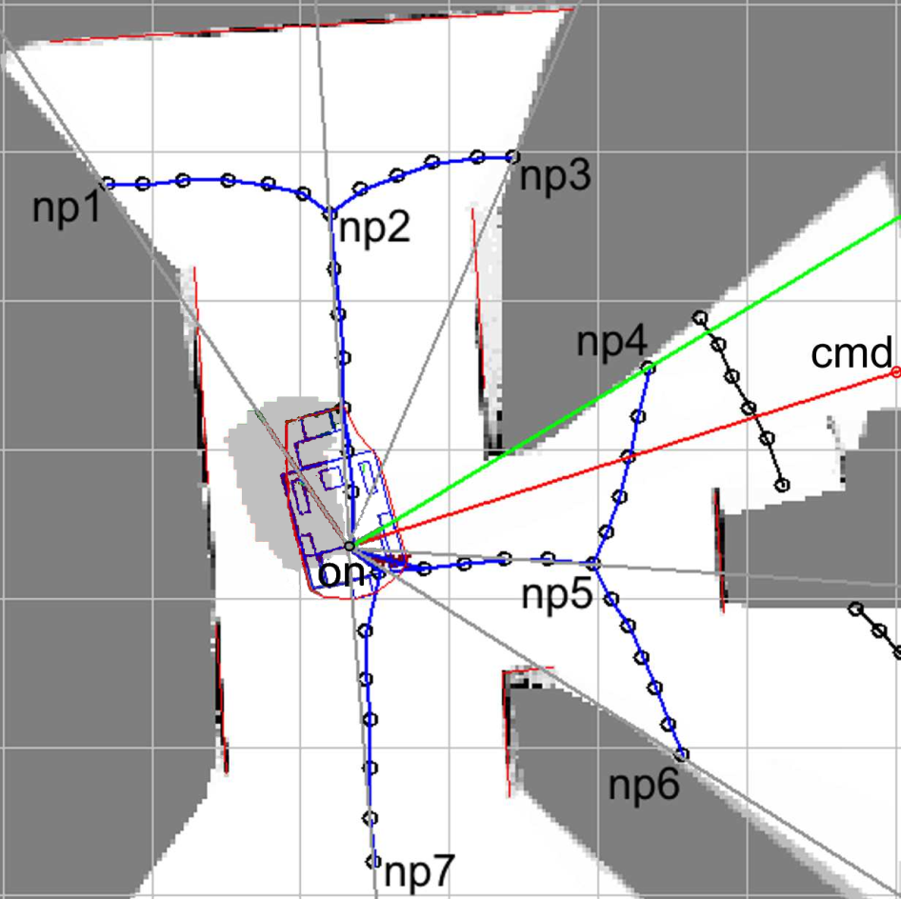

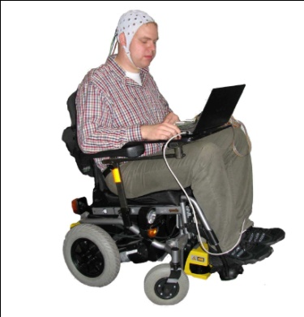
Driving Assistance | User Interfaces | Evaluation | Ongoing/Future Work
User Interfaces
Brain-Computer Interface
the bigger picture
Non-invasive, SSVEP-based brain-computer interface generating qualitative directional driving commands
Minimum energy combination
Generalized squared DFT
Threshold based linear classifier
Filtered signal
Feature vector
Classification result
Raw signal
Directional driving command
[Mandel2009b]

Slide 8
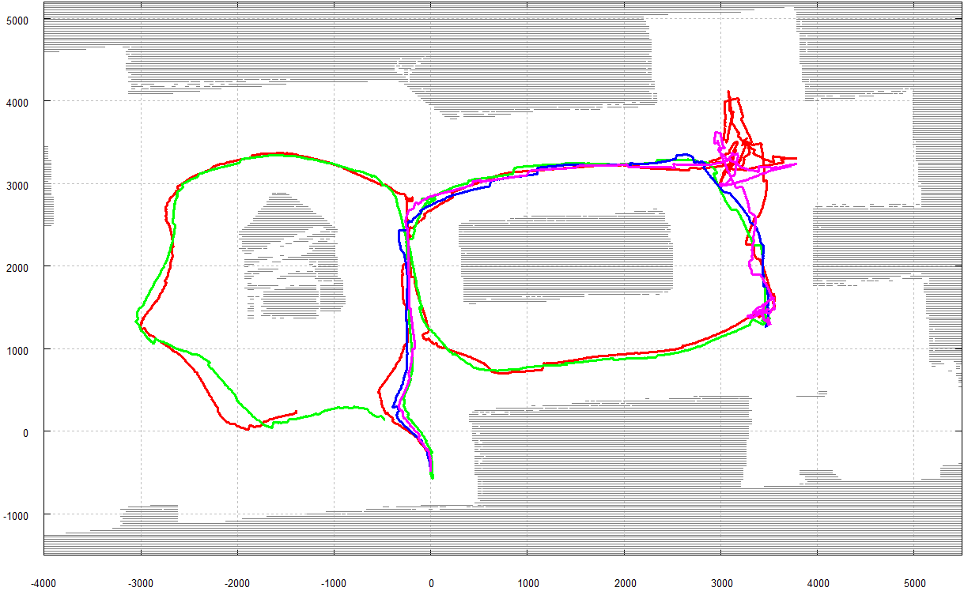
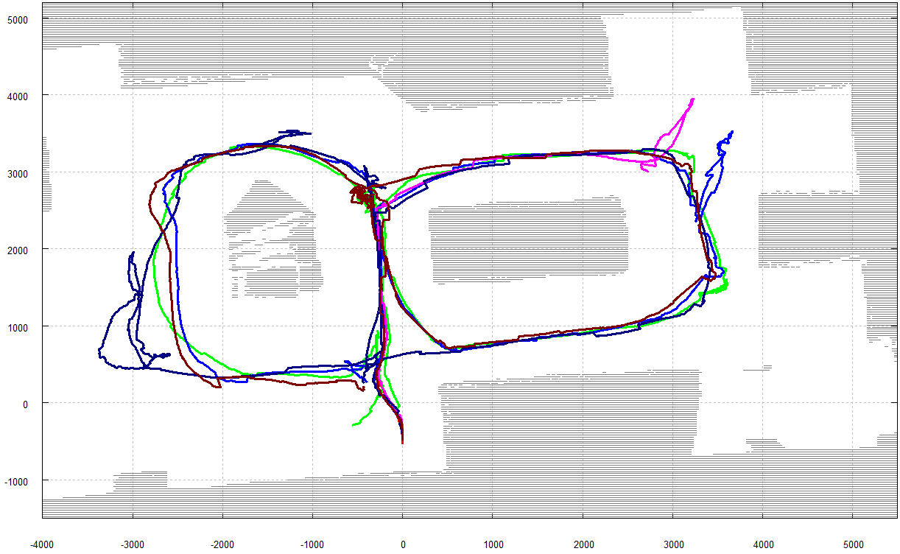
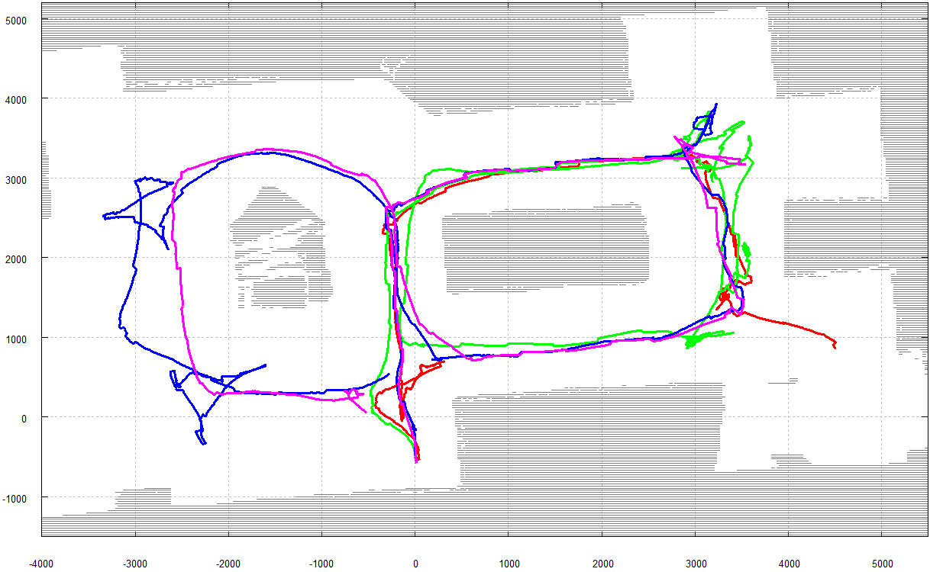
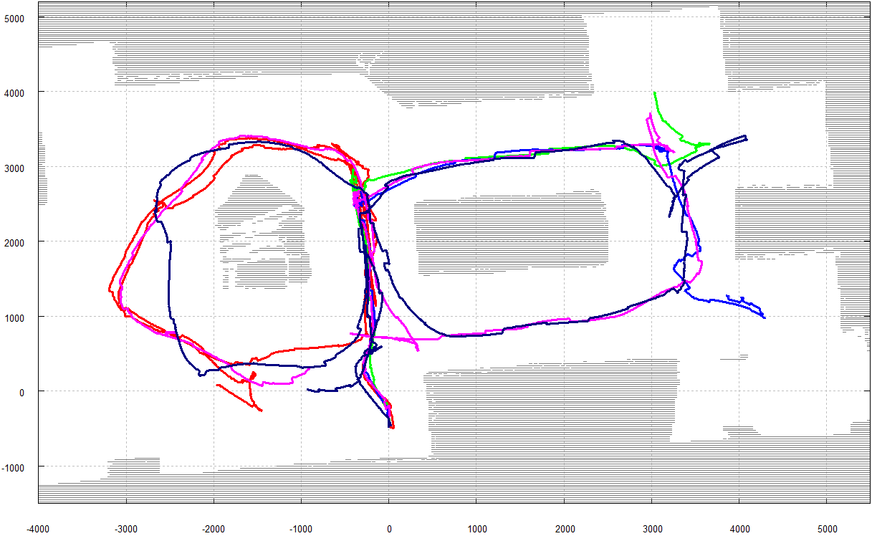
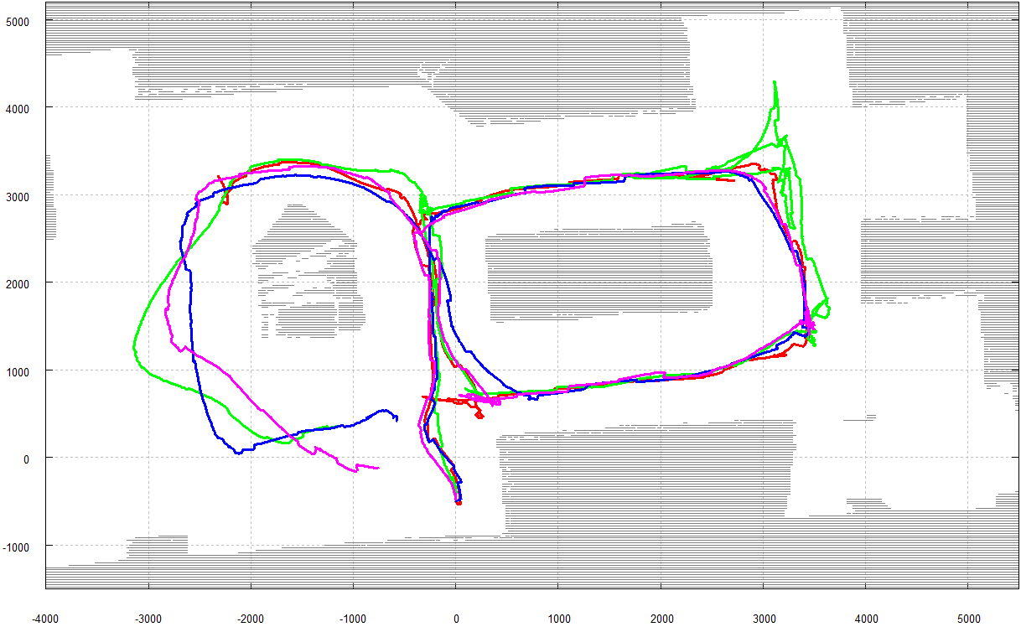
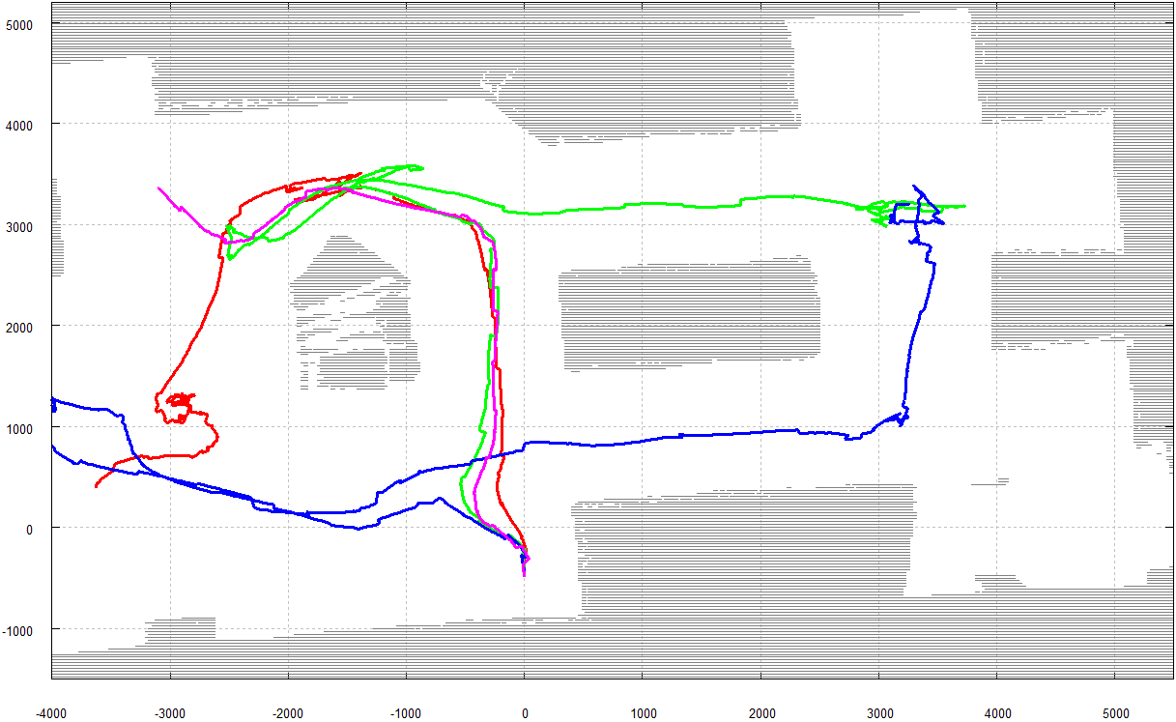
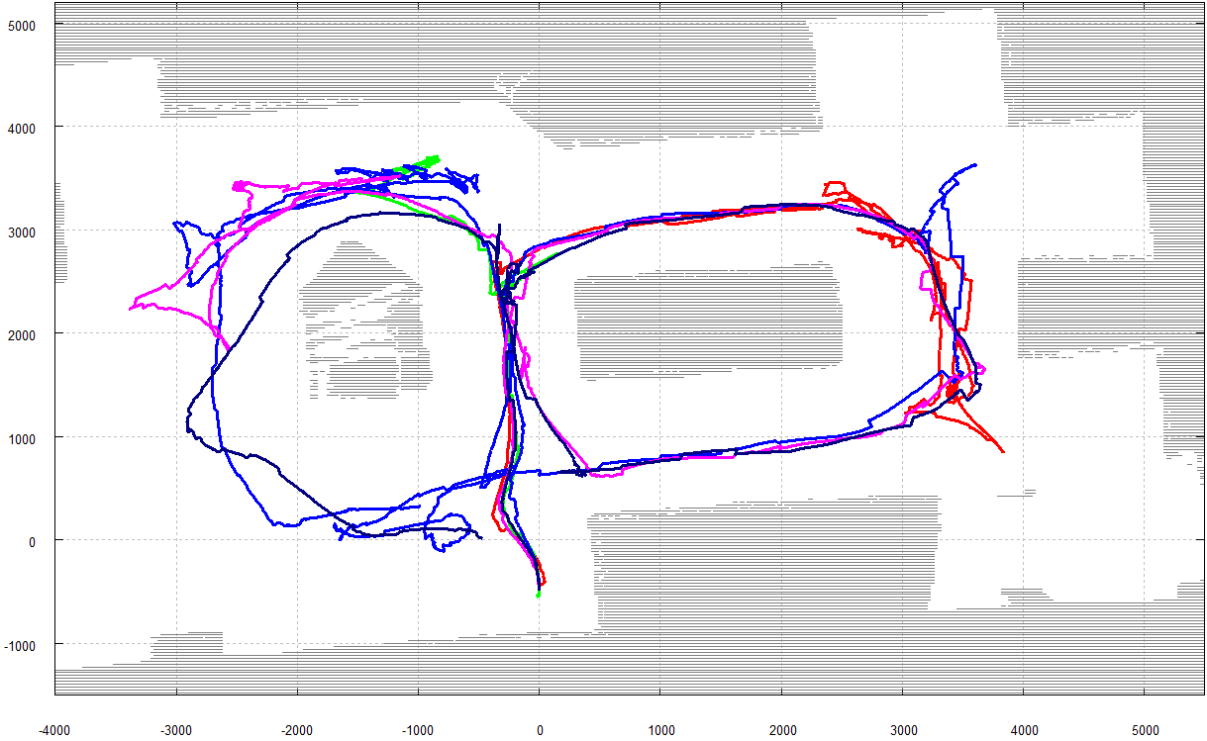
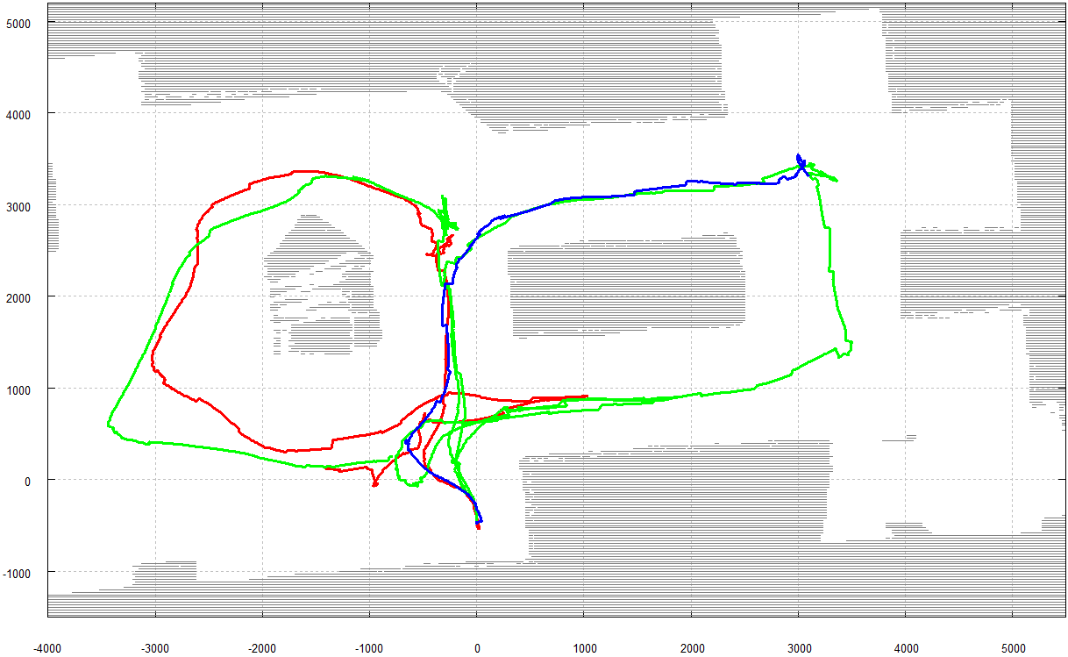
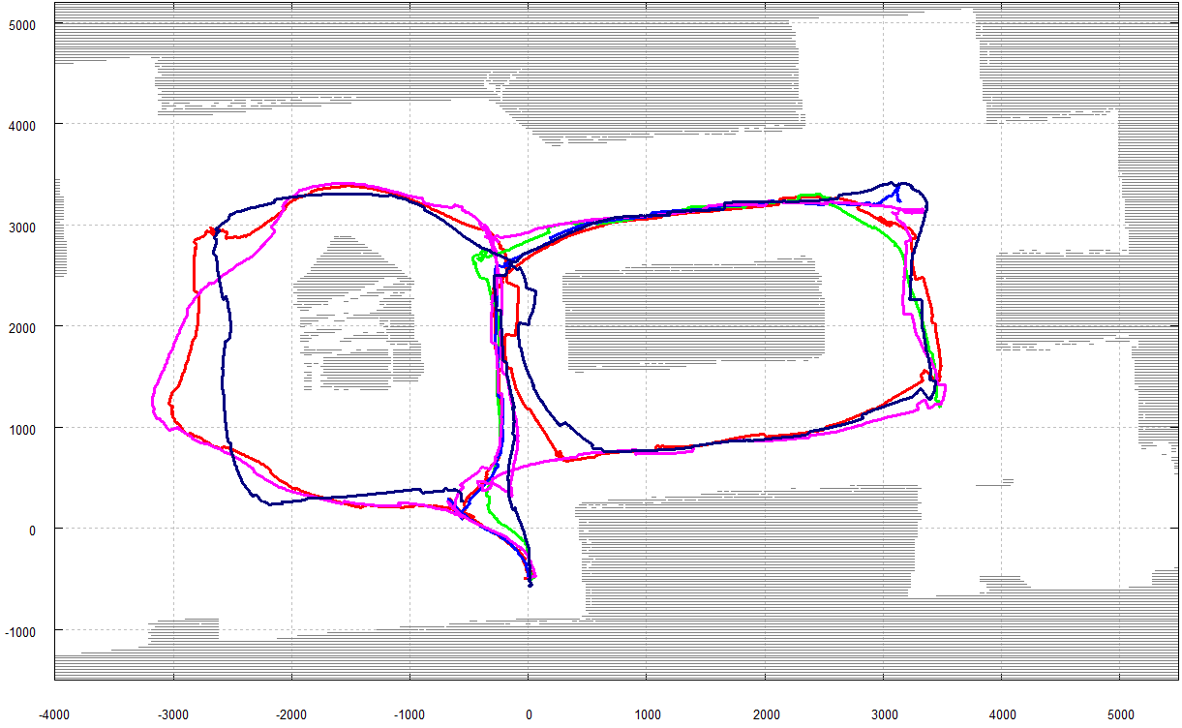
Driving Assistance | User Interfaces | Evaluation | Ongoing/Future Work
User Interfaces
Brain-Computer Interface
the bigger picture
Experimental evaluation: 9 subjects / 40 trials / 18 completed

Slide 9


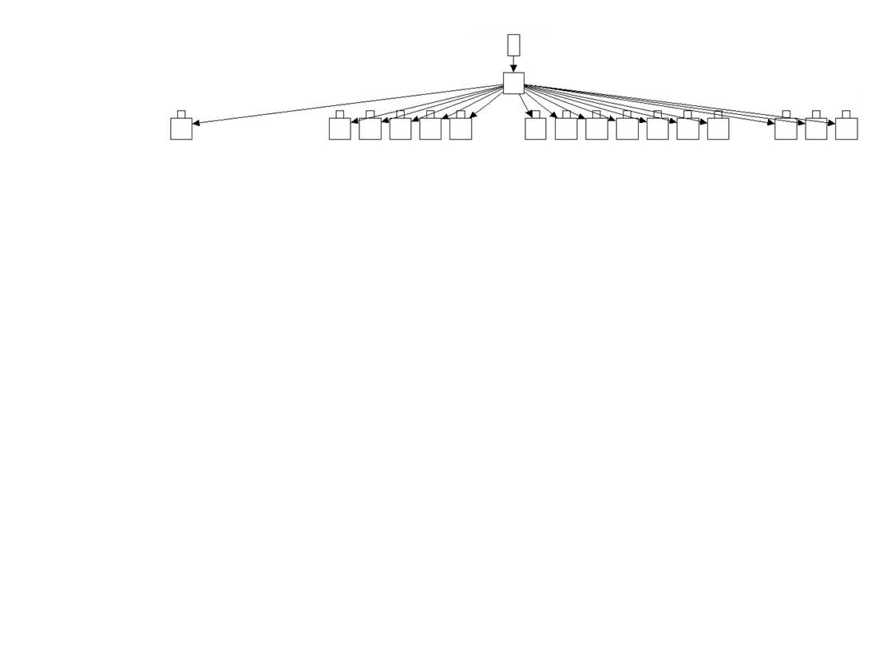
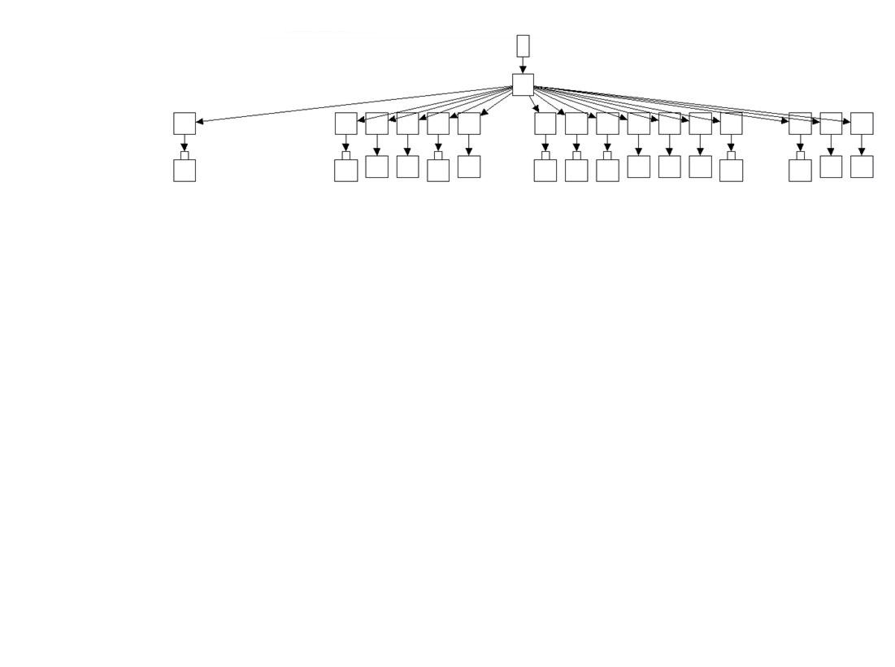
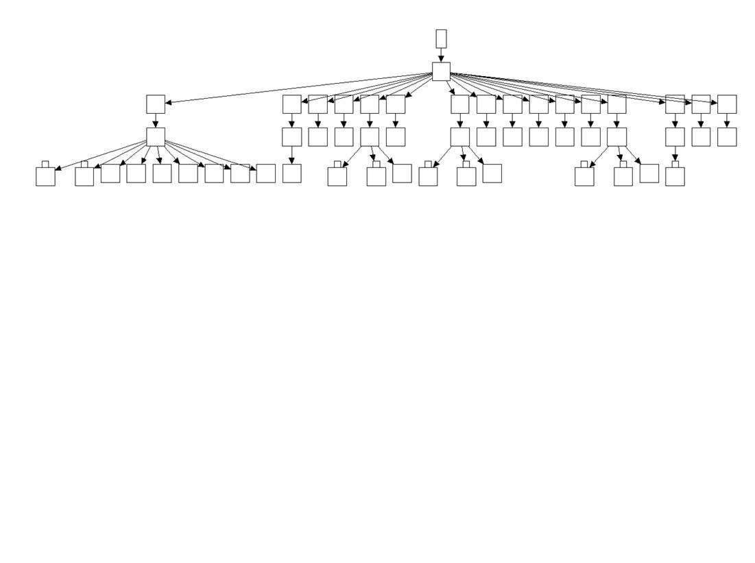
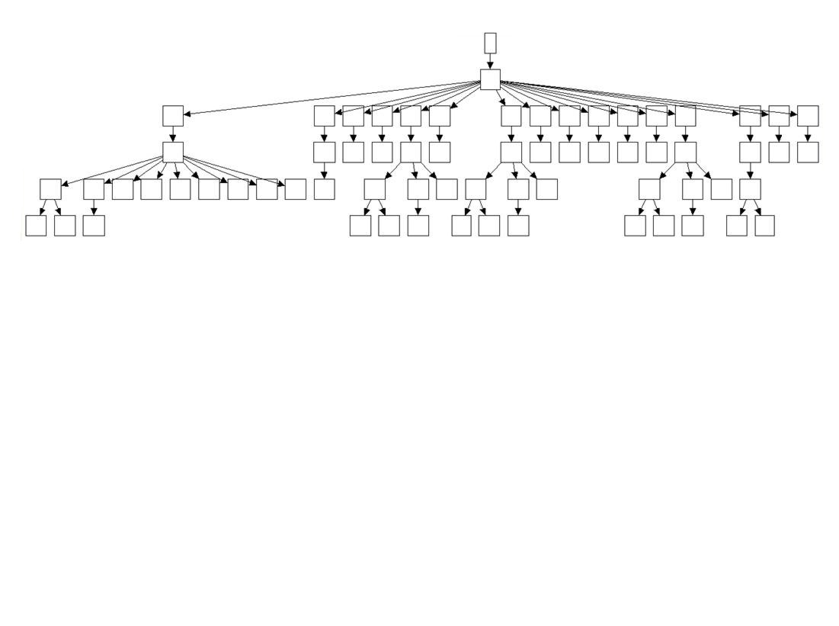
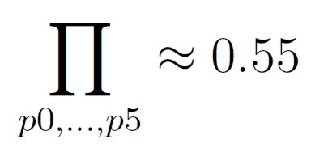
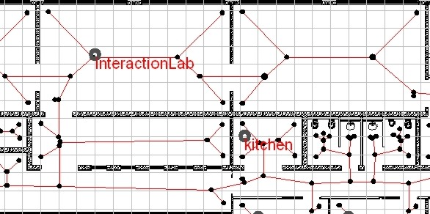
Driving Assistance | User Interfaces | Evaluation | Ongoing/Future Work
User Interfaces
Speech Interface I
the bigger picture
Robot navigation based on the mapping of coarse qualitative route descriptions to route graphs
„Turn around, drive through the interaction lab, turn left, proceed to the kitchen and stop at the first junction to the right.“
„Turn around, drive through the interaction lab, turn left, proceed to the kitchen and stop at the first junction to the right.“
„Turn around, drive through the interaction lab, turn left, proceed to the kitchen and stop at the first junction to the right.“
„Turn around, drive through the interaction lab, turn left, proceed to the kitchen and stop at the first junction to the right.“
„Turn around, drive through the interaction lab, turn left, proceed to the kitchen and stop at the first junction to the right.“
„Turn around, drive through the interaction lab, turn left, proceed to the kitchen and stop at the first junction to the right.“
[Mandel2006]

Slide 10
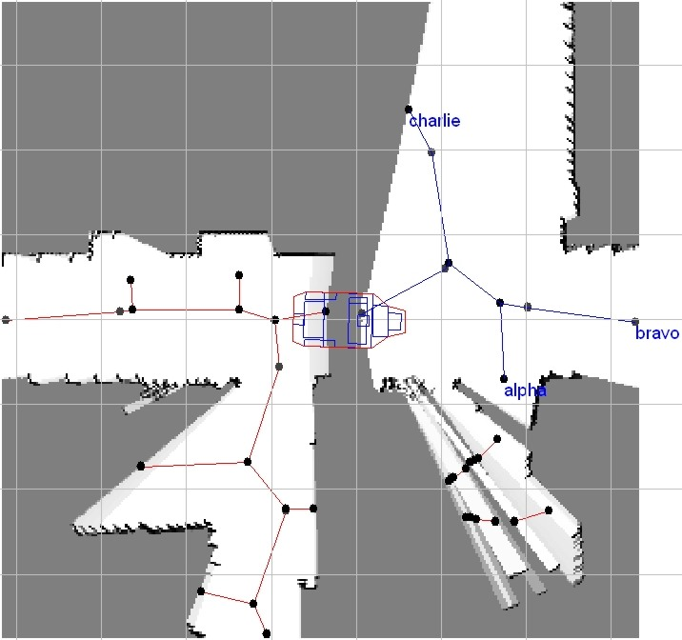
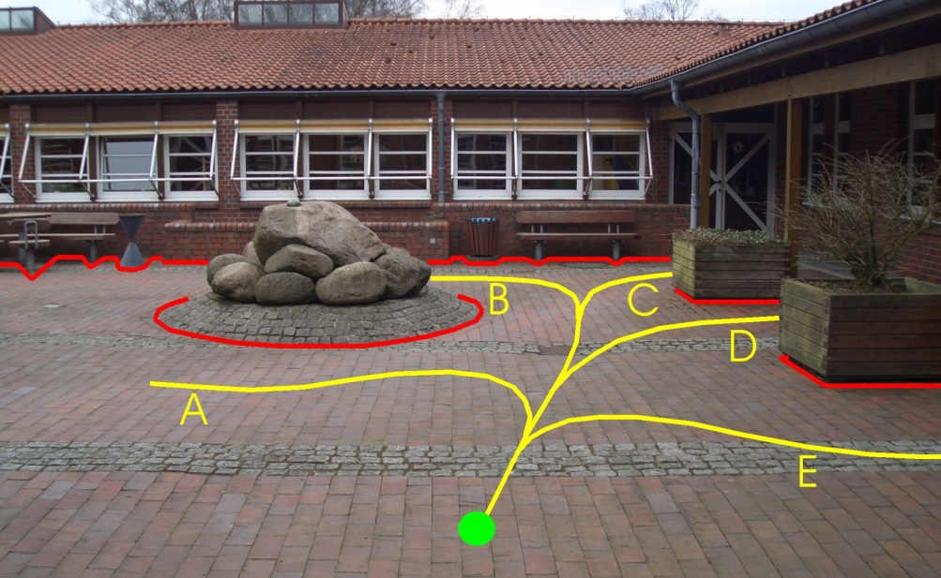
Driving Assistance | User Interfaces | Evaluation | Ongoing/Future Work
User Interfaces
Speech Interface II
the bigger picture
Verbal path selection from an offered route-set
Name spatially meaningful paths
Apply of-the-shelf speech recognition
Local path planning using cubic Bezier curves
[Mandel2007]

Slide 11
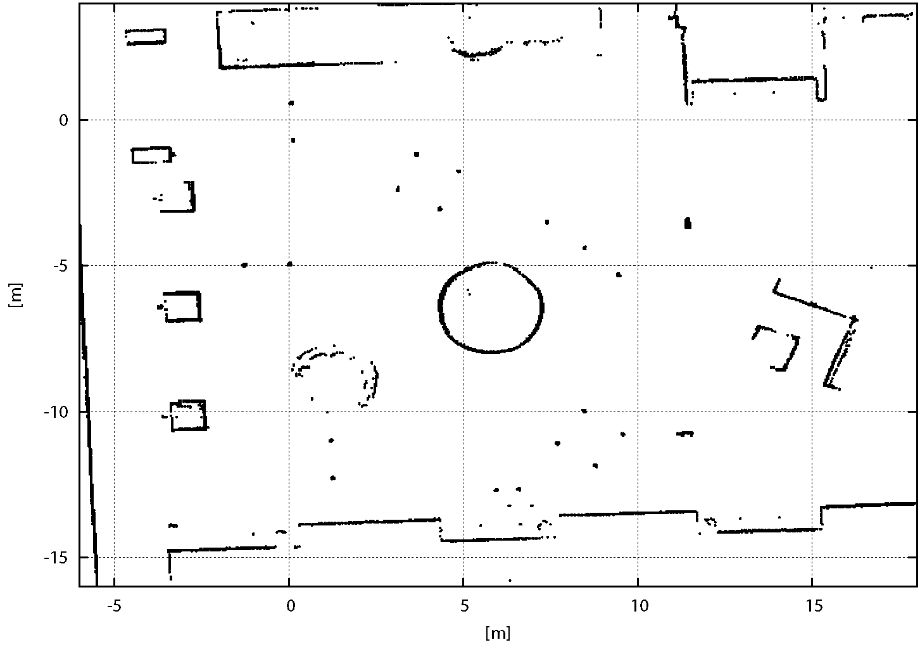
Driving Assistance | User Interfaces | Evaluation | Ongoing/Future Work
Evaluation
Setup
Course standardized by the Spanish Sport Federation for people with Cerebral Palsy
Mimics common obstructions for wheelchair-bounded persons
Start
Start
Square of 360° turn
Start
Square of 360° turn
Figure of eight
Start
Square of 360° turn
Figure of eight
Inclines with a turn
Start
Square of 360° turn
Figure of eight
Inclines with a turn
Square for turn of 180°
Start
Square of 360° turn
Figure of eight
Inclines with a turn
Square for turn of 180°
Inversion door
Start
Square of 360° turn
Figure of eight
Inclines with a turn
Square for turn of 180°
Inversion door
Goal
[Fed2010]

Slide 12
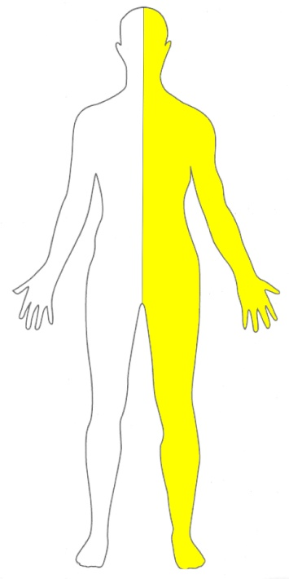
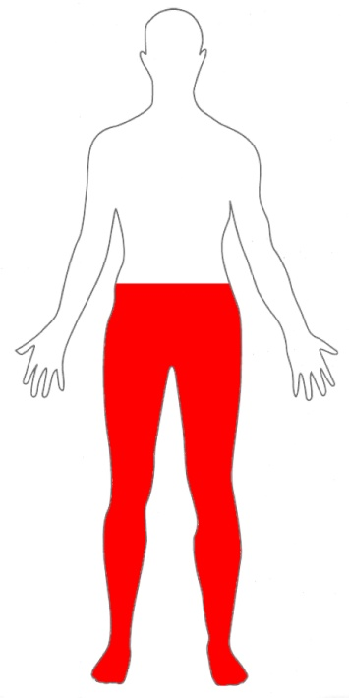
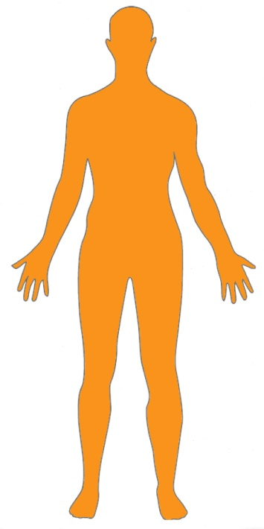
Driving Assistance | User Interfaces | Evaluation | Ongoing/Future Work
Evaluation
Subjects
Two groups of five subjects (A/B ↔ with/without driving assistance)
Age varies from 17 to 72 years
Wheelchair experience ranges from none to 43 years
Comparable impairments in A/B
hemiparesis: weakness of one body-side
paraplegia:
impairment in motor or sensory function
ataxia:
problems coordinating muscle movement

Slide 13
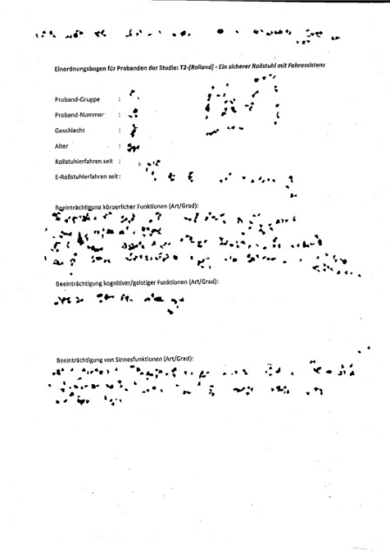
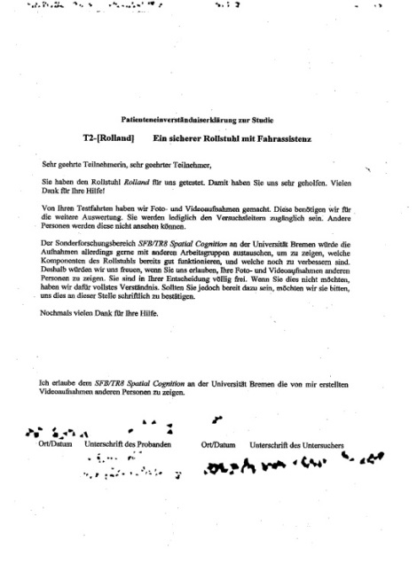
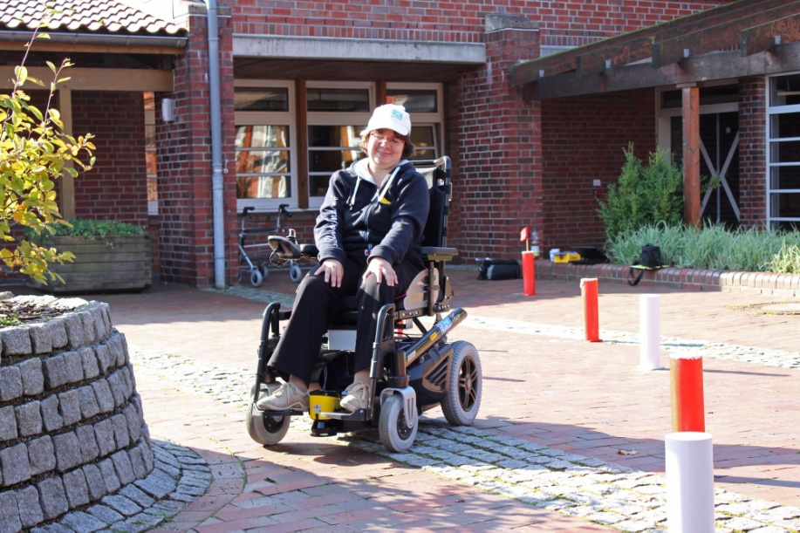
Driving Assistance | User Interfaces | Evaluation | Ongoing/Future Work
Evaluation
Procedure
Collect data about test person: age, gender, physical/cognitive impairments
Informed consent : evaluation of data, photos, …
Subjects scheduled for 5 sessions
Session comprises:
30 min hand-joystick, 30 min head-joystick
complete obstacle stations vs. good lap times
Log controller input, estimated pose, #collisions,
#neglected, aborted, or falsely executed obstacles

Slide 14
Driving Assistance | User Interfaces | Evaluation | Ongoing/Future Work
Evaluation
Criteria
Average velocity v [m/s]
Average number of collisions/lap c/l
Average number of falsely executed,
aborted , disregarded obstacles per lap e/l
Entropy rate of controller histogram
low clustering
⬄ high challenges
number of
controller histogram
entries
high clustering
⬄
low challenges
probability of occurrence of controller histogram entry
X_{i}=(v, ω)

Slide 15
Driving Assistance | User Interfaces | Evaluation | Ongoing/Future Work
Evaluation
Results I
Findings for groups
hand-joystick with driving assistance | head-joystick with driving assistance
hand-joystick without driving assistance | head-joystick without driving assistance

Slide 16
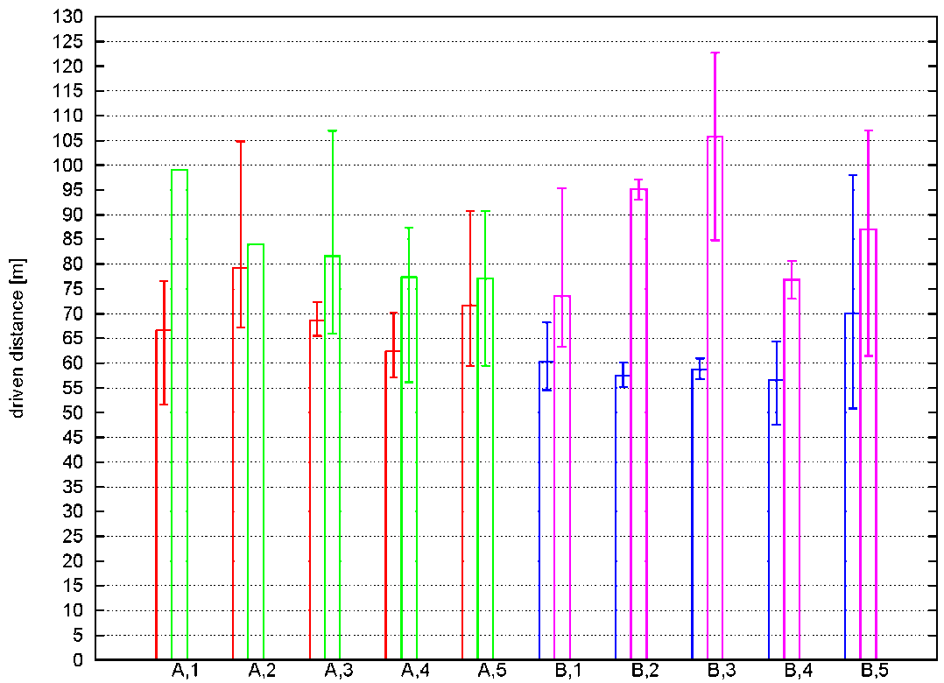
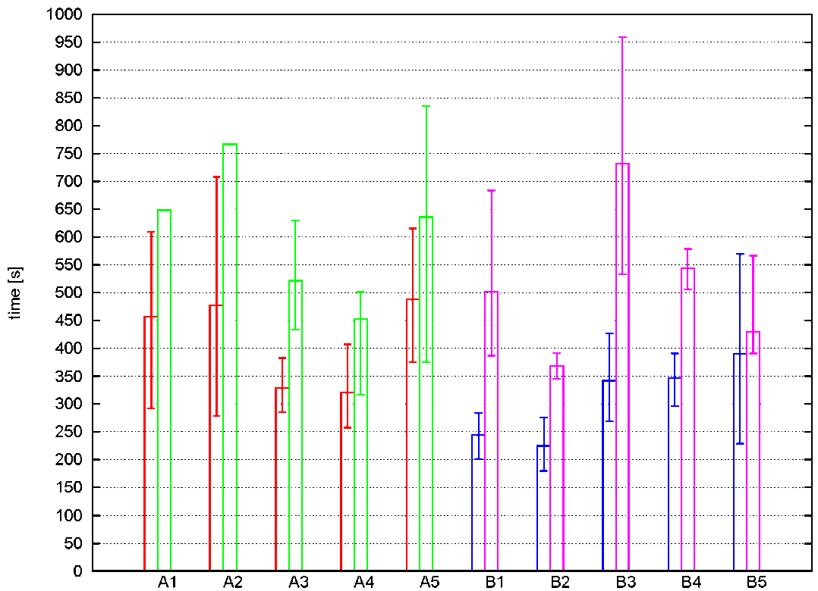
Driving Assistance | User Interfaces | Evaluation | Ongoing/Future Work
Evaluation
Results II
Exemplary findings for individuals
hand-joystick with driving assistance | head-joystick with driving assistance
hand-joystick without driving assistance | head-joystick without driving assistance

Slide 17
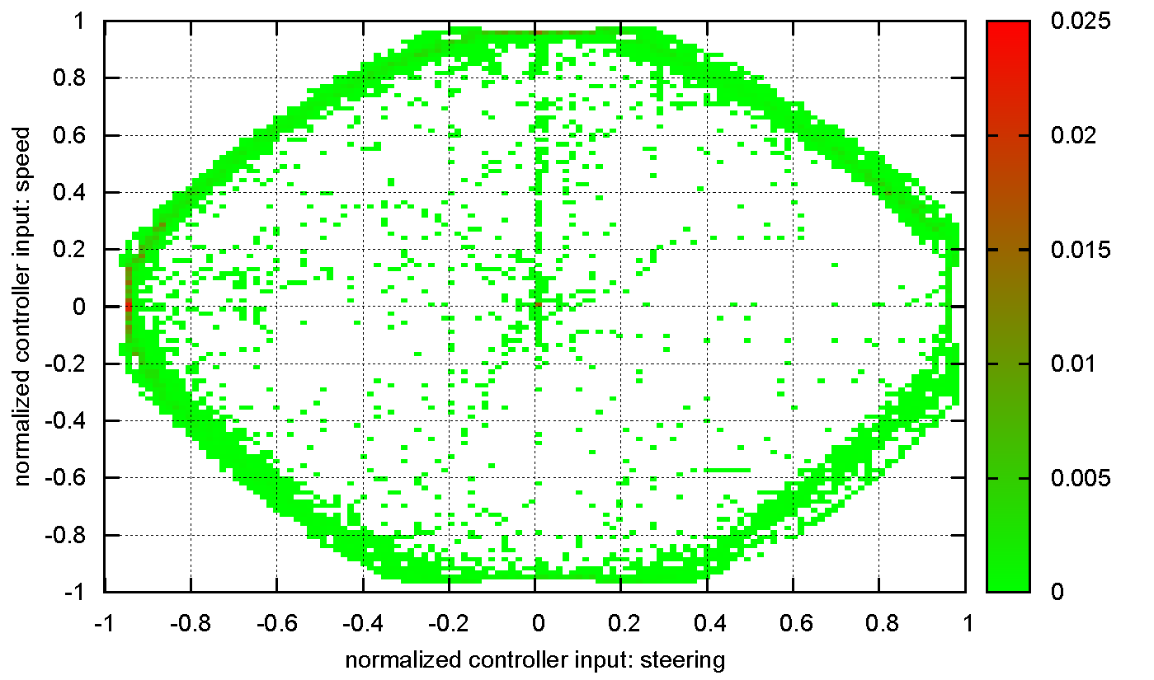
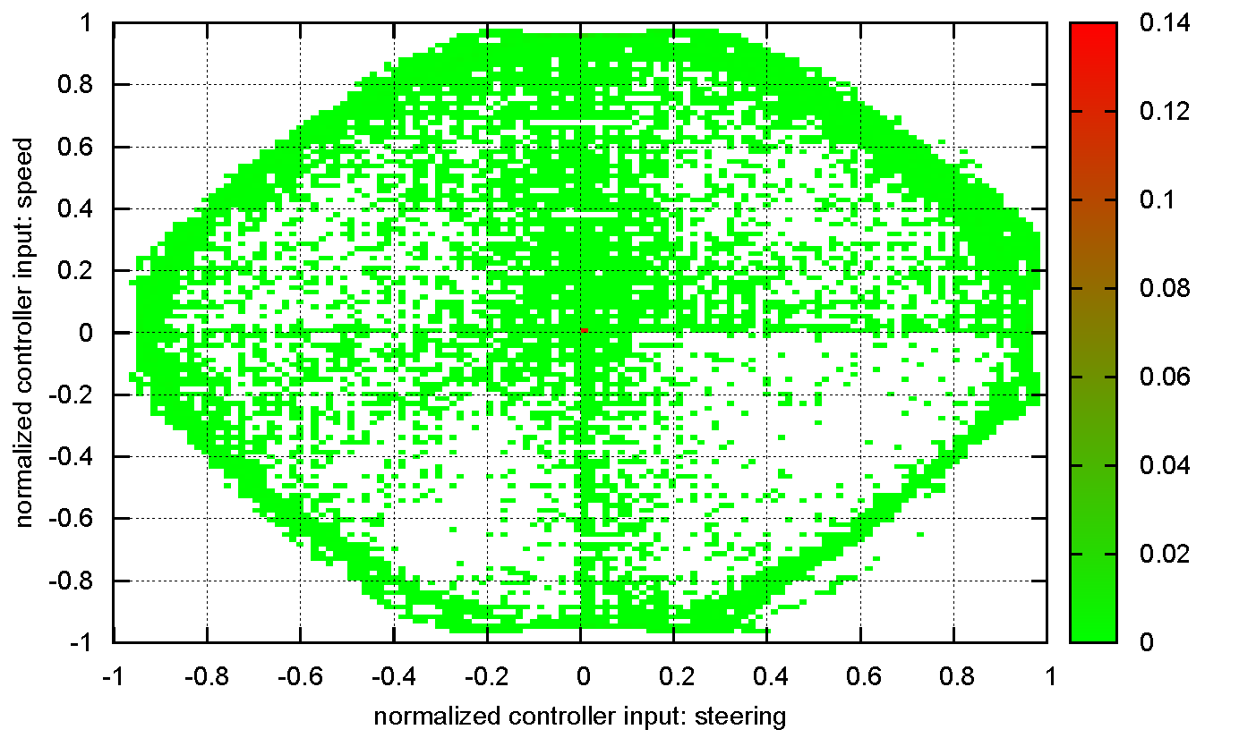
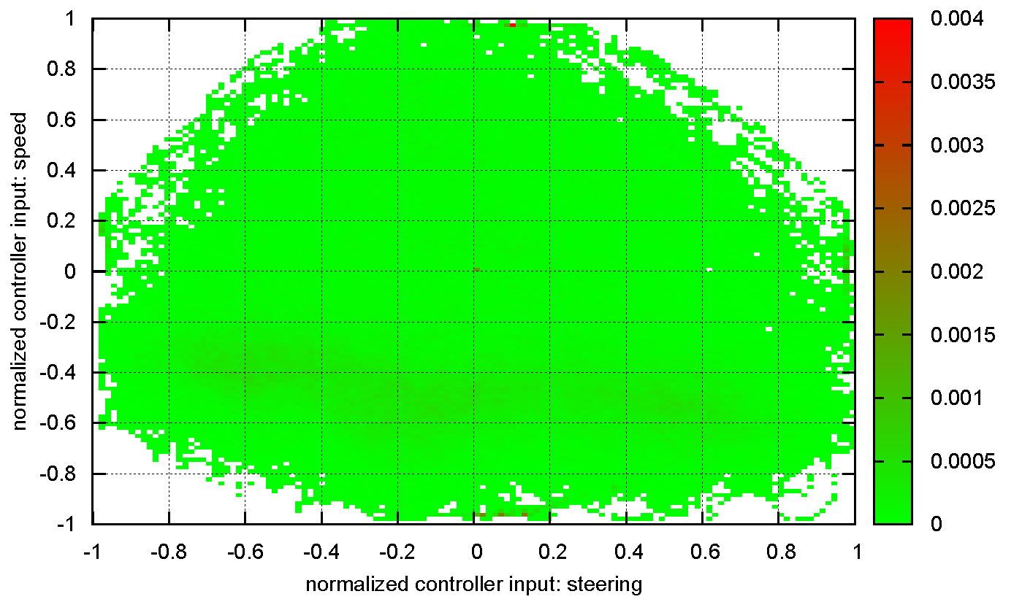
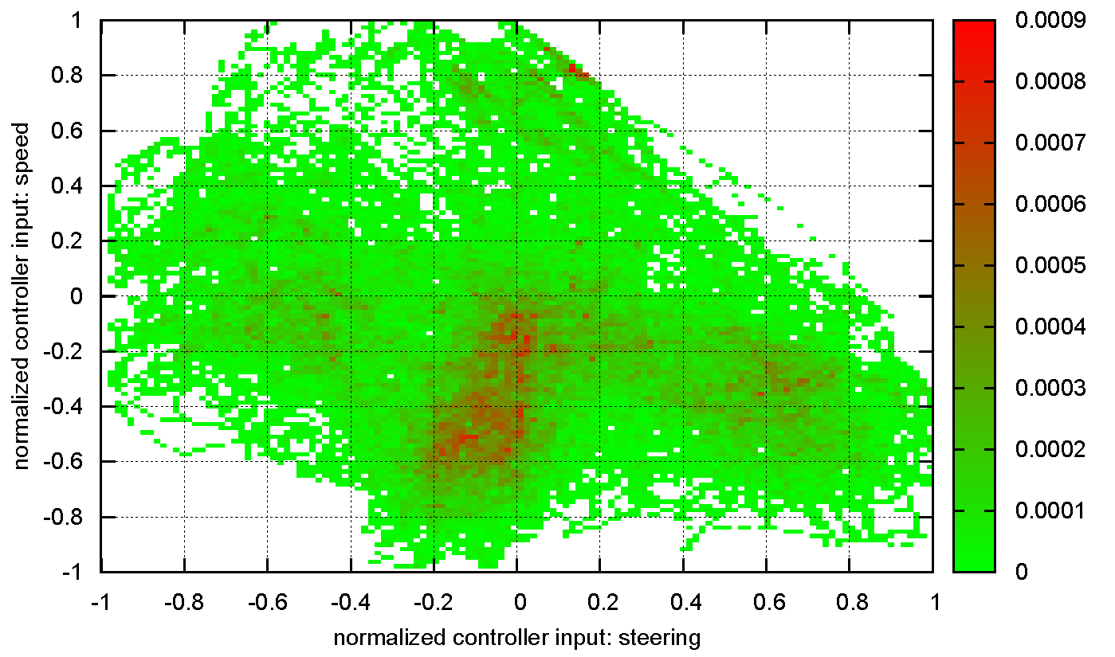
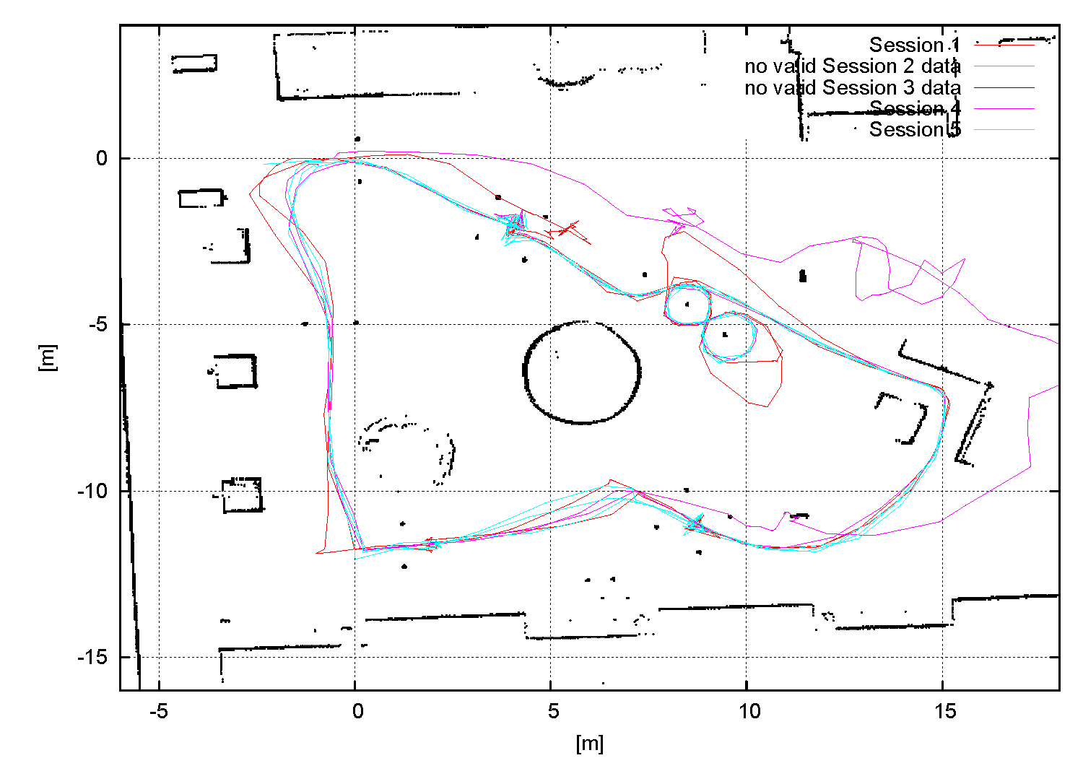
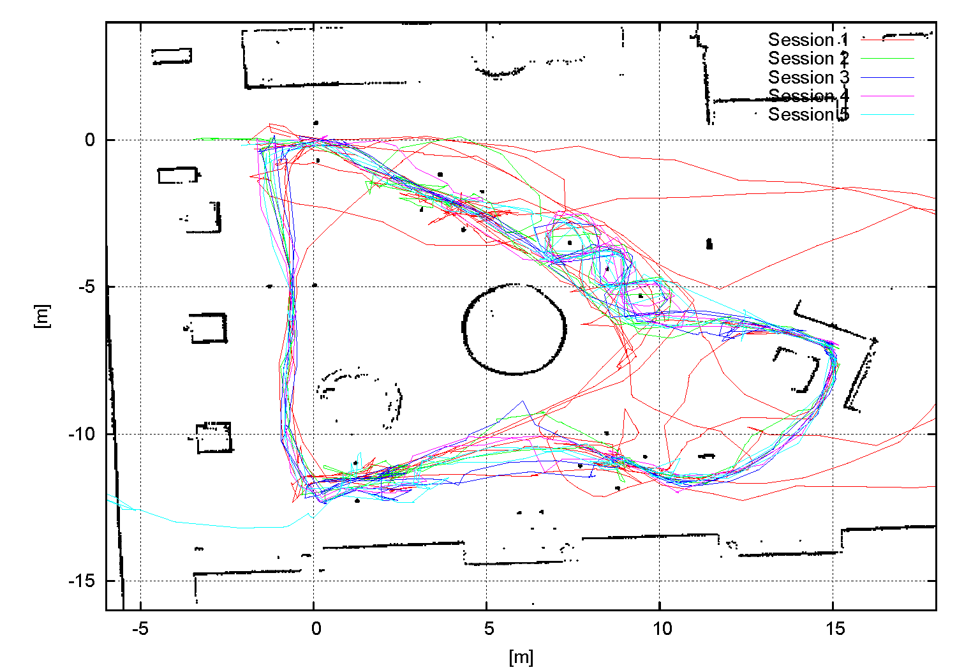
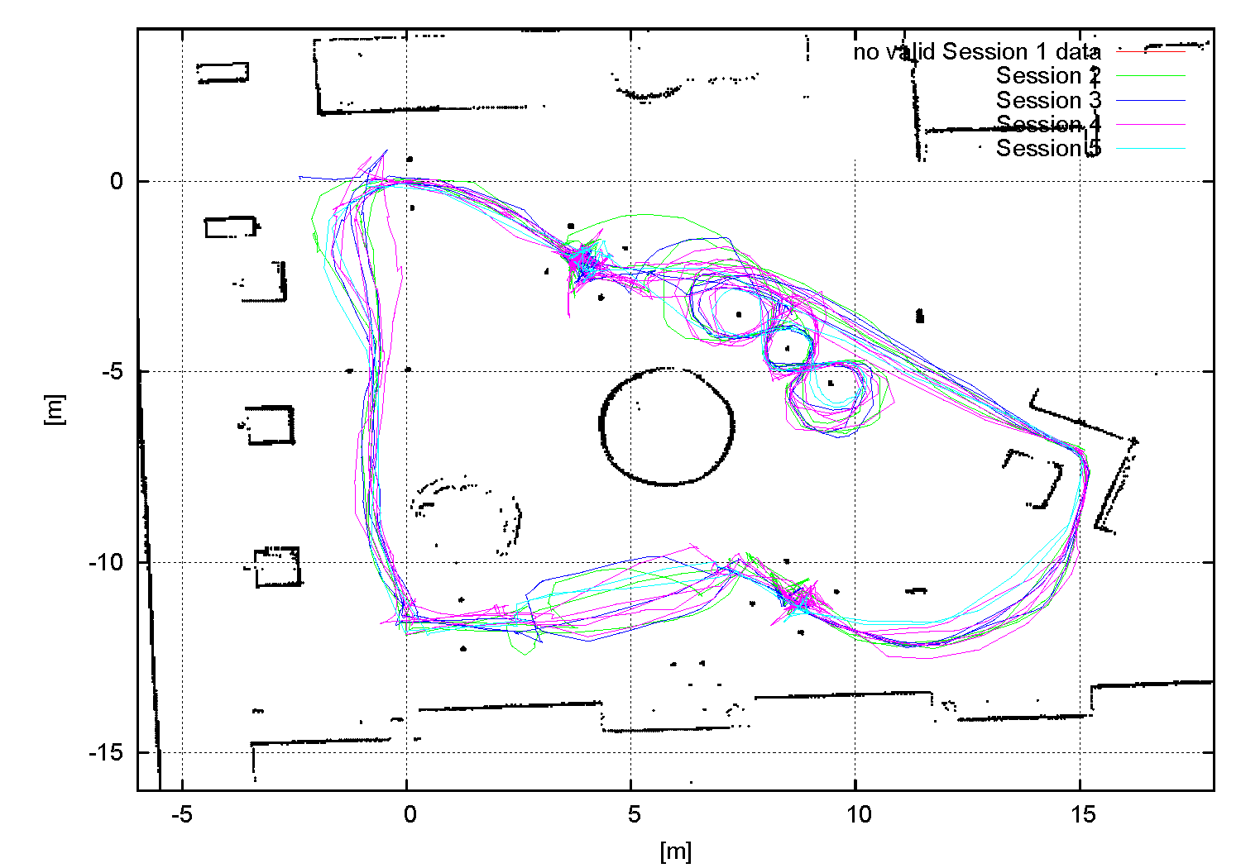
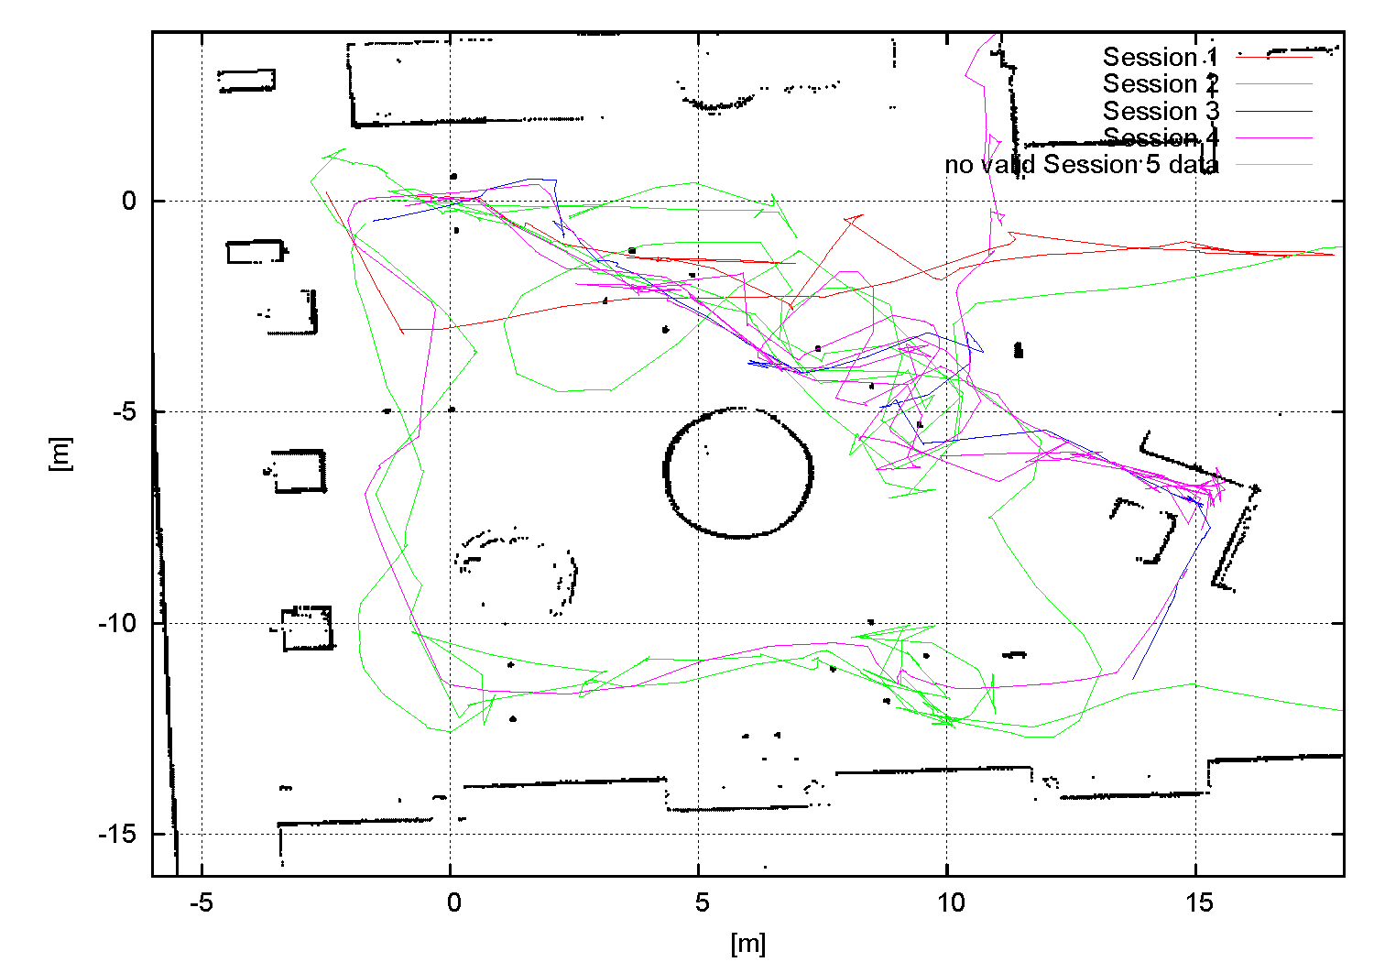
Driving Assistance | User Interfaces | Evaluation | Ongoing/Future Work
Evaluation
Results III
Exemplary findings for individuals: hand joystick without driving assistance (A4)
Exemplary findings for individuals: head joystick with driving assistance (B5)
Exemplary findings for individuals: hand joystick with driving assistance (A4)
Exemplary findings for individuals: head joystick without driving assistance (B5)

Slide 18
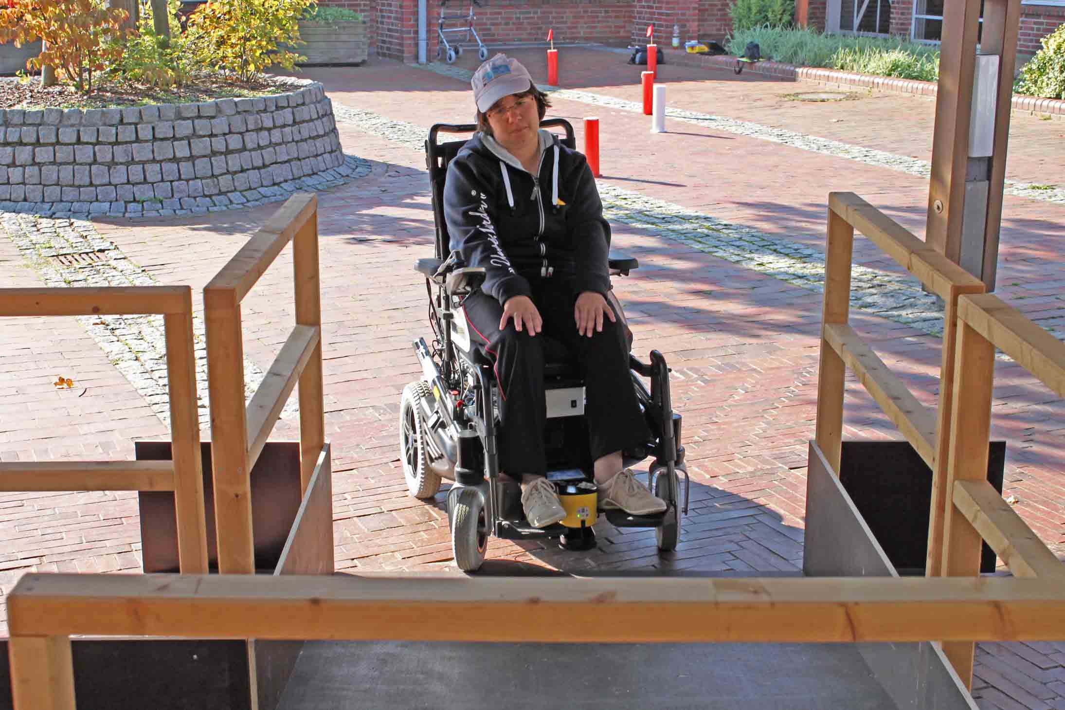
Driving Assistance | User Interfaces | Evaluation | Future Work
Ongoing/Future Work
3D Driving Assistance I
Motivation: several obstructions invisible for ground-parallel scan plane
Small ramp boundaries during experimental evaluation

Slide 19
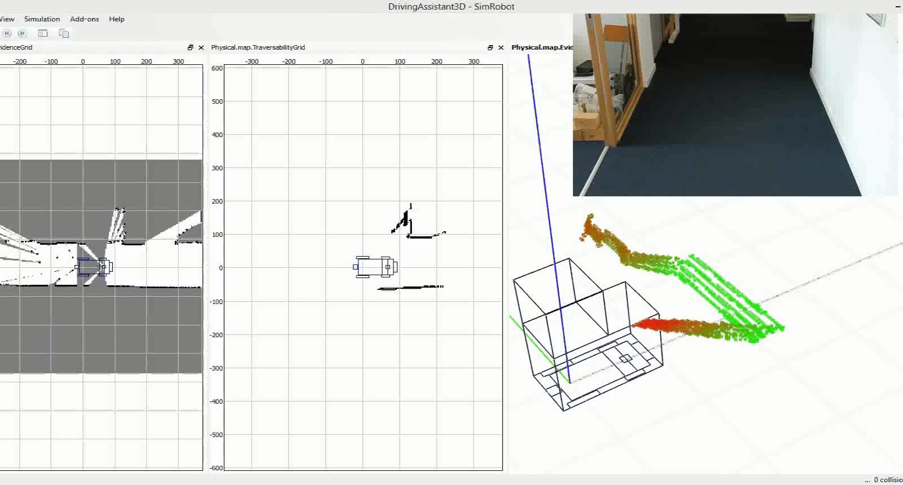
Driving Assistance | User Interfaces | Evaluation | Future Work
Ongoing/Future Work
3D Driving Assistance II
Proof of concept video

Slide 20



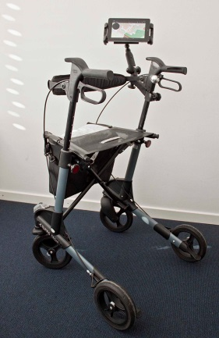
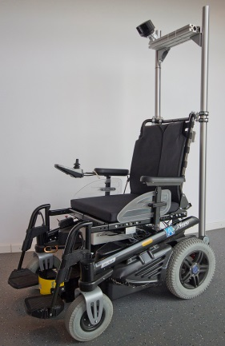
Driving Assistance | User Interfaces | Evaluation | Future Work
Ongoing/Future Work
ASSAM Evaluation
ASSAM schedules longitudinal studies @
Johanniter in Germany
Bartimeus in the Netherlands
Centre de vida independent in Spain
Evaluation metrics shall include
Barthel Index of Activities of Daily Living ^{[Mahoney 1965]} (nature & intensity of user’s disabilities)
NASA Task Load Index ^{[TLX1986]} (measure of mental workload)
Device-specific performance criteria

Slide 21
References
[Fed2010] “Reglamento De Slalom En silla Ruedas 2009-2012”, Federacion Espanola de Deportes de Paraliticos Cerebrales, 2010.
[Mahoney1965] “Functional evaluation: the barthel index” in Maryland State Medical Journal, 14, 56-61, 1965.
[Mandel2006] “Robot Navigation based on the Mapping of Coarse Qualitative Route Descriptions to Route Graphs” in Proc. Of the 2006 Intl. Conf. on Intelligent Robots and Systems, 2006.
[Mandel2007] “Comparison of Wheelchair User Interfaces for the Paralyzed: Head-Joystick vs. Verbal Path Selection from an offered Route-Set” in Proceedings of the 3rd European Conf. on Mobile Robots, 2007.
[Mandel2009a] “Controlling an Automated Wheelchair via Joystick/Head-Joystick Supported by Smart Driving Assistance” in Proc. of the 2009 Intl. Conf. on Rehabilitation Robotics, 2009.
[Mandel2009b] “Navigating a Smart Wheelchair with a Brain-Computer Interface Interpreting Steady-State Visual Evoked Potentials” in Proc. of the 2009 Intl. Conf. on Intelligent Robots and Systems, 2009.
[TLX1986] “NASA Task Load Index (TLX) v. 1.0 Manual”

