Slide 1

Getting Started with a W3C WoT Project
RIOT Summit, Berlin, Germany, 2016

Slide 2
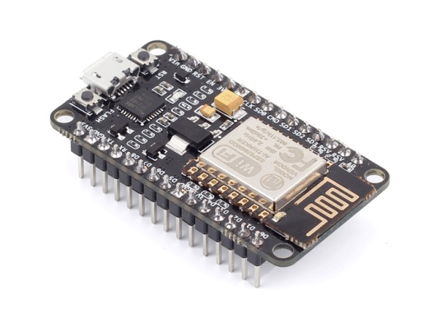
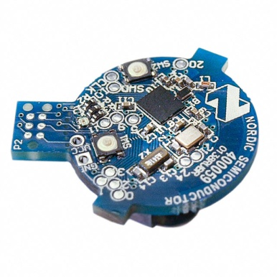
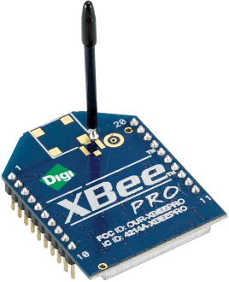
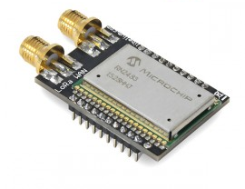

What is the Web of Things?
Application Layer
Internet of Things
: Connectivity
IEEE 802.15.4
Ethernet
Wi-Fi
Bluetooth
LoRa
…

Slide 3





What is the Web of Things?
Internet of Things
: Connectivity
IEEE 802.15.4
Ethernet
Wi-Fi
Bluetooth
LoRa
…

Slide 4
What is the Web of Things?
Web of Things: Applications
Internet of Things
: Connectivity
IEEE 802.15.4
Ethernet
Wi-Fi
Bluetooth
LoRa
…
Notes:
Connecting the physical world with the virtual world of our IT systems

Slide 5
W3C WoT Mission
Not to be yet another standard
Web of Things
…
“interconnecting existing Internet of Things platforms
and complementing available standards”

Slide 6
WoT Interface
IoT Platforms and Protocol Bindings
http://w3c.github.io/wot/current-practices/
wot-practices.html#wot-interface

Slide 7
WoT Interface
Interface exposed by Servients to the network
WoT Servient
WoT Servient
WoT Interface
WoT Interface

Slide 8
WoT Interface
Interface exposed by Servients to the network
WoT Servient
WoT Servient
WoT Interface
WoT Interface
Protocol

Slide 9
Protocol Bindings
Interface can be bound to various protocols
WoT Servient
WoT Servient
Protocol
Bindings
Protocol
Bindings
WoT Interface
HTTP
WoT Interface
HTTP
HTTP

Slide 10
Protocol Bindings
Interface can be bound to various protocols
WoT Servient
WoT Servient
Protocol
Bindings
Protocol
Bindings
WoT Interface
CoAP
WoT Interface
CoAP
CoAP

Slide 11
Protocol Bindings
Multiple bindings possible on Things
WoT Servient
WoT Servient
Protocol
Bindings
Protocol
Bindings
WoT Interface
MQTT
WS
WoT Interface
WS
WebSocket

Slide 12
Resource Model
Interaction points are Web resources
WoT Servient
WoT Servient
Resource
Model
Resource
Model
Protocol
Bindings
Protocol
Bindings
WoT Interface
∙··
WoT Interface
∙··

Slide 13
Servient Role
Exposing Things are in server role
Consuming Things are in client role
WoT Servient
WoT Servient
Web Links
Interaction
Resources
http://wot.example.com/res
Protocol
Bindings
Protocol
Bindings
Client Role
∙··
Server Role
∙··

Slide 14
Servient Role
Usually both roles at the same time → Servient
WoT Servient
WoT Servient
WoT Servient
Web Links
Interaction
Resources
Web
Links
Interaction
Resources
Web
Links
Protocol
Bindings
Protocol
Bindings
Protocol
Bindings
Client Role
∙··
Both Roles
∙··
Both Roles
∙··

Slide 15
Thing Description
Metadata and Interactions
http://w3c.github.io/wot/current-practices/
wot-practices.html#thing-description

Slide 16

How to Interact with WoT Servients?
Who are you?
What kind of data do you serve?
WoT Servient
Resource
Model
How can I access the data/function?
Protocol
Bindings
WoT Interface
What kind of functions do you have?
···
What kind of protocols/encodings do you support?
Are there some security constrains?
→ W3C Thing Description

Slide 17
Semantic Description
Reach interoperability through
Linked Data vocabularies
  subject, predicate, object triples
  rooted in the RDF model
W3C Thing Description
  describes WoT Interface to interact with Things
  extensible with domain-specific vocabulary
  different serializations possible

Slide 18
Thing Description (TD)
Describes Thing metadata and interactions
WoT Servient
WoT Servient
Resource
Model
Resource
Model
Protocol
Bindings
Protocol
Bindings
WoT Interface
∙··
WoT Interface
∙··

Slide 19
Thing Description (TD)
Consuming Things are in client role
Exposed Things are in server role
WoT Servient
WoT Servient
Protocol
Bindings
Protocol
Bindings
Client Role
Server Role

Slide 20
Thing Description (TD)
Exposed Things provide Thing Description
WoT Servient
WoT Servient
Thing
Description
Interaction
Resources
Protocol
Bindings
Protocol
Bindings
Client Role
Server Role
CoAP
HTTP

Slide 21
Thing Description (TD)
Consuming Things learn WoT Interface from TD
WoT Servient
WoT Servient
Metadata,
Web Links
Thing
Description
Interaction
Resources
Protocol
Bindings
Protocol
Bindings
Client Role
HTTP
Server Role
CoAP
HTTP

Slide 22
Thing Description (TD)
Thing-to-thing communication
WoT Servient
WoT Servient
Metadata,
Web Links
Thing
Description
Interaction
Resources
Protocol
Bindings
Protocol
Bindings
Client Role
HTTP
Server Role
CoAP
HTTP

Slide 23
Thing Description (TD)
Default serialization is JSON-LD
  based on well established JSON format
  different implementations and tools available
  @context defines vocabularies
  See TD example

Slide 24
TD Example
{
"@context": [
"http://w3c.github.io/wot/w3c-wot-td-context.jsonld",
{ "actuator": "http://example.org/actuator#" }
],
"@type": "Thing",
"name": "MyLEDThing",
"uris": [
"coap://myled.example.com:5683/",
"http://mything.example.com:8080/myled/"
],
"encodings": ["JSON", "EXI"],
"security": {
"cat": "token:jwt",
"alg": "HS256",
"as": "https://authority-issuing.example.org"
},
"properties": [
{
"@type": "actuator:onOffStatus",
"name": "status",
"valueType": { "type": "boolean" },
"writable": true,
"hrefs": [ "pwr", "status" ]
}
],
"actions": [
{
"@type": "actuator:fadeIn",
"name": "fadeIn",
"inputData": {
"valueType": { "type": "integer" },
"actuator:unit": "actuator:ms"
},
"hrefs": [ "in", "led/in" ]
},
{
"@type": "actuator:fadeOut",
"name": "fadeOut",
"inputData": {
"valueType": { "type": "integer" },
"actuator:unit": "actuator:ms"
},
"hrefs": [ "out", "led/out" ]
}
],
"events": [
{
"@type": "actuator:alert",
"name": "criticalCondition",
"valueType": { "type": "string" },
"hrefs": [ "ev", "alert" ]
}
]
}

Slide 25
{
"@context": [
"http://w3c.github.io/wot/w3c-wot-td-context.jsonld",
{ "actuator": "http://example.org/actuator#" }
],
"@type": "Thing",
"name": "MyLEDThing",
"uris": [
"coap://myled.example.com:5683/",
"http://mything.example.com:8080/myled/"
],
"encodings": ["JSON", "EXI"],
"security": {
"cat": "token:jwt",
"alg": "HS256",
"as": "https://authority-issuing.example.org"
},
"properties": [
{
"@type": "actuator:onOffStatus",
"name": "status",
"valueType": { "type": "boolean" },
"writable": true,
"hrefs": [ "pwr", "status" ]
}
],
"actions": [
{
"@type": "actuator:fadeIn",
"name": "fadeIn",
"inputData": {
"valueType": { "type": "integer" },
"actuator:unit": "actuator:ms"
},
"hrefs": [ "in", "led/in" ]
},
{
"@type": "actuator:fadeOut",
"name": "fadeOut",
"inputData": {
"valueType": { "type": "integer" },
"actuator:unit": "actuator:ms"
},
"hrefs": [ "out", "led/out" ]
}
],
"events": [
{
"@type": "actuator:alert",
"name": "criticalCondition",
"valueType": { "type": "string" },
"hrefs": [ "ev", "alert" ]
}
]
}
Property
Interaction
resources
Action
Action
Events^{(work in progress)}

Slide 26
Type System
Default currently based on JSON Schema
http://w3c.github.io/wot/current-practices/
wot-practices.html#type-system
Best start with simple types
  boolean
  integer
  number
  string
Other systems can be plugged in
under “valueType“ field

Slide 27
How to Create a TD?
Manually copy, paste, and modify
  http://w3c.github.io/wot/current-practices/
  wot-practices.html#td-examples
  or look into the TD repository
  http://vs0.inf.ethz.ch:8080
  (development repository, sometimes offline)
Generate from development framework
  TD serialization based on the interactions provided

Slide 28
Scripting API
Runtime Environment and Portable Apps
http://w3c.github.io/wot/current-practices/
wot-practices.html#scripting-api

Slide 29
Without Scripting API
Application logic often implemented natively
WoT Servient
Application Logic
C / C++ / Java / …
Resource Model
Protocol Bindings
WoT Interface
∙··

Slide 30
Scripting API
Common runtime enables portable apps
WoT Servient
Runtime Environment
App Script
Disc.
API
Client
API
Server
API
Resource Model
Protocol Bindings
WoT Interface
∙··

Slide 31
Scripting API
Common runtime enables portable apps
WoT Servient Vendor A
WoT Servient Vendor B
Runtime Environment
Runtime Environment
App Script
Disc.
API
Client
API
Server
API
Disc.
API
Client
API
Server
API
Resource Model
Resource Model
Protocol Bindings
Protocol Bindings
WoT Interface
∙··
WoT Interface
∙··

Slide 32
Scripting API
Common runtime enables portable apps
WoT Servient Vendor A
WoT Servient Vendor B
Runtime Environment
Runtime Environment
App Script
Disc.
API
Client
API
Server
API
Disc.
API
Client
API
Server
API
Resource Model
Resource Model
Protocol Bindings
Protocol Bindings
WoT Interface
∙··
WoT Interface
∙··

Slide 33
WoT Root Element (with Discovery)
interface WoT {
Promise<sequence<ConsumedThing>> discover(ThingFilter filter);
Promise<ConsumedThing> consumeDescription(Object td);
Promise<ConsumedThing> consumeDescriptionUri(DOMString uri);
Promise<ExposedThing> createThing(DOMString name);
Promise<ExposedThing> createFromDescription(Object td);
Promise<ExposedThing> createFromDescriptionUri(DOMString uri);
};

Slide 34
Client API: ConsumedThing
interface ConsumedThing {
readonly attribute DOMString name;
Promise<any> getProperty(DOMString propertyName);
Promise<any> setProperty(DOMString propertyName, any newValue);
Promise<any> invokeAction(DOMString actionName, any parameter);
ConsumedThing addListener(DOMString eventName,
ThingEventListener listener);
ConsumedThing removeListener(DOMString eventName,
ThingEventListener listener);
ConsumedThing removeAllListeners(DOMString eventName);
Object getDescription();
};

Slide 35
Server API: ExposedThing
interface ExposedThing {
readonly attribute DOMString name;
ExposedThing addProperty(DOMString name, object type);
ExposedThing addAction(DOMString name, Object input, Object output);
ExposedThing addEvent(DOMString name, Object output);
Promise<any> getProperty(DOMString propertyName);
Promise<any> setProperty(DOMString propertyName, any newValue);
Promise<any> emitEvent(DOMString eventName, any payload);
ExposedThing onUpdateProperty(DOMString n, PropertyChangeListener cb);
ExposedThing onInvokeAction(DOMString actionName, ActionHandler cb);
Object getDescription();
};

Slide 36
Script Example (Consume Thing)
WoT.consumeDescriptionUri("http://servient.example.com/things/counter")
.then(function(counter) {
counter
.invokeAction("increment", {}).then(function() {
console.log("incremented");
counter
.getProperty("count").then(function(count) {
console.log("new count state is " + count);
});
})._catch(console.error);
})
._catch(function(err) {
console.error(err);
});

Slide 37
Script Example (Expose Thing)
WoT.newThing("counter")
.then(function(thing) {
thing
.addProperty("count", {"type": "integer"})
.addAction("increment")
.onInvokeAction("increment", function() {
console.log("incrementing counter");
var value = thing.getProperty("count") + 1;
thing.setProperty("count", value);
return value;
});
thing
.setProperty("count", 0)
});

Slide 38
SUmmary
W3C Web of Things

Slide 39
Thing Implementation: WoT Servient
Application Logic:
Can consume remote Things through the Client API, local hardware and connected legacy devices through a Physical API (t.b.d.), and expose Things through the Server API. To allow portable app scripts, the Servient must povide a runtime environment.
WoT Servient
App Script
(Physic. API)
Discovery API
Client API
Server API
Runtime Environment
Resource Model:
Provides a common abstraction with uniform interface across the different protocols. Like the Web, it allows to identify and address interaction points through URIs.
Legacy comm-unication
Resource Model
Thing
Description
Protocol Bindings
Thing Description (TD):
Declares WoT Interface for interaction and provides (semantic) metadata for the Thing. TD is used by WoT clients to instantiate local software object of the Thing.
Client Role
Server Role
Proprietary interface
WoT Interface
Protocol Binding:
Converts abstract interactions with Things to different protocols using the information from TD.
Legacy
device
Web Server
Web Client
WoT Servient
WoT Servient

Slide 40



WoT Servient on Thing Itself
Native WoT Things host a Servient directly
TD is provided by Thing or supporting host on the Web
WoT Servient (Wot Device)
Browser
App Script
Script
Runtime Env.
Runtime Environment
Thing
Description
Resource Model
Resource Model
Protocol
Bindings
Protocol Bindings
Client Role
Server Role
Client Role

Slide 41
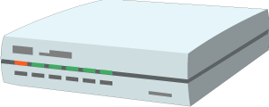
WoT Servient on Integration Hub
WoT Servients can run on hubs (e.g., smartphone, gateway)
Multiple Servients can be instantiated through sandboxed apps
Apps can act as agents/proxies for legacy devices
Hub Platform
Browser
WoT Servient
App Script
App Script
Runtime Env.
Runtime Environment
Thing
Description
Resource Model
Resource Model
Legacy comm.
Protocol
Bindings
Protocol Bindings
Client Role
Server Role
Client Role
Legacy
device

Slide 42
WoT Servient in the Cloud
A cloud mirror (device shadow) enables scalable remote access
Is synchronized with local Servient
Can forward interactions and cache data
Cloud Platform
Hub
Browser
WoT Servient
App Script
WoT Servient
App Script
App Script
Runtime Envi.
Runtime Environment
Resource Model
Thing
Description
Resource Model
Runtime Environment
Thing
Description
Resource Model
Legacy comm.
Protocol Binding
Protocol Binding
Client Role
Server Role
Client Role
Protocol Binding
Server Role
Client Role
Legacy
device
Anywhere
Cloud
Local

Slide 43
Online Resources
Interest Group
  https://www.w3.org/WoT/IG/
  https://lists.w3.org/Archives/Public/public-wot-ig/ (subscribe to mailing list)
Documents (for implementers)
  http://w3c.github.io/wot/architecture/wot-architecture.html
  http://w3c.github.io/wot/current-practices/wot-practices.html (living document)
  Beijing 2016 Release:
  http://w3c.github.io/wot/current-practices/wot-practices-beijing-2016.html
GitHub (documents and proposals)
  https://github.com/w3c/wot
Wiki (organizational information: WebConf calls, Face-to-Face meetings, …)
  https://www.w3.org/WoT/IG/wiki/Main_Page
WoT Projects (implementing WoT Current Practices)
  https://github.com/thingweb/
  https://github.com/mkovatsc/wot-demo-devices
  Please add yours!

Slide 44
PlugFest
W3C WoT F2F Beijing 2016

Slide 45


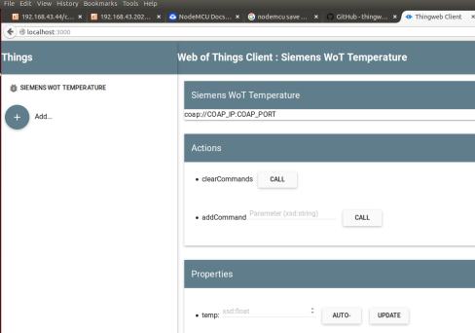




Scenario 1 – ‘Hello WoT‘
Setup servient
interaction
based on TD
WoT TD interpreter
for human interaction
/voteTooHot
/on

Slide 46

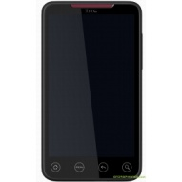



Scenario 2 – ‘Full WoT‘
WoT Client
consumes script
WoT Servient providing
script for voting
/voteTooHot
/on
/voteTooHot
TD Repository
WoT Servient searchs
a voting servient
Search for Action
@type=“tooHot“

Slide 47


Scenario 3 – ‘Mini Automation‘
Consume brightness sensor
to control curtain

Slide 48
Online Resources
Current Practices (Beijing Release)
  http://w3c.github.io/wot/current-practices/wot-practices-beijing-2016.html
Organization Wiki
  https://www.w3.org/WoT/IG/wiki/F2F_meeting,_July_2016,_China,_Beijing#PlugFest
Test Cases
  https://github.com/w3c/wot/blob/master/plugfest/2016-beijing/plugfest-test-cases-beijing-2016.md
Report Template
  https://github.com/w3c/wot/blob/master/plugfest/2016-beijing/TestCaseCoverage.xlsx
  (t.b.d.)

